Slide 1
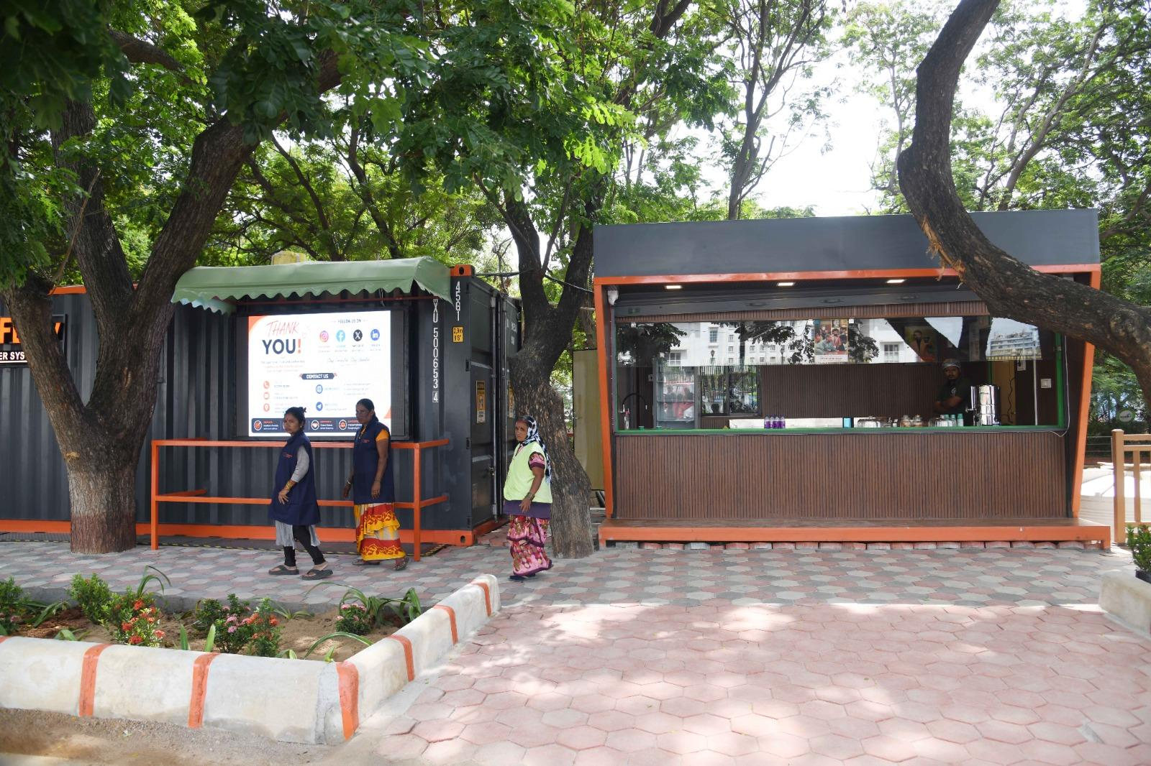


LOOCAFE × REFLOW
How to build the most scalable and sustainable public toilet model
Design, livelihoods, accountability and wastewater treatment.
Vedanth Nath
Karnataka Urban Infrastructure
& Investment Summit 2026
9 September · Conrad Bengaluru
Lumbini Park · Original project photograph, July 2026
Notes:
Hey everybody. I've spent a fairly unreasonable amount of my young life thinking about public toilets. Let me show you why. I want to take you to a street in Hyderabad, beside Hussain Sagar.
Source/context: Lumbini Park · Original project photograph, July 2026
Web review slide: 1
Live allocation for this topic: 15 seconds.

Slide 2
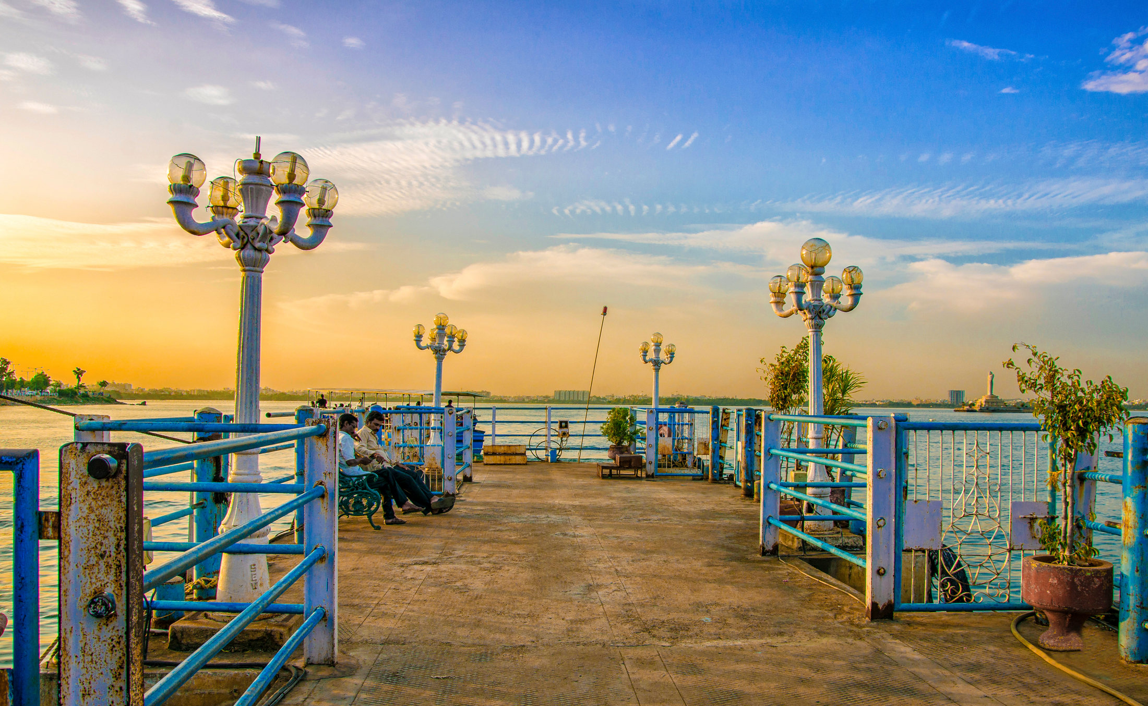
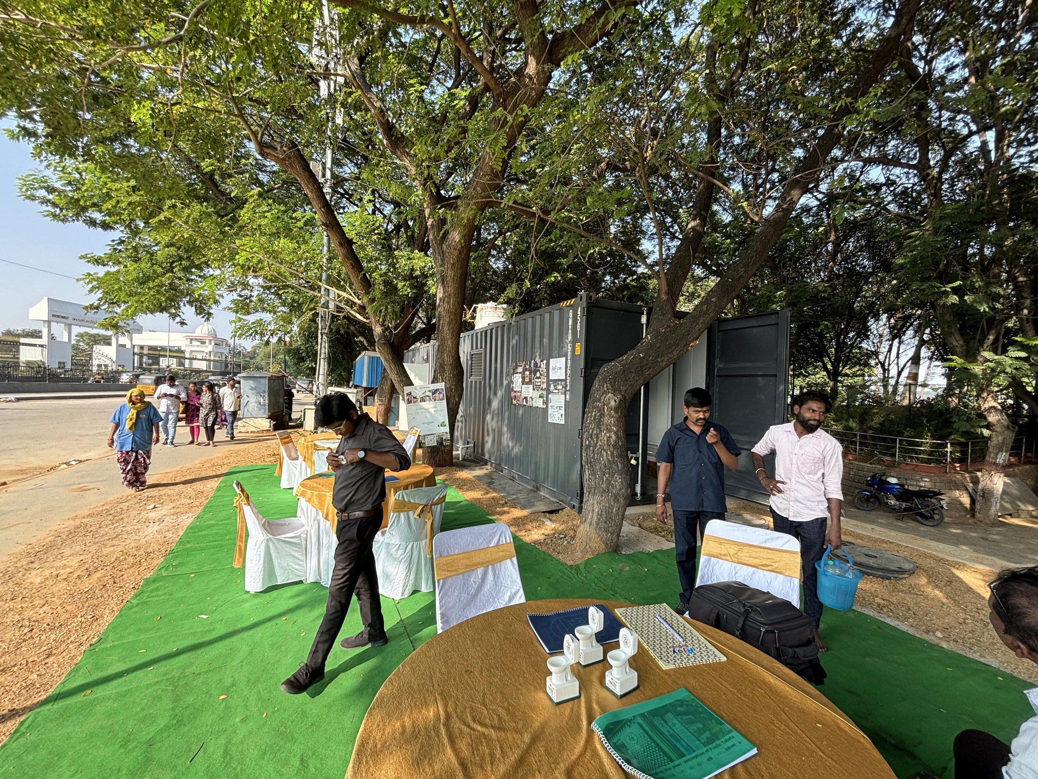
LOOCAFE × REFLOW · THE STREET
The street I grew up with.
A public space has to let people stay.
Hyderabad archive · Photos provide location context, not a documented before/after
02
Notes:
Growing up, I'd come to this part of Hyderabad almost every weekend. Loads of people. Something to eat. Somewhere to walk. But if you cannot find a toilet you can use, how long can you stay? Think about women, families, older people. That's where I want to start.
Source/context: Hyderabad archive · Photos provide location context, not a documented before/after
Web review slide: 2
Live allocation for this topic: 20 seconds.

Slide 3
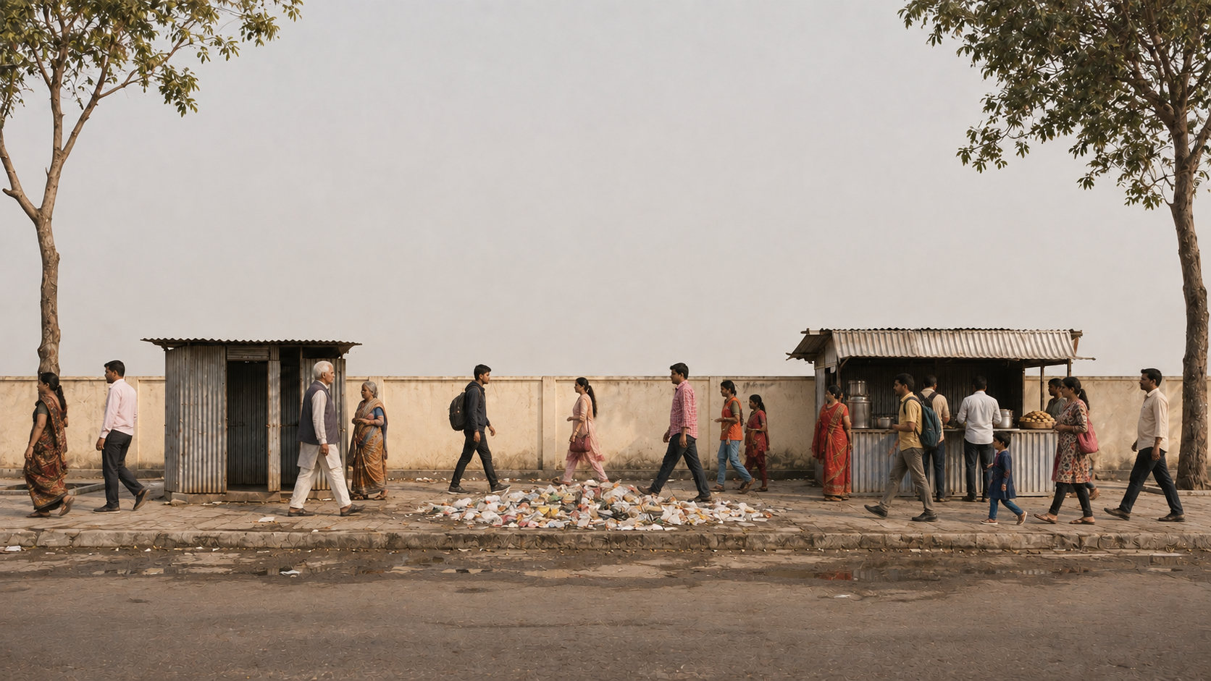
BUILD 1 / 5
This is where we start.
A food stall. Rubbish. A toilet too many people cannot use.
Illustration of the narrated street · Not an as-built reconstruction
Notes:
So, how do we build a public toilet model that scales and lasts? Let me build the idea with you. Here's our street: a food stall, rubbish and inadequate toilet provision.
Source/context: Illustration of the narrated street · Not an as-built reconstruction
Web review slide: 3 · Street build 1
Live allocation for this topic: 55 seconds.

Slide 4
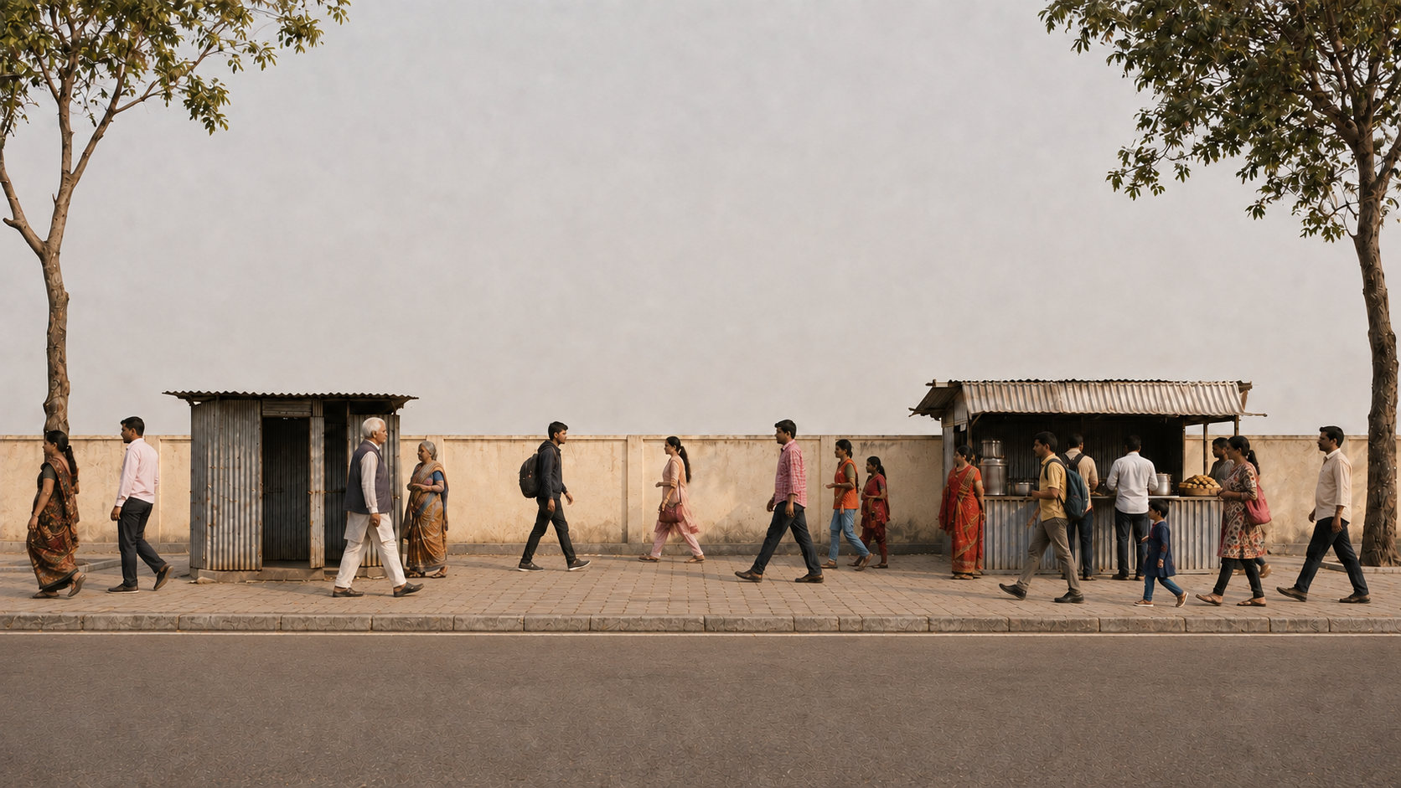
BUILD 2 / 5
First, make room for people.
Clear the rubbish and repair the walking surface.
Illustration of the narrated street · Not an as-built reconstruction
Notes:
First, clear the rubbish and repair the walking surface.
Source/context: Illustration of the narrated street · Not an as-built reconstruction
Web review slide: 3 · Street build 2
Live allocation for this topic: 55 seconds.

Slide 5
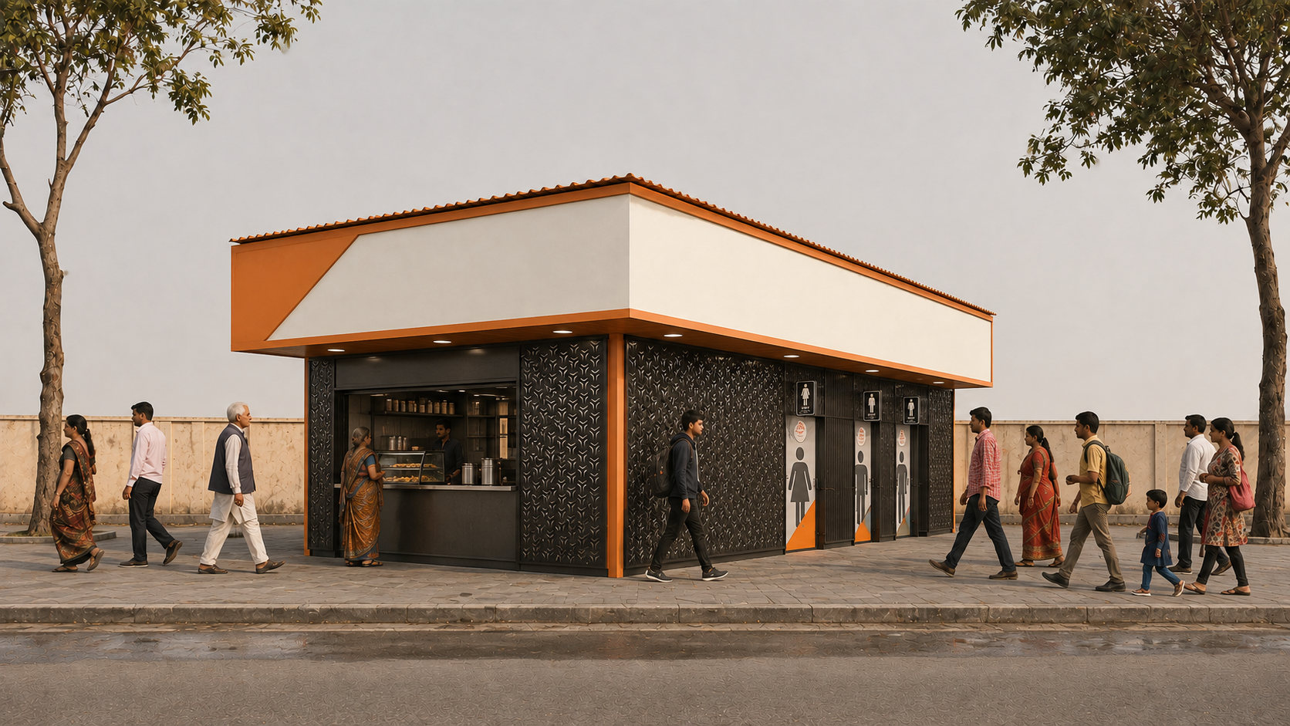
BUILD 3 / 5
One integrated LooCafe.
Shop at the front; toilet entrances on the side and toward the back.
Illustration of the narrated street · Not an as-built reconstruction
Notes:
Then put in one integrated LooCafe. The shop is at the front; the toilets are along the side and toward the back.
Source/context: Illustration of the narrated street · Not an as-built reconstruction
Web review slide: 3 · Street build 3
Live allocation for this topic: 55 seconds.

Slide 6
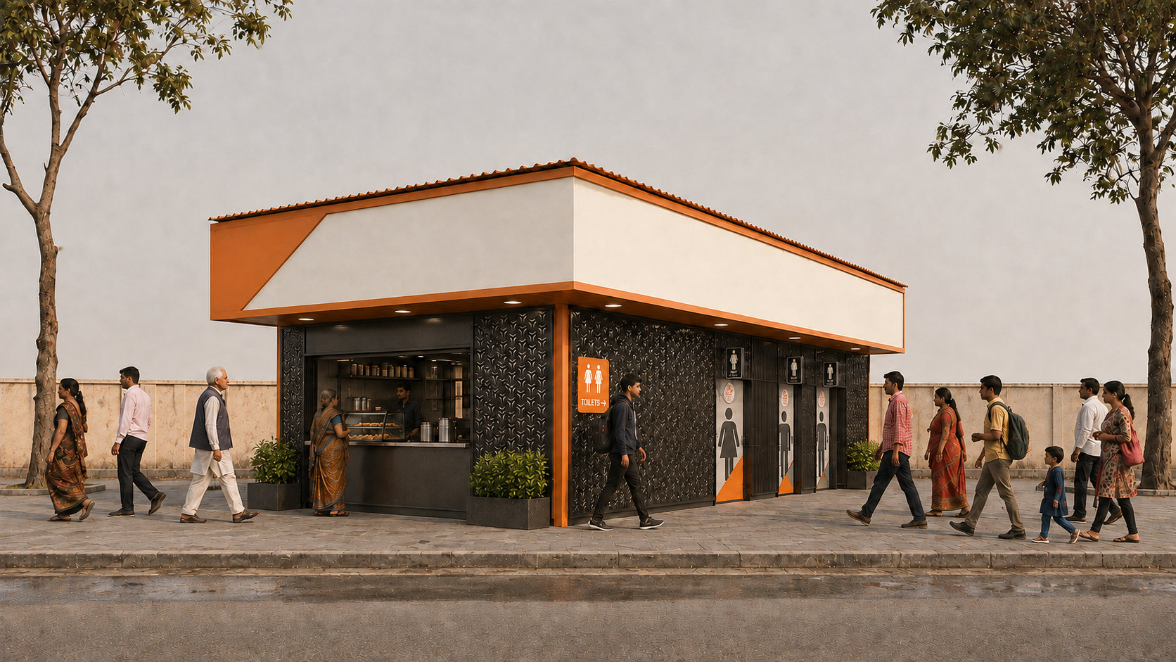
BUILD 4 / 5
The shop supports the service.
SHOP → UPKEEP
The front shop generates revenue to help pay for cleaning and maintenance.
Illustration of the narrated street · Not an as-built reconstruction
Notes:
Now give it a clear entrance, signs and some planting. The shop brings an everyday business into the facility.
Source/context: Illustration of the narrated street · Not an as-built reconstruction
Web review slide: 3 · Street build 4
Live allocation for this topic: 55 seconds.

Slide 7
BUILD 5 / 5
Advertising helps fund upkeep.
ADVERTISING → UPKEEP
Upper advertising panels provide another source of income for upkeep.
Illustration of the narrated street · Not an as-built reconstruction
Notes:
And the panels above it can bring advertising income. The point is to connect the design with a way of keeping it working. Now let's look at the real thing.
Source/context: Illustration of the narrated street · Not an as-built reconstruction
Web review slide: 3 · Street build 5
Live allocation for this topic: 55 seconds.

Slide 8
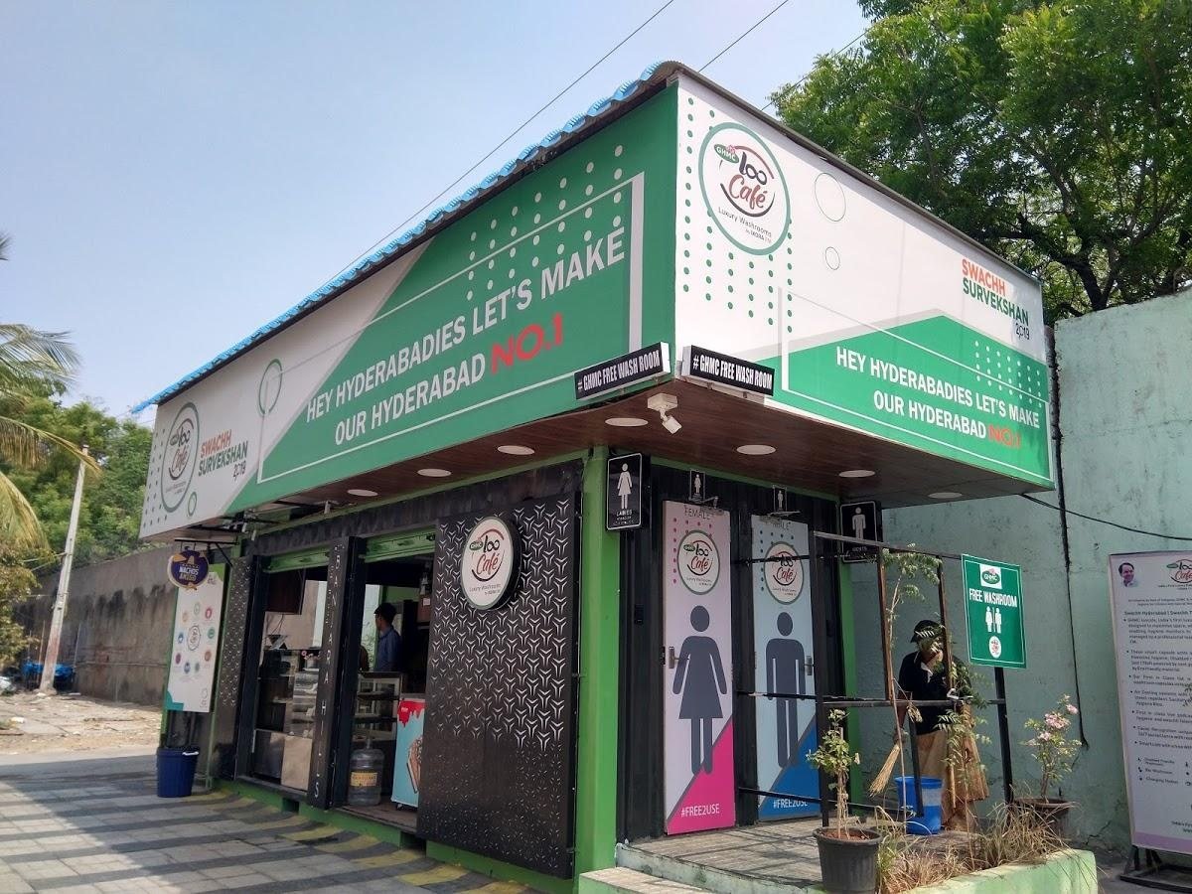
LOOCAFE × REFLOW · THE STREET
This is the standard LooCafe.
1
Toilets along the side
Dedicated entrances keep the toilet access distinct from the shop.
3
2
Shop at the front
The operator’s business helps support daily toilet care.
3
Advertising above
1
Upper panels provide space for advertising income.
2
BANJARA HILLS · ONE INTEGRATED STRUCTURE
Retail at the front. Toilet access along the side. Advertising above.
Sources: loocafe.com/gallery · Company photographs; locations as documented
08
Notes:
Here's the real Banjara Hills unit. The shop and toilets are one structure. Look at the corner: the retail frontage is on one face, and the toilet entrances are along the side. The upper panels give us advertising space. Those are the parts I want you to keep in mind as we build the explanation.
Source/context: Sources: loocafe.com/gallery · Company photographs; locations as documented
Web review slide: 4
Live allocation for this topic: 15 seconds.

Slide 9
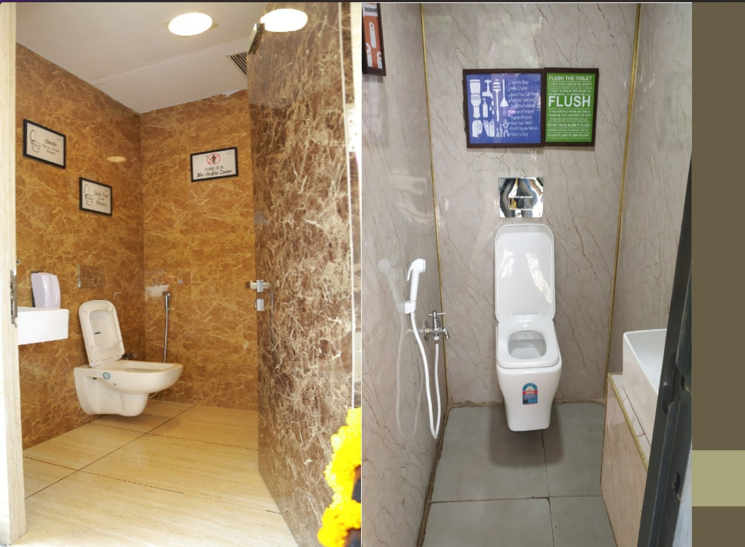
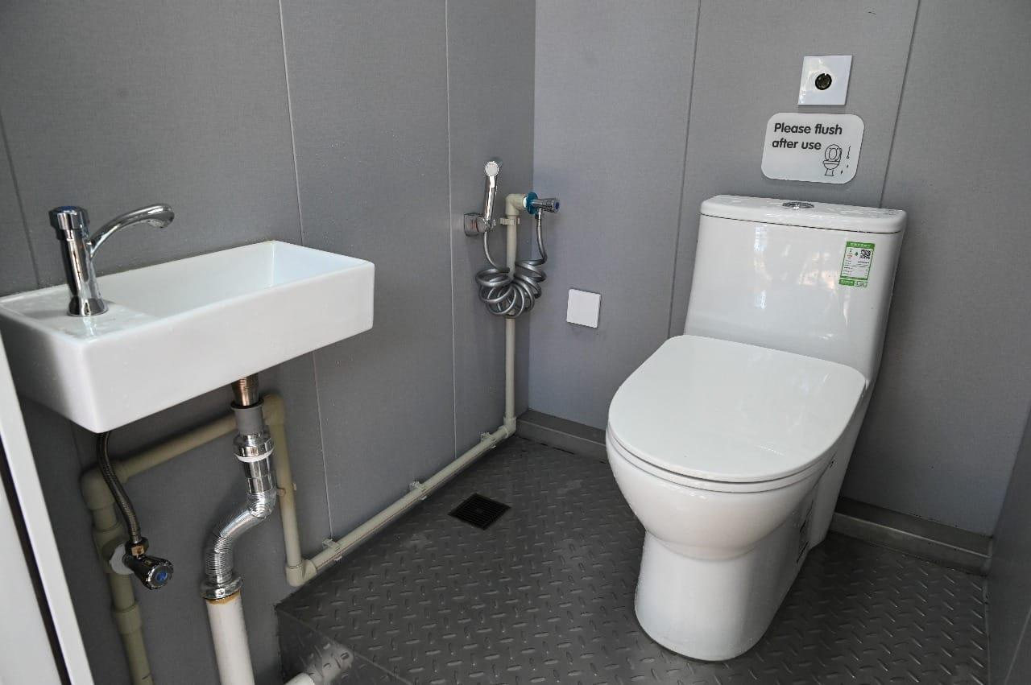
LOOCAFE × REFLOW · THE STREET
Inside the toilet: privacy, fixtures and finish.
Toilet Tales · Enclosed cubicles and finishes
Lumbini Park · WC, washbasin and hand spray
Enclosed cubicles and maintained washing facilities shape the user experience.
Original project / Toilet Tales archive · Interior and entrance details across sites
09
Notes:
Inside, we want it to look really good. You should feel comfortable walking in. Clean surfaces, lighting, the details you actually touch. Aspiration matters here. We want to set a standard that people expect, and that the operator takes pride in maintaining. A clear entrance. A private cubicle. A space that looks as though someone cares about it. These are basic design decisions with very real consequences. Think about the approach, the signs, the door and privacy. A wheelchair symbol by itself doesn't solve access. The whole route and the space inside have to work. That's part of making the perfect toilet.
Source/context: Original project / Toilet Tales archive · Interior and entrance details across sites
Web review slide: 5
Live allocation for this topic: 12 seconds.

Slide 10
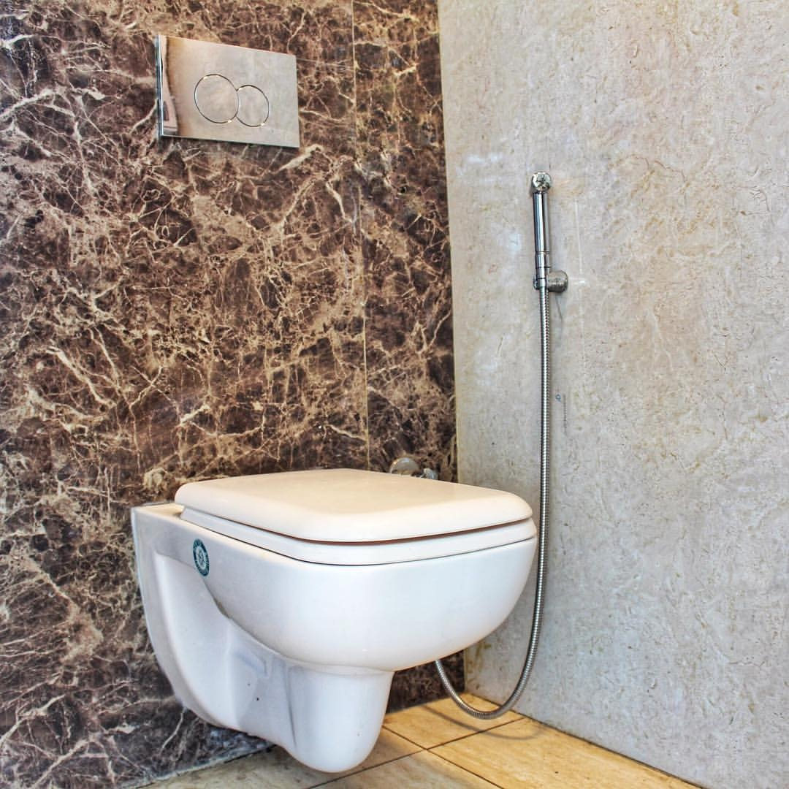
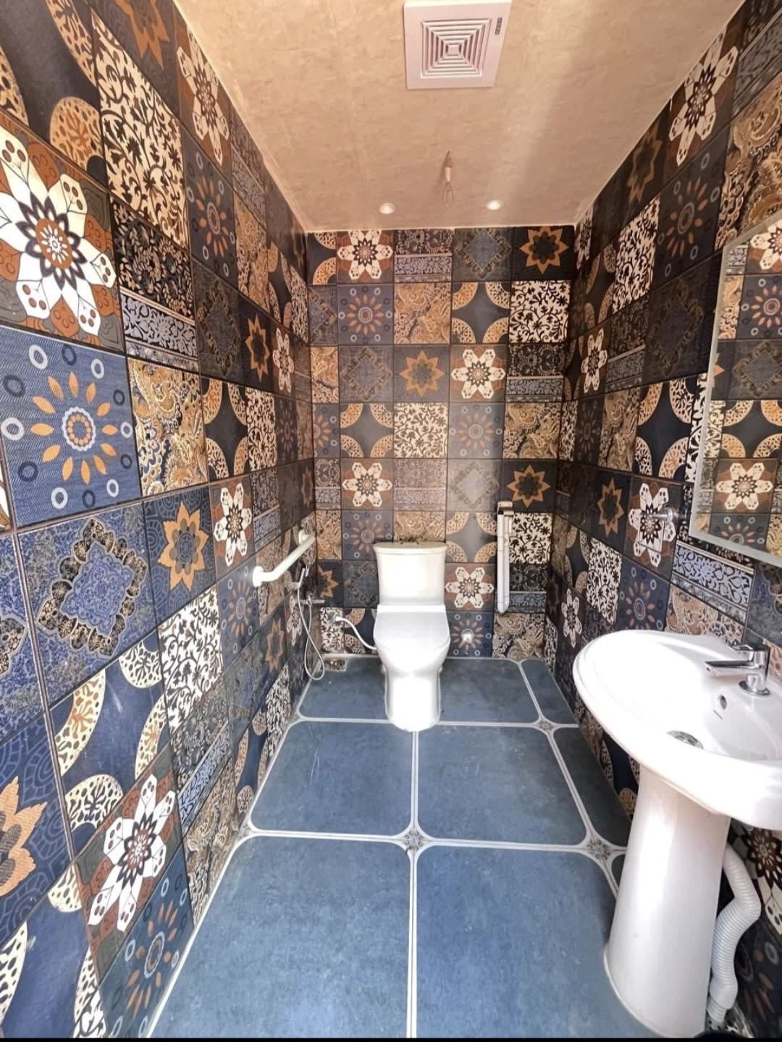
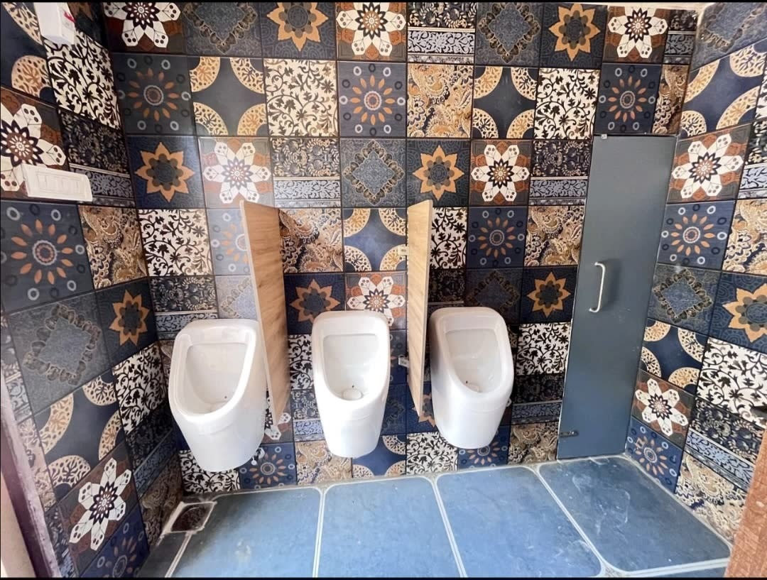
LOOCAFE × REFLOW · THE STREET
“Make sure that it looks really awesome.”
Enclosed WC · Wall finish and handheld wash fixture
Tiled cubicle · WC and washbasin
Urinal bay · Fixture arrangement
Private cubicles, deliberate finishes and clearly arranged fixtures.
Sources: loocafe.com/gallery · Company photographs; locations as documented
10
Notes:
From the inside, it looks really posh. One of the things we want to build with LooCafes is aspiration. That's the standard we want to set. This isn't just a nice front on a toilet. The place you actually use has to receive the same attention. Here are the cubicle finishes and the way the fixtures are arranged.
Source/context: Sources: loocafe.com/gallery · Company photographs; locations as documented
Web review slide: 6
Live allocation for this topic: 10 seconds.

Slide 11
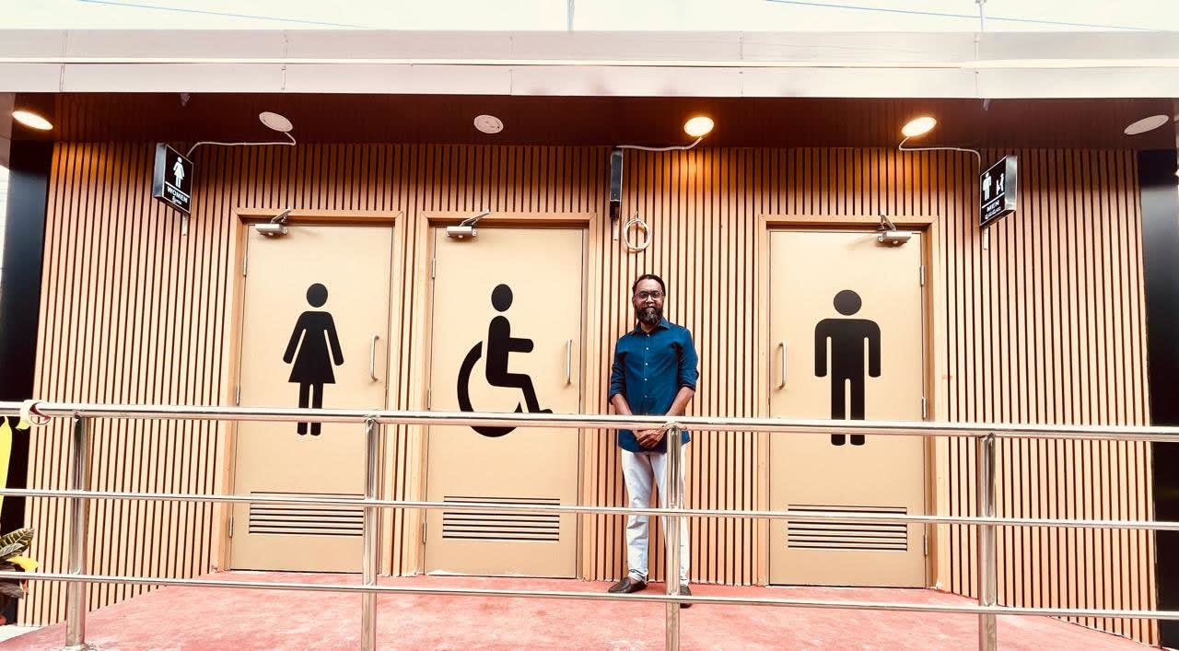
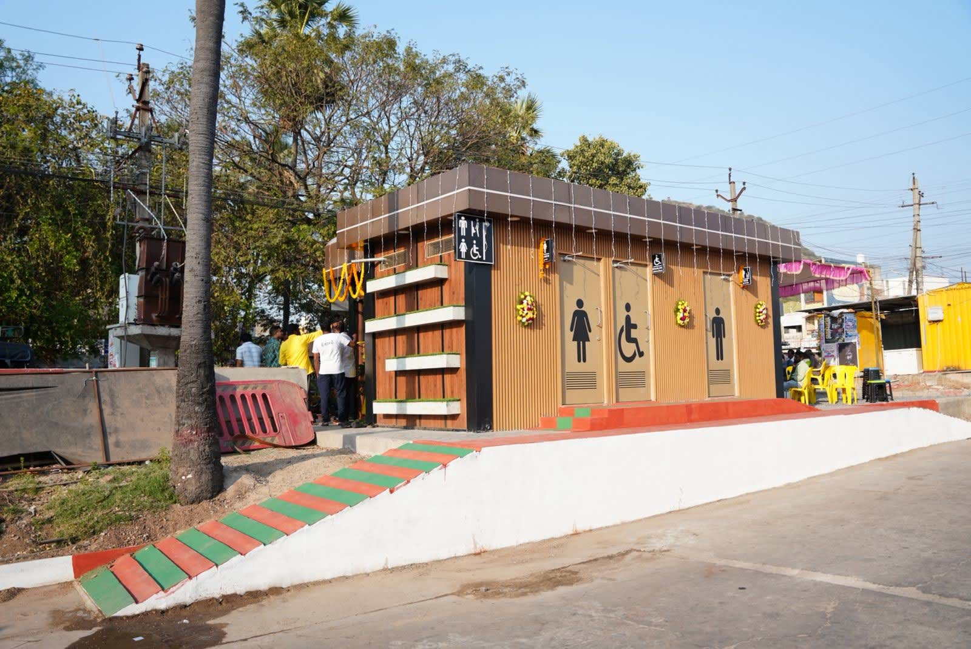
LOOCAFE × REFLOW · THE STREET
The entrance is part of the toilet.
Mangalagiri · Entrance signs and handrails
Mangalagiri · Facility and landscaped approach
Make the facility visible, identify the entrances and keep the approach clear.
Sources: loocafe.com/gallery · Company photographs; locations as documented
11
Notes:
The design starts before somebody opens a door. Can they see where to go? Is the entrance obvious? What does the approach feel like? At Mangalagiri you can see the entrance frontage, handrails, signs and planting together. These details are part of making a public toilet usable. A photograph alone is not an accessibility audit.
Source/context: Sources: loocafe.com/gallery · Company photographs; locations as documented
Web review slide: 7
Live allocation for this topic: 10 seconds.

Slide 12
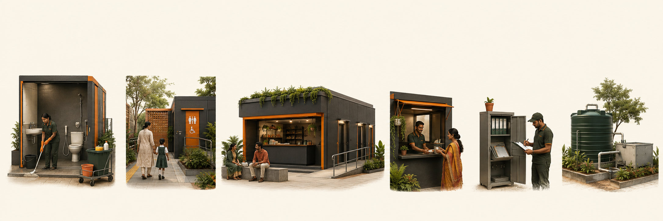
LOOCAFE × REFLOW · THE STREET
What makes the model worth repeating?
Cleanliness
Safety and access
Aspirational design
A usable cubicle, water and daily care.
Privacy, signs and a clear approach.
A place people feel comfortable using.
Livelihood
Accountability
Wastewater
A business with room to earn.
Records, checks and follow-up repairs.
A suitable treatment and residuals route.
All six have to survive beyond opening day.
Concept illustration · Design and operating principles from the presentation brief
12
Notes:
These are the values I mean. A usable toilet, a safe approach and privacy. A viable business. Someone checking the work. And a proper destination for the wastewater.
Source/context: Concept illustration · Design and operating principles from the presentation brief
Web review slide: 8
Live allocation for this topic: 25 seconds.

Slide 13
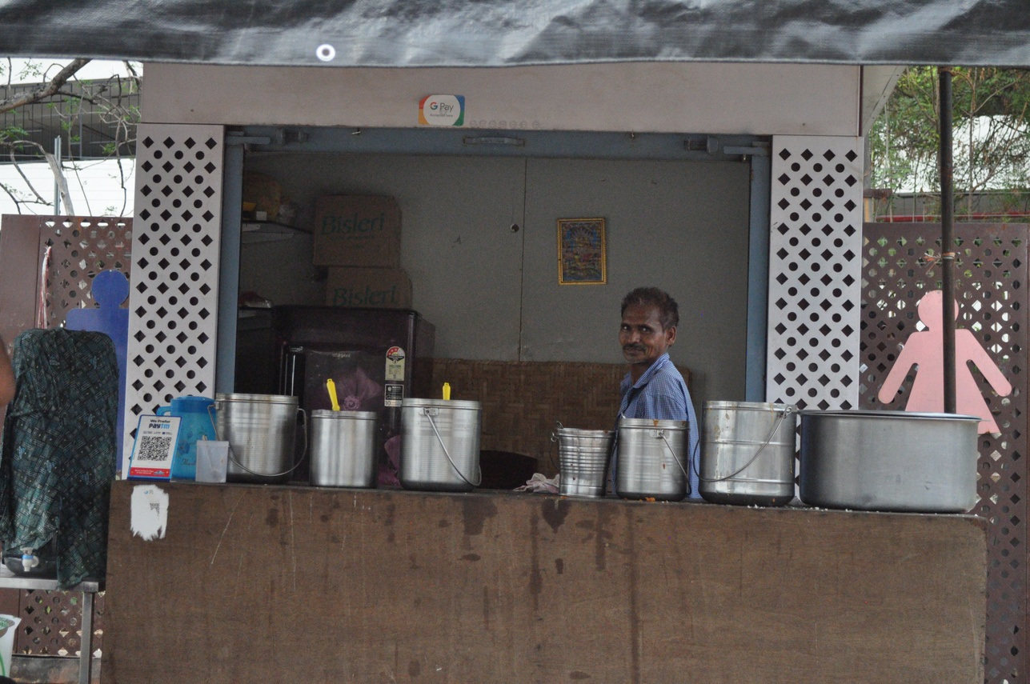
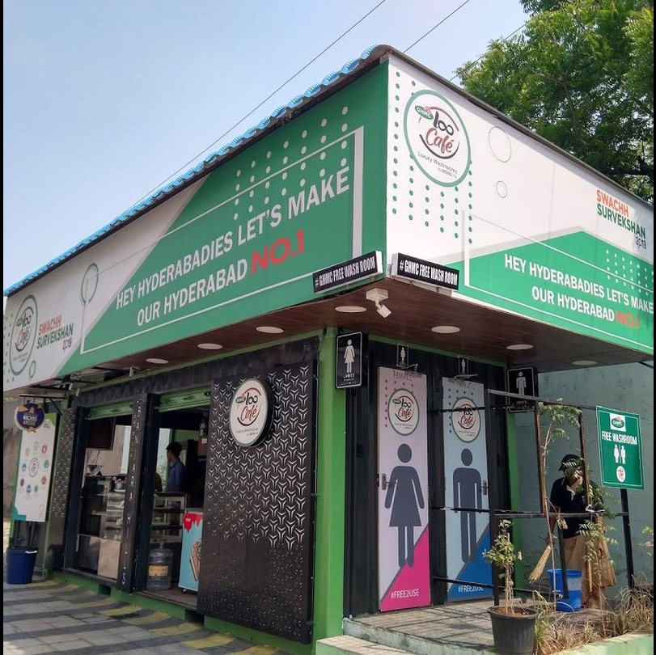
LOOCAFE × REFLOW · THE STREET
The front shop helps fund the toilets behind it.
Retail and advertising revenue help pay for cleaning and maintenance.
Toilet Tales archive · Retail and advertising surfaces; operating-model explanation
13
Notes:
Back to our street. Now look at the shop. Its role is to give someone an ongoing business here, linked to keeping the public facility working. The shop is somebody's livelihood. A partner has an establishment, customers, and a place to take responsibility for. Commercial activity can contribute to maintaining the toilets. But that responsibility has to be explicit. A counter by itself doesn't make cleaning happen. This is a person running a business. The model has to make sense for them too. Revenue has to cover the actual work of keeping the toilet usable. And look up. These panels are another potential source of revenue. They're also a very visible part of the street. In Karnataka, that surface should belong to the place. The important commercial question is how committed income pays for the service over time. There is also someone there. You can ask for help. An active frontage and lighting make the place more approachable. Safety still needs privacy, good design and operating procedures. The shopkeeper is part of that.
Source/context: Toilet Tales archive · Retail and advertising surfaces; operating-model explanation
Web review slide: 9
Live allocation for this topic: 25 seconds.

Slide 14
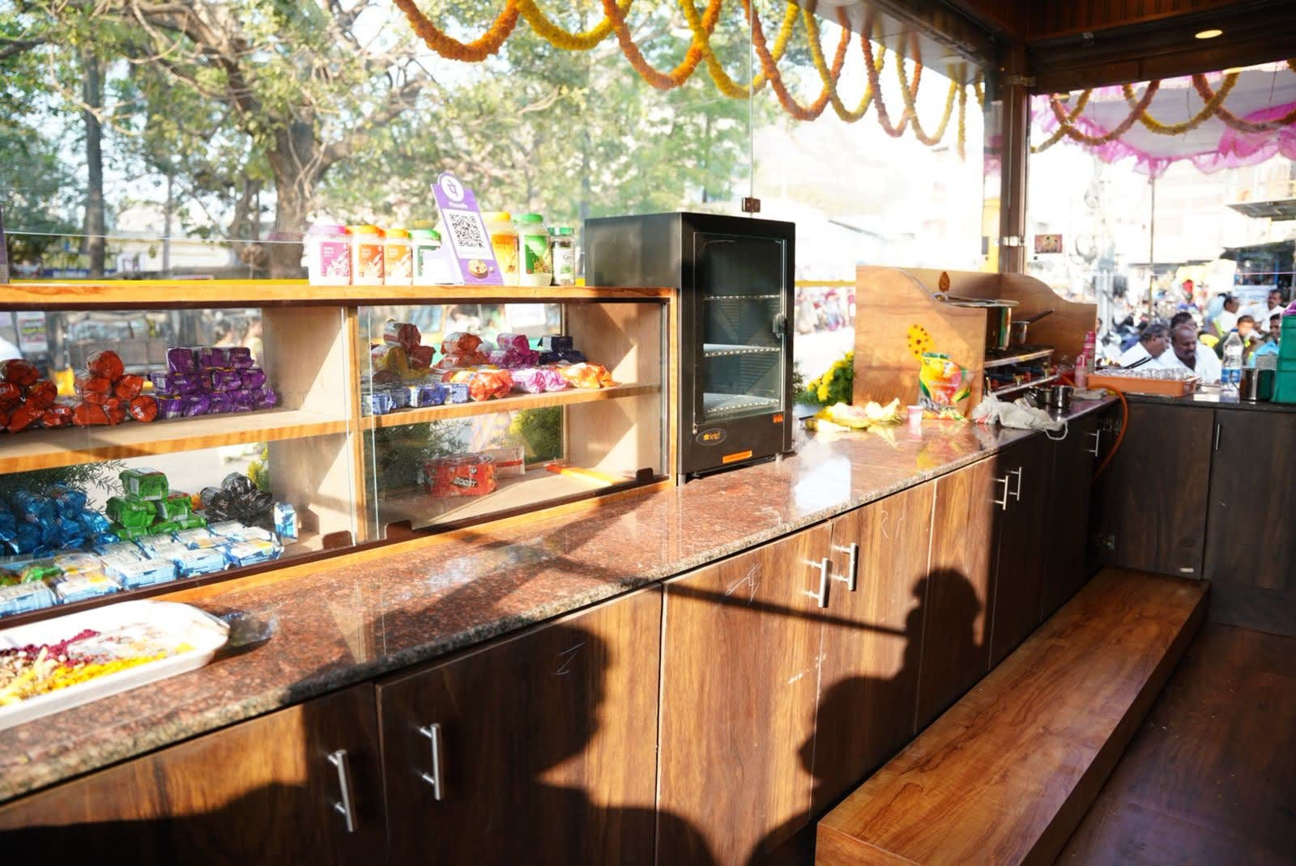
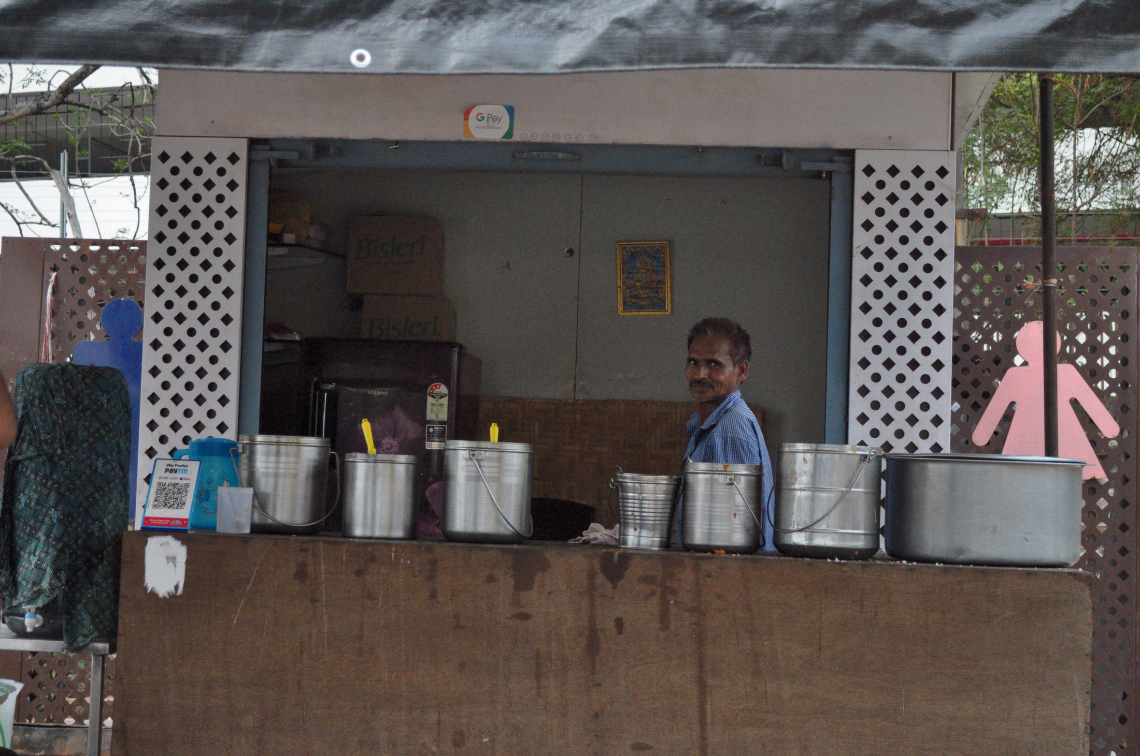
LOOCAFE × REFLOW · THE STREET
The shop is an operating business.
Retail counter · Display and service space
Food counter · The business in use
A working counter at the front helps support toilet care behind it.
Company photographs · loocafe.com/gallery; Toilet Tales 2.1, PDF p. 18
14
Notes:
Let me show you the shop properly. Here is the fitted counter, and here is a food counter in use at another unit. There is stock, equipment and a person running a business. That business helps pay for care of the public toilets. Advertising provides another income source. The point is to connect an everyday livelihood with an everyday maintenance responsibility. These photographs show different units; they are not a before-and-after pair.
Source/context: Company photographs · loocafe.com/gallery; Toilet Tales 2.1, PDF p. 18
Web review slide: 10
Supporting review slide.

Slide 15
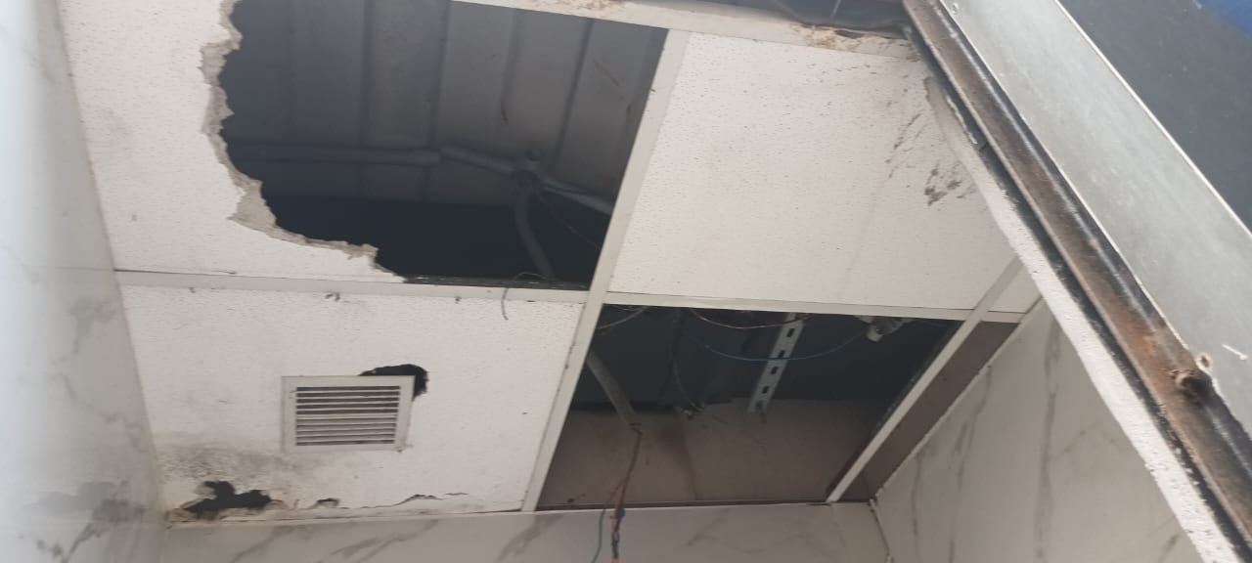
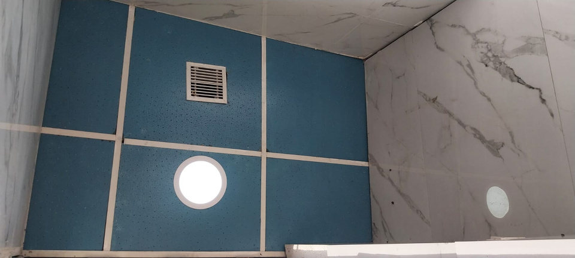
LOOCAFE × REFLOW · THE STREET
ACCOUNTABILITY
Damaged ceiling · Before section, 9 September 2024
Ceiling photograph · Status report, 13 September 2024
Notice the fault. Assign the repair. Check the work.
Dog Park, Gachibowli · Site status report, 13 Sep 2024, pp. 7 & 10 · Different camera views
15
Notes:
Accountability has to include the things that go wrong. A ceiling needs repair. A drain needs attention. Someone has to notice, someone has to act, and someone has to check the work. These are original photographs from our Dog Park status report: the damaged ceiling is in the section labelled before, dated 9 September 2024; the other ceiling photograph is in the report dated 13 September. They are different views, so I am not claiming an exact matched cubicle or a four-day repair guarantee. The point is that operating a toilet includes maintaining the asset after opening day. Now let me show you the workflow.
Source/context: Dog Park, Gachibowli · Site status report, 13 Sep 2024, pp. 7 & 10 · Different camera views
Web review slide: 11
Live allocation for this topic: 20 seconds.

Slide 16
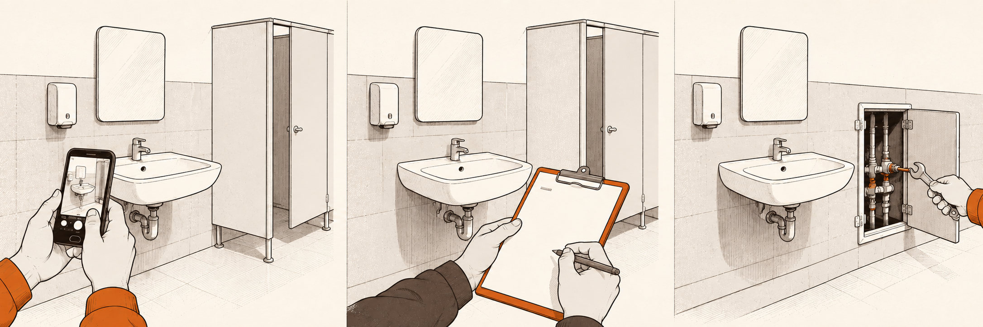
LOOCAFE × REFLOW · THE STREET
Accountability: record, check, resolve.
Record
Check
Resolve
Photograph the condition.
Make a second inspection.
Assign the repair and follow up.
A photo record, a second check and a clear route to report a problem.
Explanatory illustration · Not a photograph or verified app interface
16
Notes:
This illustration explains the accountability loop. It is not an app screenshot. The operator records the work, a supervisor checks it, and problems need an assigned response. The real interface screens belong alongside this explanation.
Source/context: Explanatory illustration · Not a photograph or verified app interface
Web review slide: 12
Supporting review slide.

Slide 17
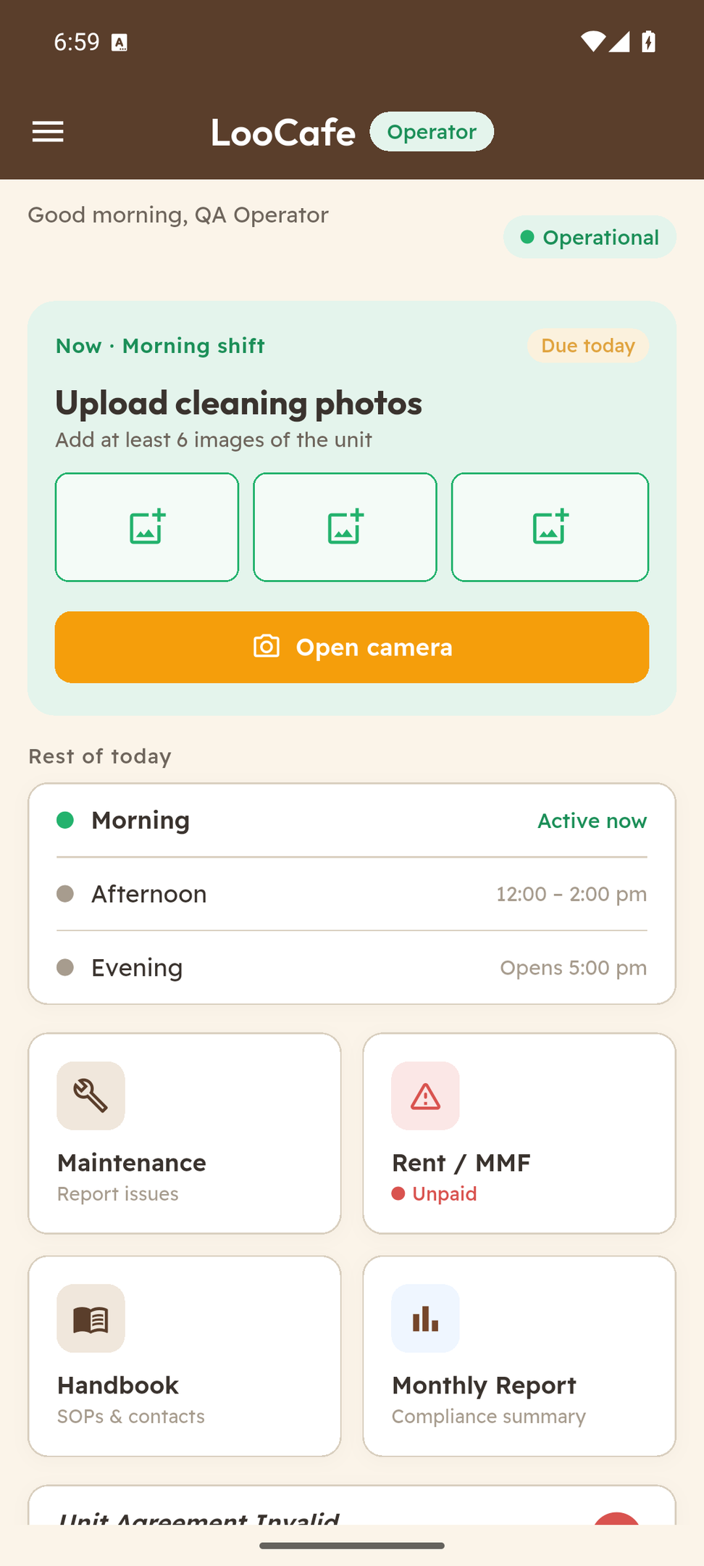
LOOCAFE × REFLOW · THE STREET
The operator knows what is due today.
A clear task
The active shift asks for at least six unit photographs.
A daily schedule
Morning, afternoon and evening are shown together.
One place to act
Maintenance, handbook and monthly reporting are available from home.
Daily cleaning records belong in the operating routine.
Actual Android emulator capture · Local QA operator and unit; demonstration data
17
Notes:
This is our actual operator app, running with a test account. The operator opens it and sees what is due today. Upload cleaning photos. See the next shift. Report a maintenance issue. You shouldn't need a complicated system to make the everyday responsibility clear. This screenshot shows the workflow; it is not evidence that a particular site completed today's work.
Source/context: Actual Android emulator capture · Local QA operator and unit; demonstration data
Web review slide: 13
Live allocation for this topic: 15 seconds.

Slide 18
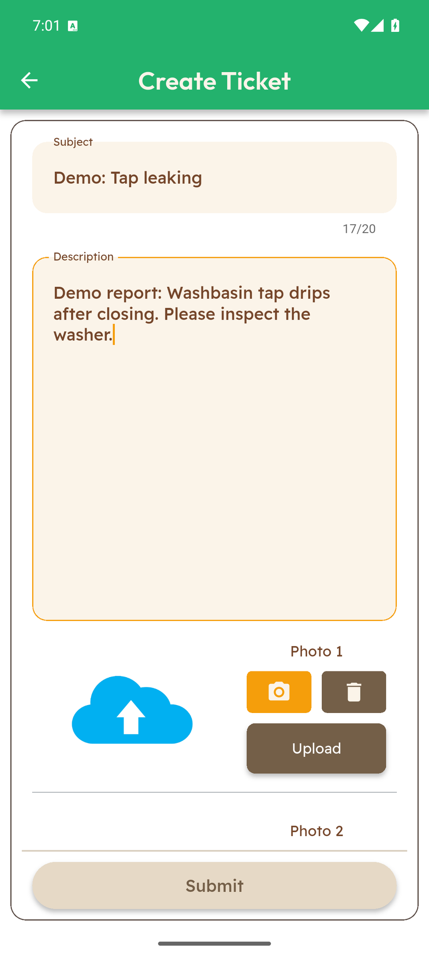
LOOCAFE × REFLOW · THE STREET
Turn a problem into a maintenance ticket.
Describe the problem
A short title and a detailed description record what needs attention.
Show the evidence
The form provides photo uploads alongside the report.
Keep the record
Submitted issues can be reviewed in ticket history.
Describe the issue and attach photographs for review.
Actual Android emulator capture · Illustrative draft entered in the app; not submitted
18
Notes:
When something isn't working, the operator needs a clear way to say so. Here is the actual maintenance form: title, description and photographs. That gives the next person something concrete to review. Creating a ticket is the first step; assignment, response and closure still need to be managed. We shouldn't claim a response time without the operating records. The leaking-tap description is an illustrative draft entered into the actual form. It was not submitted as a real site fault.
Source/context: Actual Android emulator capture · Illustrative draft entered in the app; not submitted
Web review slide: 14
Live allocation for this topic: 15 seconds.

Slide 19
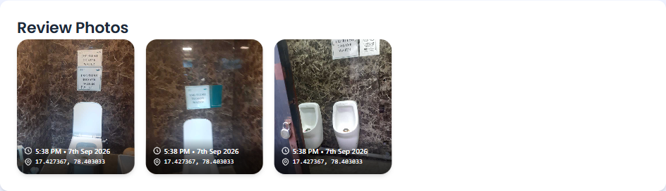
LOOCAFE × REFLOW · THE STREET
Open the record. Inspect the photographs.
Actual submitted review · Toilet and urinal photographs with recorded time and location
The dashboard brings the submitted photographs, time and location together.
Actual dashboard.loocafe.com capture · LC_ID_023 evening review, 7 Sep 2026 · Submitted record, not independent verification
19
Notes:
Here is an actual record from our dashboard. These are the photographs submitted for one evening review. You can inspect the fixtures, see the timestamp and see the recorded location. That makes the work visible. It does not, on its own, prove that every part of a toilet is clean or that a fault has been repaired. That still needs a check and a response. This is the bridge between the operator’s phone and the person overseeing the service.
Source/context: Actual dashboard.loocafe.com capture · LC_ID_023 evening review, 7 Sep 2026 · Submitted record, not independent verification
Web review slide: 15
Live allocation for this topic: 12 seconds.

Slide 20
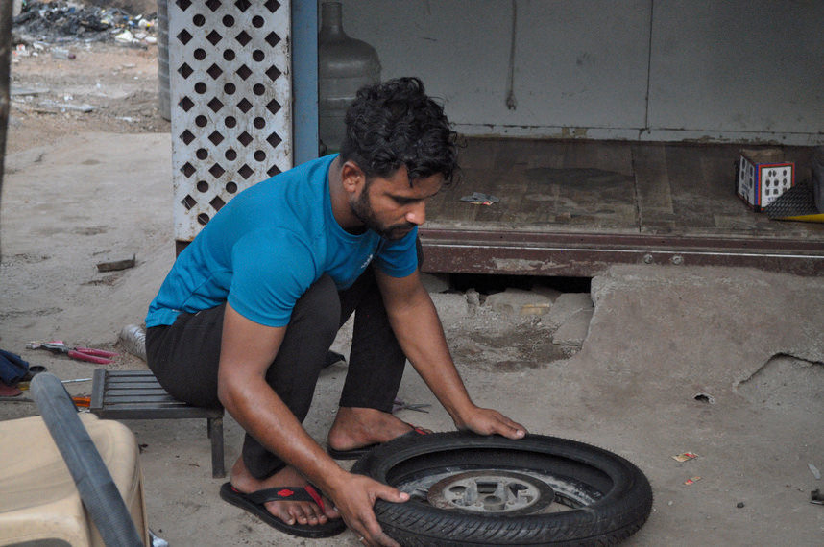
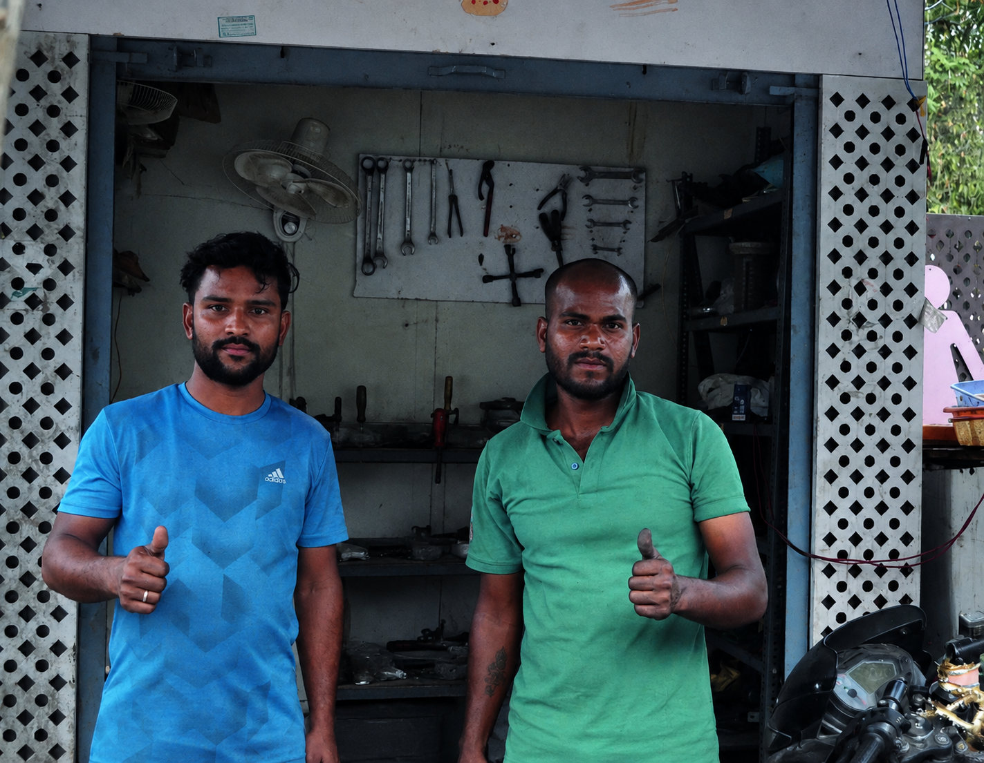
LOOCAFE × REFLOW · THE STREET
A livelihood, with responsibility.
Asif repairing a wheel
Repair workspace · edited photograph
A skill
A business
A daily responsibility
Bike repair, learned from his father.
A repair shop beside LooCafe Mini.
Toilet care before repair work.
Asif paired a LooCafe Mini with bike repair, and made toilet care part of his day.
Toilet Tales 2.1, p. 27 · Centre person removed from right-hand photograph; original retained
20
Notes:
Here is a real example from Toilet Tales. Asif had run kirana stores. With LooCafe Mini, he took a different route: bike repair, using skills his father had taught him. The profile describes him starting the day by cleaning the toilet before working at the repair station. This is what I mean by agency: someone bringing a skill and a business to the site, with responsibility for a public service. The archive records that story; it does not provide verified current earnings.
Source/context: Toilet Tales 2.1, p. 27 · Centre person removed from right-hand photograph; original retained
Web review slide: 16
Live allocation for this topic: 20 seconds.

Slide 21
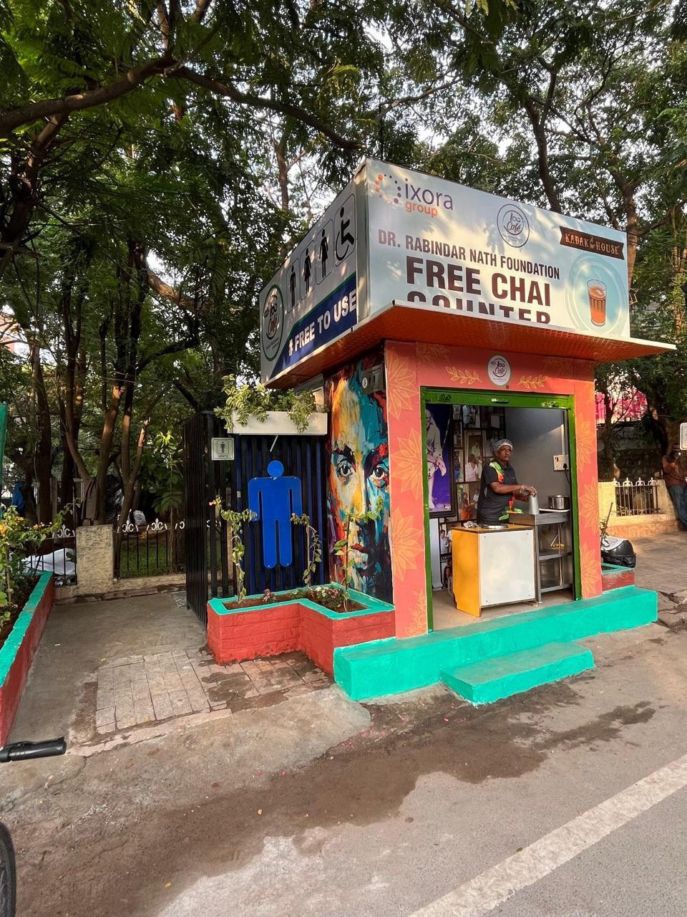
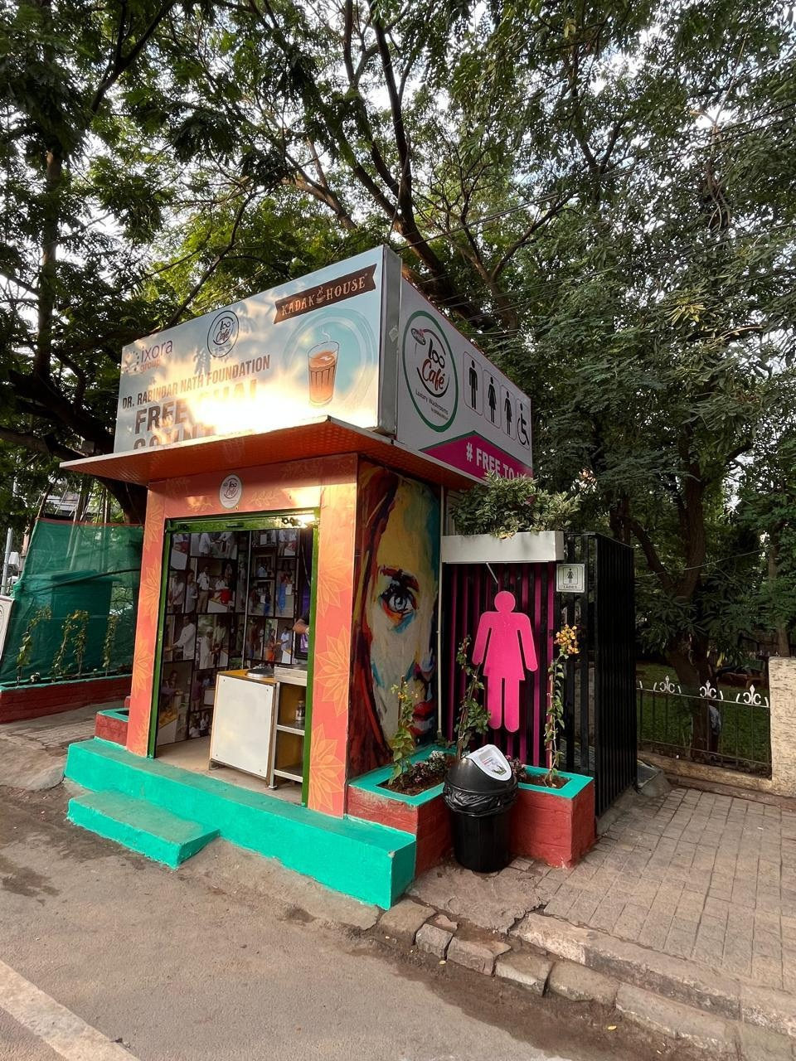
LOOCAFE × REFLOW · THE STREET
LooCafe Mini: a smaller unit, the same responsibility.
Mini front: counter and toilet entrance
Mini side: entrance and signs
A front counter, side toilet entrances and visible signs in one compact unit.
Original Mini photographs; historical signs retained
21
Notes:
Look at the Mini from both sides. The counter faces the street and the toilets sit beside it. The small format still needs access, water, cleaning and a suitable wastewater route.
Source/context: Original Mini photographs; historical signs retained
Web review slide: 17
Live allocation for this topic: 25 seconds.

Slide 22
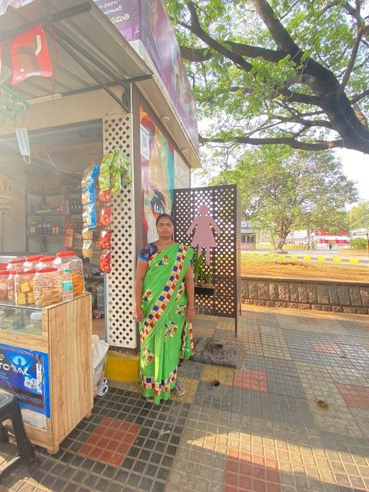
LOOCAFE × REFLOW · THE STREET
Mini: what fits, and what still needs space.
8 × 8 ft
Website-stated Mini footprint.
2 toilets
Website-stated standard configuration.
Site clearance
Approach, utilities and maintenance access.
Allow for access, utilities and maintenance beyond the enclosure.
loocafe.com Mini description; website-stated dimensions, site requirements vary
22
Notes:
The website describes an eight-by-eight-foot Mini with two toilets. That is the product description, not the total site allocation. An accessible approach, utilities and maintenance still need space.
Source/context: loocafe.com Mini description; website-stated dimensions, site requirements vary
https://loocafe.com/
Web review slide: 18
Live allocation for this topic: 25 seconds.

Slide 23
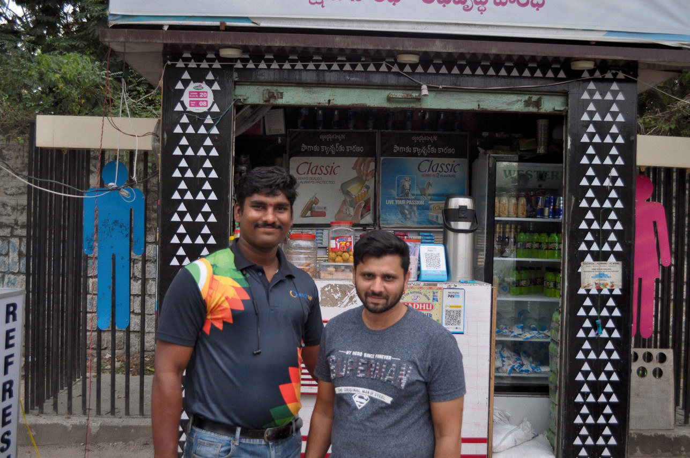
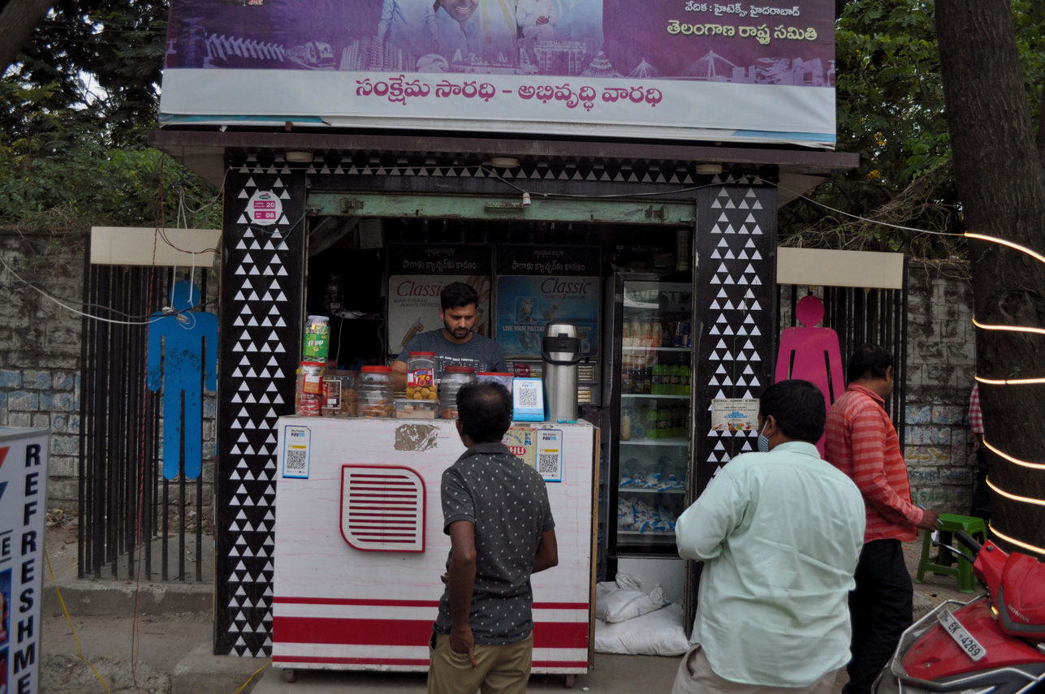
LOOCAFE × REFLOW · THE STREET
Toilet Tales: a place to earn.
Reuf at the counter
The stall serving customers
A trade
Customers
Toilet care
From electrical retail to a stall.
An everyday business at the unit.
Part of the daily routine.
Reuf moved from electrical retail into a LooCafe stall.
Toilet Tales 2.1, PDF p. 28; interview-time account
23
Notes:
Reuf had run an electrical shop. His Toilet Tales profile describes moving into a LooCafe stall and caring for the washrooms daily. It is a specific livelihood story, not a fixed-income promise.
Source/context: Toilet Tales 2.1, PDF p. 28; interview-time account
Web review slide: 19
Live allocation for this topic: 25 seconds.

Slide 24
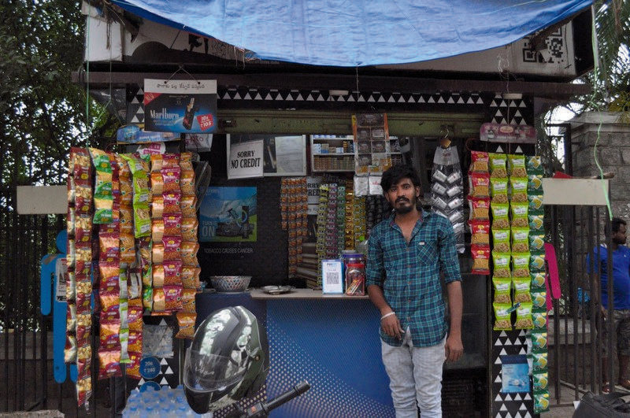
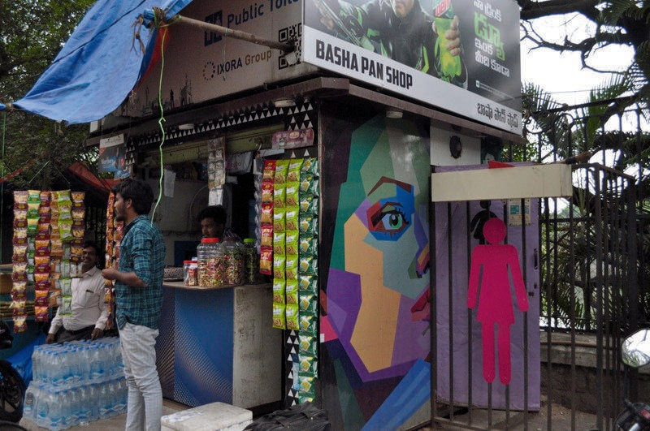
LOOCAFE × REFLOW · THE STREET
Toilet Tales: care is work, every day.
Sheikh Mahboob Basha
The stall and toilet entrance
Work
Routine
Support
Employment at the stall.
Twice-daily care, as recorded.
Clear expectations and repair assistance.
Sheikh Mahboob Basha’s profile records twice-daily washroom care.
Toilet Tales 2.1, PDF p. 26; not a current inspection
24
Notes:
Mahboob found work at a stall after losing his job during the pandemic. His profile records washroom care twice a day. This work needs clear responsibility and support. The account describes employment, not ownership.
Source/context: Toilet Tales 2.1, PDF p. 26; not a current inspection
Web review slide: 20
Live allocation for this topic: 25 seconds.

Slide 25
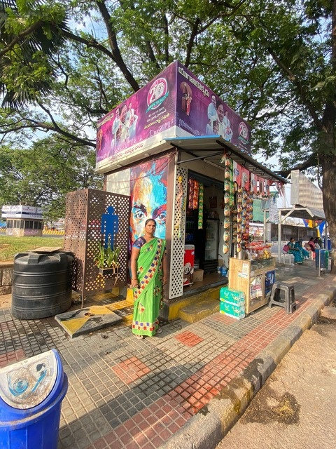
LOOCAFE × REFLOW · THE STREET
LooCafe Mini: a shop and toilets in one small unit.
Corner view: shop and toilet entrances
Closer view: counter and women’s entrance
The counter faces the street. Toilet entrances remain beside it.
Original LooCafe Mini archive; photographs show design and setting, not measured performance
25
Notes:
Here is another Mini in its real street setting. The shop and the toilet are part of one small unit. Look at the entrance and the space around it, not just the box. The footprint may be small, but access, cleaning and a wastewater route still have to work.
Source/context: Original LooCafe Mini archive; photographs show design and setting, not measured performance
Web review slide: 21
Live allocation for this topic: 25 seconds.

Slide 26
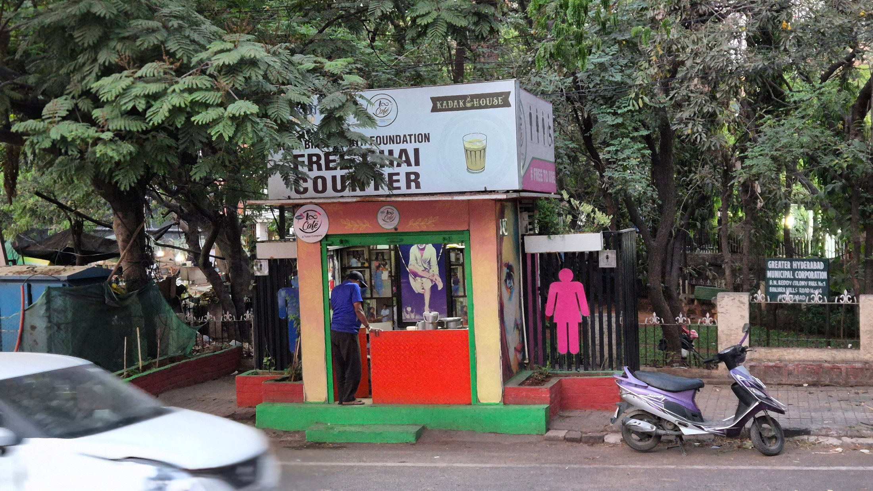
LOOCAFE × REFLOW · THE STREET
DRNF: free chai beside public sanitation.
Original DRNF free-chai-counter photograph
DRNF-branded counter and toilet entrance
A public-service counter can share the unit with public toilets.
DRNF chai-counter archive and LooCafe Mini archive; funding arrangements vary by site
26
Notes:
The same physical format can also support a different service model. These DRNF-branded counters offer free chai alongside public sanitation. The photographs show the counter and toilet access together. Free chai is a service commitment; we should explain who funds and operates it rather than assume the usual retail economics.
Source/context: DRNF chai-counter archive and LooCafe Mini archive; funding arrangements vary by site
Web review slide: 22
Live allocation for this topic: 25 seconds.

Slide 27
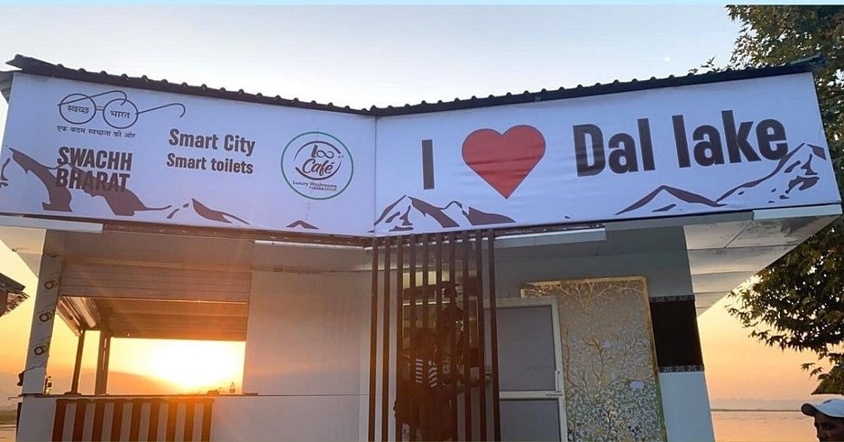
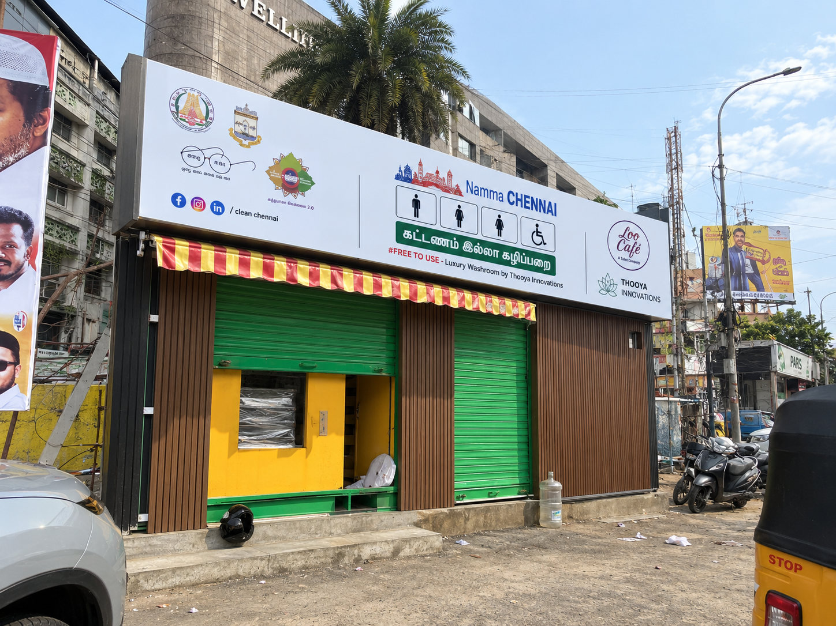
LOOCAFE × REFLOW · THE STREET
Different streets. A repeatable service.
Different site formats use the same link between business income and toilet care.
Original archive · Dal Lake, Chennai and Mini examples; not all are ReFlow installations
27
Notes:
Our work across India shows that range. Srinagar, Hyderabad, Chennai, Mangalagiri. Different surroundings and formats. Scaling means repeating the service as well as the structure. Here it is beside Dal Lake. Difficult connections or constrained access make the infrastructure question very real. Now look at what happens after someone flushes.
Source/context: Original archive · Dal Lake, Chennai and Mini examples; not all are ReFlow installations
Web review slide: 23
Live allocation for this topic: 12 seconds.

Slide 28
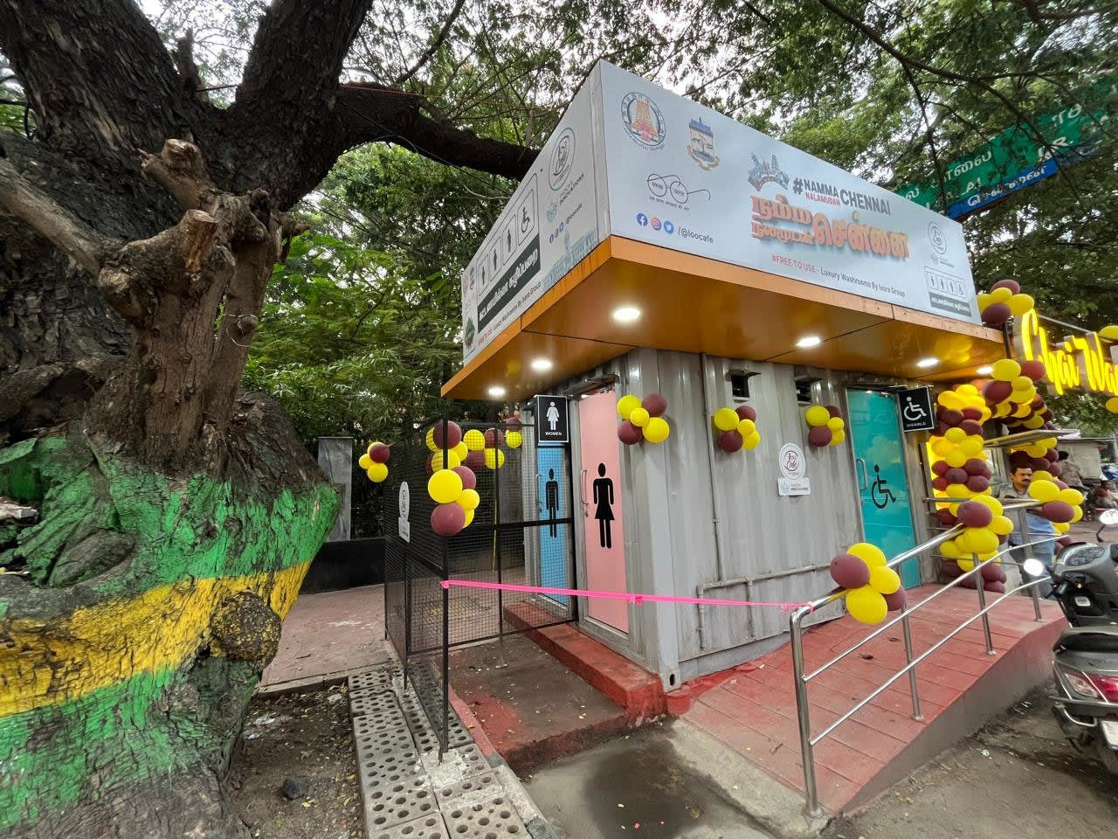
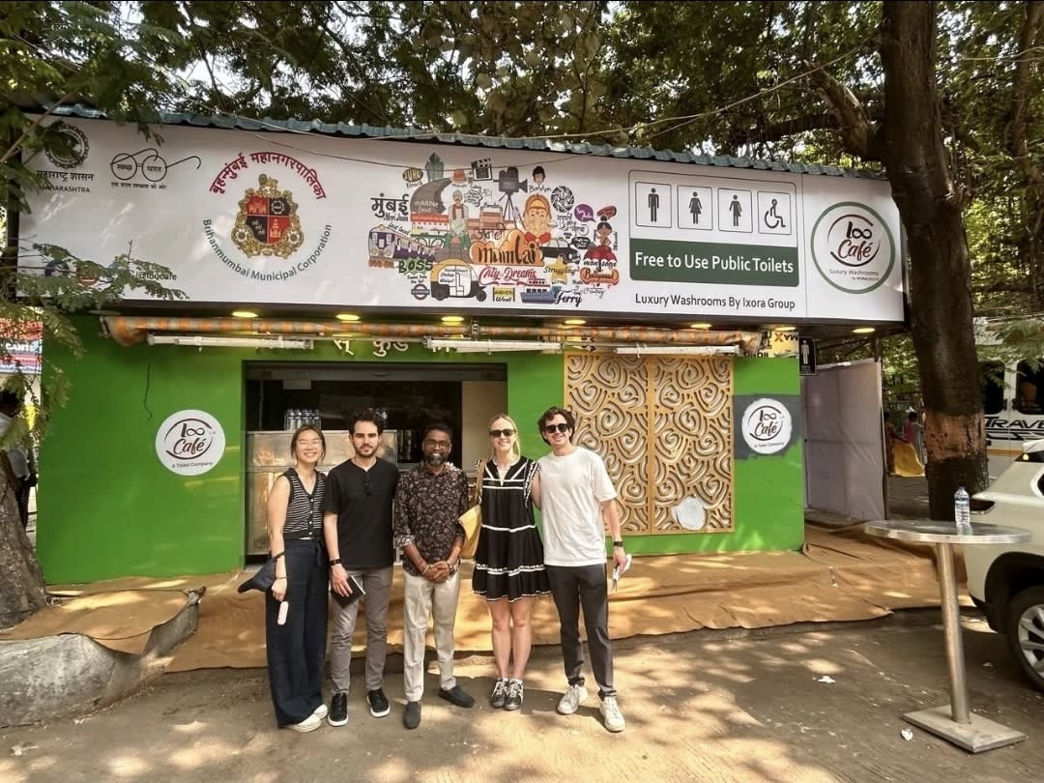
LOOCAFE × REFLOW · THE STREET
Our footprint: different cities and settings.
Mangalagiri
Chennai
Mumbai
Andhra Pradesh
Tamil Nadu
Maharashtra
Landscaped unit
Street-side unit
BMC-linked facility
Each location needs a suitable site, a working toilet and a maintenance plan.
Sources: loocafe.com/gallery · Company photographs; locations as documented
28
Notes:
These are real locations in our wider LooCafe work: Mangalagiri, Chennai and Mumbai. I'm showing the places because the footprint is more than a number. Each site has its own space, users and operating conditions. These photographs document LooCafe locations; they do not mean every one has ReFlow treatment.
Source/context: Sources: loocafe.com/gallery · Company photographs; locations as documented
Web review slide: 24
Live allocation for this topic: 15 seconds.

Slide 29
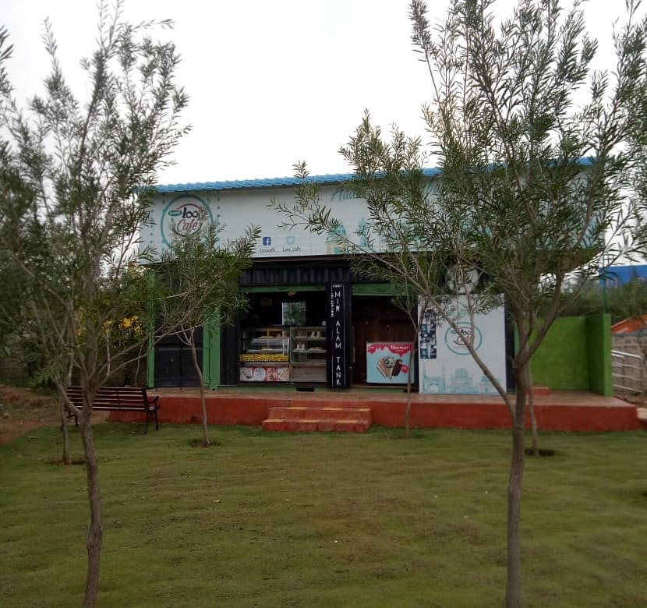
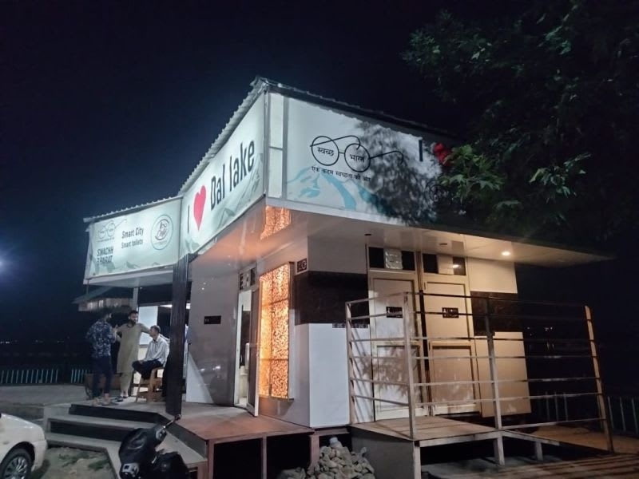
LOOCAFE × REFLOW · THE STREET
From Hyderabad parks to Dal Lake.
Mir Alam Park · Public park setting
Dal Lake, Srinagar · Night-time frontage
Mir Alam Park, Hyderabad · Dal Lake, Srinagar
Sources: loocafe.com/gallery · Company photographs; locations as documented
29
Notes:
In Hyderabad, look at the park setting. Then look at Dal Lake in Srinagar. The setting changes, but the public still needs a toilet they can find and use. The treatment route and maintenance plan have to suit the location.
Source/context: Sources: loocafe.com/gallery · Company photographs; locations as documented
Web review slide: 25
Live allocation for this topic: 12 seconds.

Slide 30
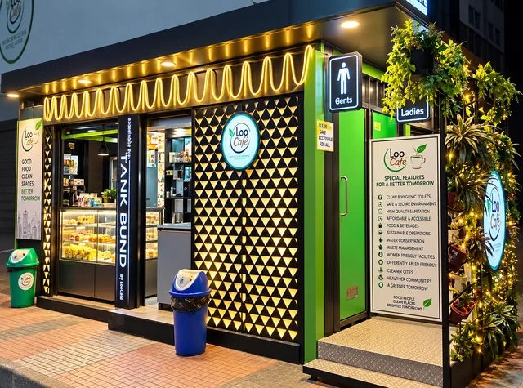
LOOCAFE × REFLOW · THE STREET
A toilet can belong in a well-designed public space.
Mangalagiri · Approach and planting
Tank Bund · Lighting, signs and entrance
A clear approach, visible signs and lighting help people find the facility.
Company photographs · loocafe.com/gallery and reflowtoilets.com · Locations as documented
30
Notes:
You wanted to go for a good stroll. The toilet should feel like it belongs in that public space. Here is the approach at Mangalagiri. Then look at the illuminated frontage at Tank Bund: the entrance, signs and planting are visible together. The photograph shows the design; it does not establish a lighting standard or an accessibility audit. Greenery must not get in the way of the entrance or the person maintaining it.
Source/context: Company photographs · loocafe.com/gallery and reflowtoilets.com · Locations as documented
Web review slide: 26
Supporting review slide.

Slide 31
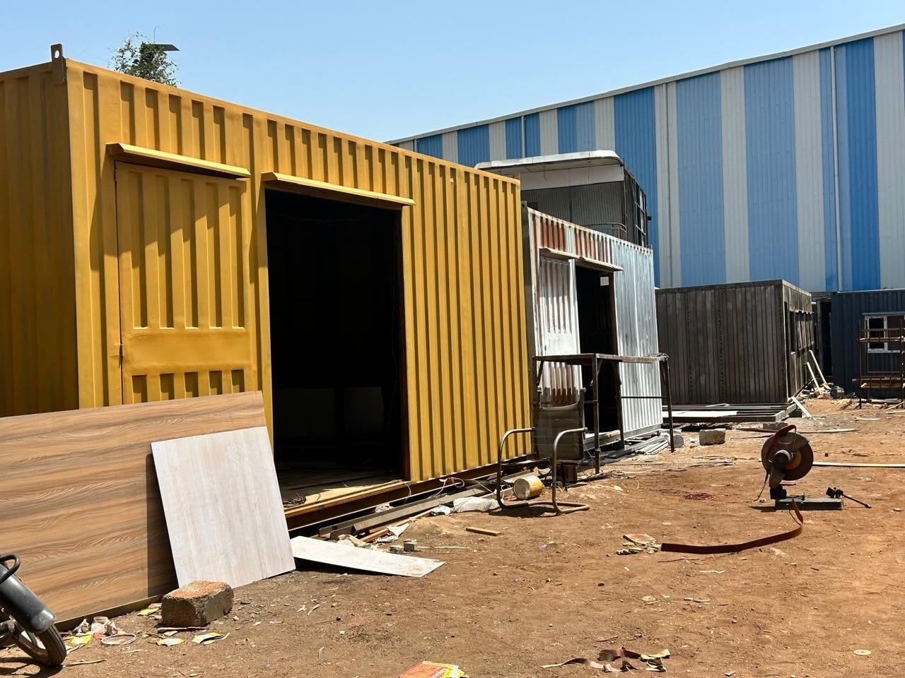
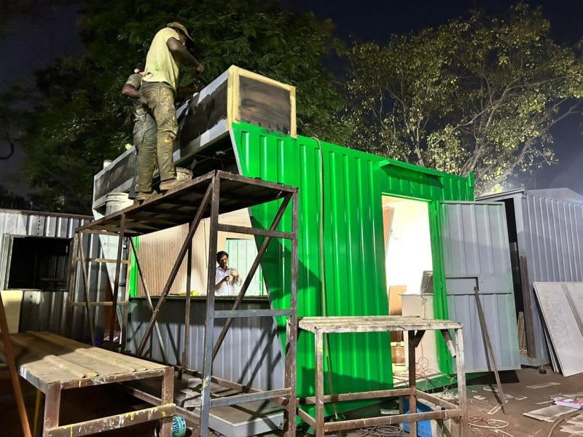
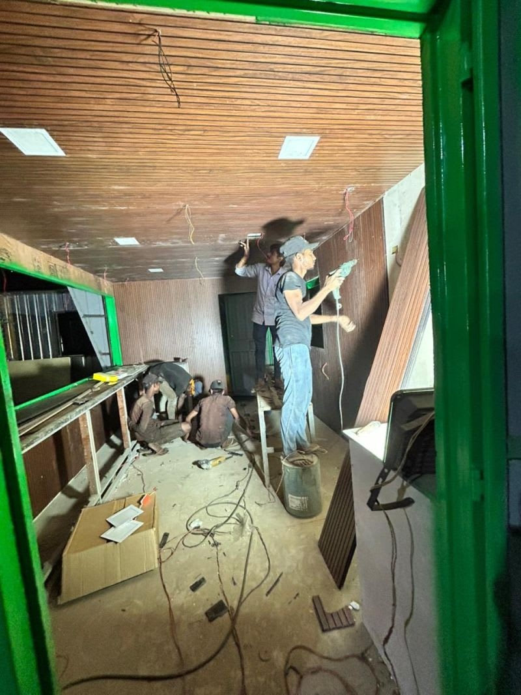
LOOCAFE × REFLOW · THE STREET
Scalability starts in the workshop.
1 · Enclosure
2 · Exterior
3 · Interior
Build the structure
Fabricate and finish
Fit the usable space
Container conversion
Exterior workshop view
Interior fit-out
At every site: prepare, install, commission and maintain.
Sources: loocafe.com/gallery · Company photographs; locations as documented
31
Notes:
How does this scale? Part of the answer is here, before the unit reaches the street. We build the enclosure, fit the interior and install the components. Repeatable fabrication helps. It still needs site preparation, installation and commissioning. I wouldn't confuse placing the structure with having a treatment system ready to operate.
Source/context: Sources: loocafe.com/gallery · Company photographs; locations as documented
Web review slide: 27
Live allocation for this topic: 15 seconds.

Slide 32
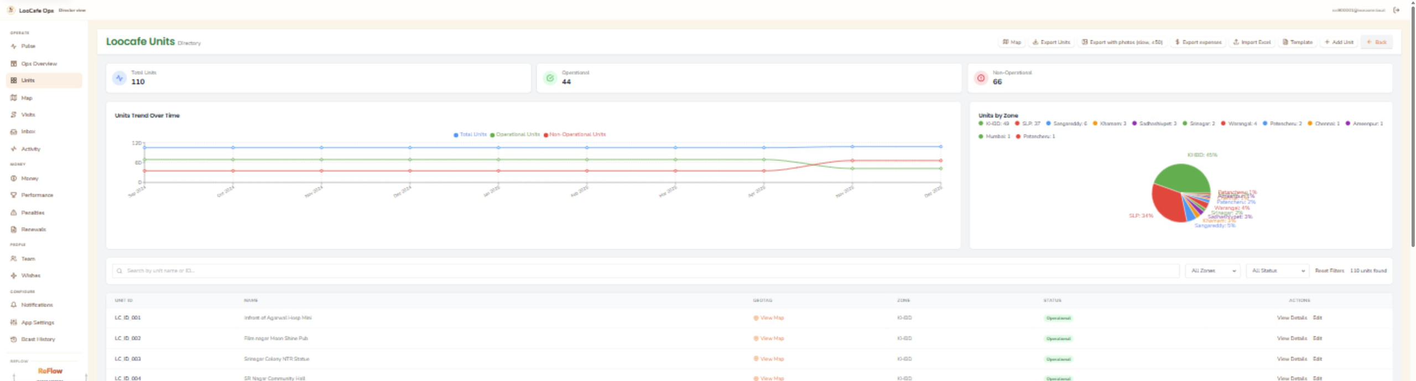
LOOCAFE × REFLOW · THE STREET
A unit directory gives the network a shared record.
Find the site
Read the record
Keep it current
Unit IDs, names and map links
Zone and operational status
A registry needs verification in the field
Unit identity, location and recorded status in one place.
Actual dashboard.loocafe.com/units capture · Registry status, not audited service availability
32
Notes:
This is an actual capture of dashboard.loocafe.com. The directory currently contains 110 records: 44 marked operational and 66 non-operational. Those are database labels, not an independently verified uptime survey or the complete historical deployment footprint. That is exactly why a shared record and field checks belong together. Do not repeat the earlier claim that 150 units are all maintained from this evidence.
Source/context: Actual dashboard.loocafe.com/units capture · Registry status, not audited service availability
Web review slide: 28
Supporting review slide.

Slide 33
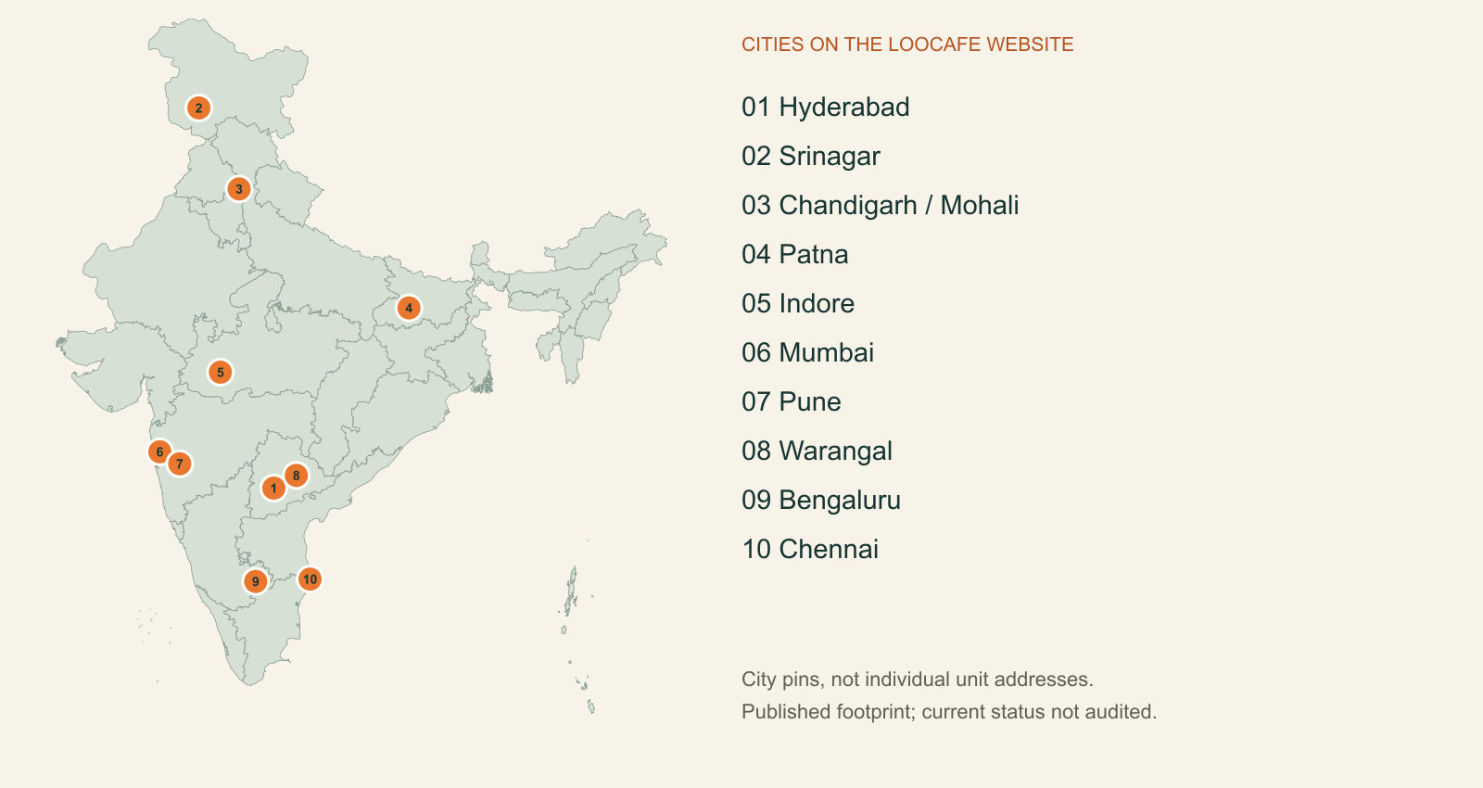
LOOCAFE × REFLOW · THE STREET
LooCafe’s published city footprint.
Ten website city markers, not an individual-unit operating audit.
loocafe.com city map; city coordinates, not unit-level status
33
Notes:
These are the cities plotted on our website. The dots show city-level presence, not every toilet address. This published footprint differs from the live register and from the subset with ReFlow treatment.
Source/context: loocafe.com city map; city coordinates, not unit-level status
https://loocafe.com/
Web review slide: 29
Live allocation for this topic: 25 seconds.

Slide 34
LOOCAFE × REFLOW · BELOW THE STREET
But where does the flush go?
URBAN INDIA · 2020 INVENTORY
NTR SAMADHI MINI · COMPANY RECORD
Estimated sewage generation
10 metres
72.4
billion L/day
The unit moved.
The drain connection did not follow.
Actual STP utilisation
20.2
billion L/day
Mini
→
New site
Our 11 April 2023 letter reports no drain connection at the new location.
Historical national baseline, not current coverage or ReFlow performance.
Choose the treatment route. Fund the operation. Verify the result.
CPCB, March 2021, Fig. 3.1: 2020 inventory · Ixora relocation letter, 11 Apr 2023: company-reported case
34
Notes:
Now come back to our street. In our company letter of 11 April 2023, we reported that the NTR Samadhi Mini had moved ten metres and had no drain connection available at the new location. That is a company-reported relocation problem, not an independent engineering inspection or proof of a later solution. It makes the infrastructure question concrete: where does the flush go? The CPCB 2021 report gives us a useful national baseline: about 72.4 billion litres of sewage generated each day, against 20.2 billion litres of actual STP utilisation in its 2020 inventory. Those are historical national figures, not ReFlow results or current coverage. A city needs suitable sewer connections, appropriate local treatment and a service that keeps operating. The treatment route must fit the site. Installed capacity and verified treatment are different measures.
Source/context: CPCB, March 2021, Fig. 3.1: 2020 inventory · Ixora relocation letter, 11 Apr 2023: company-reported case
https://cpcb.gov.in/openpdffile.php?id=UmVwb3J0RmlsZXMvMTIyOF8xNjE1MTk2MzIyX21lZGlhcGhvdG85NTY0LnBkZg%3D%3D
Web review slide: 30
Live allocation for this topic: 30 seconds.

Slide 35
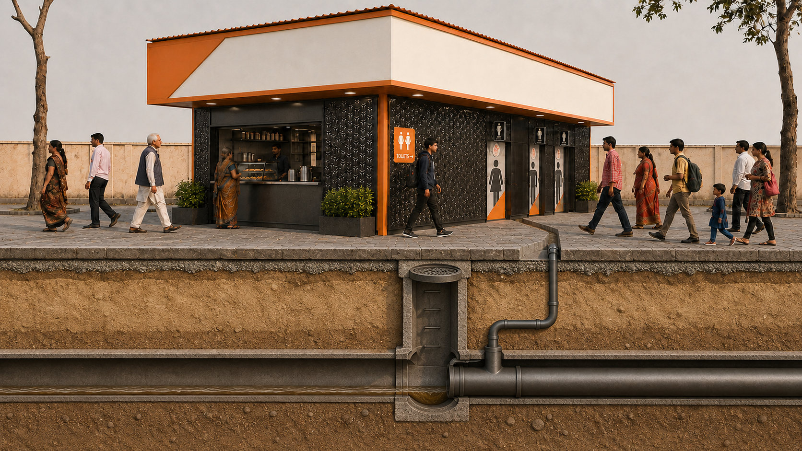
LOOCAFE × REFLOW · BELOW THE STREET
The same street. The sewer beneath it.
Toilet outlet → local connection → municipal sewer → downstream treatment.
Generated cutaway of the existing illustrated street; not an as-built survey
35
Notes:
Look below the same street. A sewer carries wastewater away, but it still needs working downstream treatment. This cutaway explains the connection; it is not a survey of the pipes under Lumbini Park.
Source/context: Generated cutaway of the existing illustrated street; not an as-built survey
Web review slide: 31
Live allocation for this topic: 25 seconds.

Slide 36


LOOCAFE × REFLOW · BELOW THE STREET
Bring treatment to the site.
Lumbini Park · ReFlow installation and adjoining kiosk
Factory view · Treatment equipment and pipework
The service bay contains the treatment equipment behind the public toilets.
Original Lumbini and factory photographs · Factory equipment is labelled separately
36
Notes:
The left photograph shows the Lumbini Park installation; the right is a factory view of treatment equipment and pipework. Wastewater comes into a managed treatment process. The flow is collected and regulated. Biological treatment reduces the pollution load. Further treatment and disinfection prepare the water for its intended reuse. It goes into storage and returns to flushing. Each of those steps has a specific job. There are anaerobic and aerobic stages. Microorganisms do much of the work of reducing the pollutant load. The blowers support the aerobic process. And biology needs time to establish itself. We can place a prefabricated structure quickly, but we still have to commission the treatment and verify what comes out.
Source/context: Original Lumbini and factory photographs · Factory equipment is labelled separately
Web review slide: 32
Live allocation for this topic: 15 seconds.

Slide 37


LOOCAFE × REFLOW · BELOW THE STREET
Outside: the enclosure. Inside: the equipment.
Installed BCRT exterior · enhanced photograph
Treatment equipment · original factory photograph
The toilet enclosure also has to accommodate treatment and maintenance access.
Sources: loocafe.com/gallery · Company photographs; locations as documented
37
Notes:
Now look at the physical engineering. Here's a factory enclosure, and here are the tanks and pipework inside. The equipment needs space. People need access to inspect it and maintain it. These factory photographs explain the packaging; the precise configuration has to be matched to the installed unit.
Source/context: Sources: loocafe.com/gallery · Company photographs; locations as documented
Web review slide: 33
Supporting review slide.

Slide 38



LOOCAFE × REFLOW · BELOW THE STREET
The public side and the service side.
Daylight exterior · enhanced
Second daylight angle · enhanced
Night frontage · enhanced
Night entrance · original
Public entrances, covered approach and illuminated signs.
Sources: loocafe.com/gallery · Company photographs; locations as documented
38
Notes:
The user sees a private cubicle. The maintenance team needs to reach the treatment equipment. Both have to work in the same system. That's why I want you to see both sides, rather than just the attractive exterior or only a process diagram.
Source/context: Sources: loocafe.com/gallery · Company photographs; locations as documented
Web review slide: 34
Live allocation for this topic: 15 seconds.

Slide 39
LOOCAFE × REFLOW · BELOW THE STREET
Follow the water.
DOCUMENTED FUNCTIONAL SEQUENCE
1
Collect
Regulate incoming wastewater.
2
Biology
Anaerobic + aerobic treatment.
3
Treat further
Further treatment before reuse.
4
Disinfect
UV on the documented reuse path.
5
Reuse
Return treated water for flushing.
Additional ECR: high loading / unstable effluent.
Non-potable reuse · Simplified process, not a piping plan.
FACTORY PHOTOGRAPH · EQUIPMENT CONTEXT
Collect → treat → disinfect → reuse for flushing
BCRT O&M manual, Aug 2024, pp. 6–8 (printed) · Simplified selected configuration
39
Notes:
Toilet wastewater is collected and regulated. Biological stages reduce the pollutant load. Further treatment and disinfection prepare the water for flushing reuse. The ECR is additional treatment for high load or unstable effluent in this manual. It is not a box we should casually draw as always running. This is non-drinking reuse.
Source/context: BCRT O&M manual, Aug 2024, pp. 6–8 (printed) · Simplified selected configuration
Web review slide: 35
Supporting review slide.

Slide 40

LOOCAFE × REFLOW · BELOW THE STREET
The treatment stages—and the return to flushing.
ECR provides additional treatment when required; the reuse route returns water for flushing.
Based on BCRT O&M manual, Aug 2024 · Conceptual equipment shapes; not to scale
40
Notes:
Here is the whole process in one image. Collection, biological treatment, further treatment and disinfection, then reuse for flushing. The additional ECR is conditional in the selected manual. The equipment shapes are illustrative. Makeup water, power and managed residuals remain part of the operating system.
Source/context: Based on BCRT O&M manual, Aug 2024 · Conceptual equipment shapes; not to scale
Web review slide: 36
Live allocation for this topic: 55 seconds.

Slide 41

LOOCAFE × REFLOW · BELOW THE STREET
The engineering is in the operating limits.
Commission the biology
Seed the process and increase loading in stages.
Connect controls to use
Reuse-water levels gate pump and UV operation.
Coordinate cleaning
Use a treatment-compatible cleaning protocol.
Hardware, operating conditions and daily care have to work together.
BCRT O&M Manual, Aug 2024, printed pp. 12, 14–15, 23 · Documented configuration; actual control-panel photo
41
Notes:
We can manufacture the structure. We still have to commission the biology. The manual describes seeding and progressive loading. Tank levels gate pump and UV operation, and overload protection matters. This is why I want to talk about the operating system around the technology, not just the hardware.
Source/context: BCRT O&M Manual, Aug 2024, printed pp. 12, 14–15, 23 · Documented configuration; actual control-panel photo
Web review slide: 37
Live allocation for this topic: 35 seconds.

Slide 42

LOOCAFE × REFLOW · BELOW THE STREET
ReFlow issues can be tracked by component.
Name the component. Set the priority. Track the response.
ReFlow dashboard DEMO workflow · AI-cleaned reproduction; original capture retained
42
Notes:
This is the actual ReFlow dashboard interface, with the product’s DEMO dataset visible. It illustrates component-based maintenance: the affected part, the person raising it, priority and status. The ticket examples are demonstration records, not evidence of faults at the installation. The treatment monitoring demo contains unverified performance and circularity statements, so I have not used it as measured treatment evidence. The table has been redrawn for legibility from the actual demo interface. All four ticket IDs, subjects, components, names, priorities and statuses were compared with the source screen. It is not an untouched screenshot.
Source/context: ReFlow dashboard DEMO workflow · AI-cleaned reproduction; original capture retained
Web review slide: 38
Live allocation for this topic: 15 seconds.

Slide 43

LOOCAFE × REFLOW · BELOW THE STREET
BCRT: read the specification before sizing the site.
1,000 L/day
180 flushes/day
4.5 kW
Manual treatment capacity; maximum 1,200 L/day.
Manual figure; maximum 200. Not a visitor count.
Manual installed power, not measured energy consumption.
Reference: 40-foot, seven-cubicle BCRT. Confirm the installed variant separately.
Concept illustration · BCRT O&M Manual, Aug 2024, cover and printed p. 3; reference configuration only
43
Notes:
These numbers belong to the forty-foot, seven-cubicle manual. They cannot be used as the rating of a different installed unit. Installed power is not daily energy use. Match the equipment schedule and commissioning record before quoting site capacity.
Source/context: Concept illustration · BCRT O&M Manual, Aug 2024, cover and printed p. 3; reference configuration only
Web review slide: 39
Live allocation for this topic: 25 seconds.

Slide 44
LOOCAFE × REFLOW · BELOW THE STREET
BCRT maintenance needs access and trained people.
Inspect
Check levels, pumps, blowers and pipework.
Maintain
Keep equipment accessible for planned work.
Escalate
Send treatment faults to a trained technician.
A serviceable plant needs more than a sealed enclosure.
Original factory photograph; BCRT O&M Manual, printed pp. 2, 18–23
44
Notes:
The service passage is not leftover space. Someone must inspect equipment, reach valves and replace failed components. Cleaning the cubicle and maintaining the plant are linked jobs, with different skills. The original user-supplied views show signage and the feedback panel. The manual also specifies maintenance and restart planning. Cleaning products must be compatible with the biological process.
Source/context: Original factory photograph; BCRT O&M Manual, printed pp. 2, 18–23
Web review slide: 40
Live allocation for this topic: 25 seconds.

Slide 45

Concept illustration · BCRT O&M manual; non-potable reuse and managed outputs, not an as-built diagram
45
Notes:
The return arrow is flushing water. There is still makeup water, electricity, consumables and a residuals route to manage. Our job is to measure what crosses that boundary. Circularity is not a reason to make those responsibilities disappear.
Source/context: Concept illustration · BCRT O&M manual; non-potable reuse and managed outputs, not an as-built diagram
Web review slide: 41
Live allocation for this topic: 20 seconds.

Slide 46
LOOCAFE × REFLOW · BELOW THE STREET
Measure the difference.
400
Water reused
Freshwater makeup
litres/day
litres/day
Energy intensity
Verified service
people/day pre-launch
Speaker-reported activity; not measured treatment performance.
kWh/m³ treated
Availability + sample results
Measure water, reliability and treatment quality together.
400 people/day: speaker-reported pre-launch activity; period and count method unverified
46
Notes:
We are seeing around 400 people a day pre-launch, as our team reports. That is an activity figure, not a hydraulic rating and not a measured water-saving result. To quantify impact, we need reuse and makeup meters, energy data, availability and treatment-quality results over the same period. That is how a pilot becomes a credible case for scale.
Source/context: 400 people/day: speaker-reported pre-launch activity; period and count method unverified
Web review slide: 42
Live allocation for this topic: 25 seconds.

Slide 47

Concept illustration · Proposed service-network illustration · Not a deployment map
47
Notes:
Now pull back. The ambition is a network of dependable public services. A repeatable design, an operator at each site, maintenance that reaches each unit and treatment that is verified. That is how a smart public toilet contributes to a better city.
Source/context: Concept illustration · Proposed service-network illustration · Not a deployment map
Web review slide: 43
Live allocation for this topic: 15 seconds.

Slide 48

LOOCAFE × REFLOW · THE CITY
Citywide sanitation uses more than one treatment route.
1
Sewers + treatment
Convey wastewater to a suitable treatment plant.
2
Local treatment
Treat at or near the site; match the reuse or disposal route.
3
3
Managed residuals
1
2
Arrange collection, transport and suitable treatment or disposal.
MATCH THE ROUTE TO THE SITE
Connect suitable sites to sewers; use appropriate local treatment where it fits the service need.
Concept illustration · NIUA handbook, 2019, pp. 19, 23–27, 40–43 · Not a city map or piping plan
48
Notes:
Now pull back from the toilet to the city. This is a schematic illustration, not a map of one city. The point is to connect local treatment, sewered treatment and managed residuals into a dependable sanitation service. We should choose the right route for each site.
Source/context: Concept illustration · NIUA handbook, 2019, pp. 19, 23–27, 40–43 · Not a city map or piping plan
Web review slide: 44
Live allocation for this topic: 12 seconds.

Slide 49


LOOCAFE × REFLOW · THE CITY
Come and look inside.
The next conversation should happen at the unit.
Original ReFlow visit photographs · Lumbini Park
49
Notes:
People come to the site, walk through it and discuss the engineering with us. I'd like to extend that invitation to you. See the actual place, the team and the treatment process. Ask us the difficult questions.
Source/context: Original ReFlow visit photographs · Lumbini Park
Web review slide: 45
Supporting review slide.

Slide 50

LOOCAFE × REFLOW · THE CITY
The market: different ways to fund and run a toilet.
Model
Upkeep funding
Wastewater route
Main dependency
Municipal / contracted
Budget or O&M contract
Sewer or managed local system
Budget and supervision
Pay-per-use
User charges; sometimes subsidy
Site-dependent
Demand and affordability
Retail / advertising
Trading margin and advertising
Site-dependent
Income and enforceable upkeep
LooCafe + BCRT
Operating model + treatment budget
On-site treatment; flushing reuse
Commissioning and technical care
Models can overlap. A prefab shell alone does not determine service quality.
Concept illustration · Analytical comparison: MoHUA sanitation guidance, NIUA and company model documents
50
Notes:
This compares operating approaches, not brand rankings. Municipal and pay-per-use toilets can work well. Retail and advertising can support access. ReFlow adds treatment duties; it still needs an operator and maintenance budget.
Source/context: Concept illustration · Analytical comparison: MoHUA sanitation guidance, NIUA and company model documents
https://mohua.gov.in/upload/uploadfiles/files/Urban_Sanitation.pdf
Web review slide: 46
Live allocation for this topic: 25 seconds.

Slide 51

LOOCAFE × REFLOW · THE CITY
Standard LooCafe and LooCafe with BCRT.
Question
Standard LooCafe
With BCRT / ReFlow
Public service
Toilets, retail and operating responsibility
Retains the public service model
Wastewater
Suitable sewer or another managed route
Treatment at site; flushing reuse
Equipment
Fixtures and facility utilities
Adds process equipment and controls
Daily operation
Cleaning, repairs and utilities
Also commissioning and treatment care
Site decision
Reliable access and sanitation route
Local treatment fits site and resources
BCRT adds treatment capability and responsibility.
Concept illustration · Company model explanation and BCRT O&M Manual; no comparative performance trial
51
Notes:
Standard LooCafe is the facility and business model. BCRT adds treatment. Both need daily care. The plant also needs commissioning, sample results, technical maintenance and a residuals route. Choose the configuration for the site.
Source/context: Concept illustration · Company model explanation and BCRT O&M Manual; no comparative performance trial
Web review slide: 47
Live allocation for this topic: 25 seconds.

Slide 52

LOOCAFE × REFLOW · THE CITY
The business has to pay for the service.
Income
Costs
Reserve
Retail contribution, advertising and agreed service payments.
Labour, cleaning, utilities, repairs and treatment care.
Replacements and periods of lower income.
Compare net contribution with the full cost of staying open.
Concept illustration · Commercial planning framework; no site-specific profit or return claimed
52
Notes:
Sales are not profit. Look at what remains after running the shop. Add committed advertising or service payments. That income must cover toilet operation, plant care and a replacement reserve. Build the business case site by site.
Source/context: Concept illustration · Commercial planning framework; no site-specific profit or return claimed
Web review slide: 48
Live allocation for this topic: 25 seconds.

Slide 53

LOOCAFE × REFLOW · THE CITY
PPP: agree who provides what.
Public partner
Private partner
The agreement
Site rights, approvals, access and service standards.
Delivery, operation and maintenance within the contract.
Funding, risks, reporting and remedies for failure.
Public–private partnership is a service contract, not a promise of zero cost.
Concept illustration · DEA PPP guidance; illustrative allocation, not agreed Karnataka terms
53
Notes:
PPP means public-private partnership. Name what each side provides, who carries each risk, how the service is paid for, and what happens when standards are missed. Agree the allocation for the actual project.
Source/context: Concept illustration · DEA PPP guidance; illustrative allocation, not agreed Karnataka terms
https://www.pppinindia.gov.in/faqs
Web review slide: 49
Live allocation for this topic: 25 seconds.

Slide 54

LOOCAFE × REFLOW · THE CITY
A contract can cover years of service.
15 years
36 locations
4 locations
Concession period in the GHMC certificate.
Project scope described in the document.
Listed completed, qualified as reported by telephone.
Historical contract scope and recorded progress are different measures.
Concept illustration · GHMC experience certificate, 7 Aug 2020, archived 07-08-2020.pdf
54
Notes:
The August 2020 GHMC certificate describes a fifteen-year concession including operation and maintenance. It describes thirty-six locations but lists four completed. This is evidence of a long-term structure, not a current deployment count.
Source/context: Concept illustration · GHMC experience certificate, 7 Aug 2020, archived 07-08-2020.pdf
Web review slide: 50
Live allocation for this topic: 25 seconds.

Slide 55

Concept illustration · Proposal for discussion · Karnataka wastewater-reuse workshop: PIB, 8 Nov 2025
55
Notes:
For Karnataka, I want us to think beyond procurement of a structure. Choose the site and treatment route properly. Make operating responsibility clear. Verify treatment and reuse. Measure availability. Then scale what works, alongside the city's wider sanitation network.
Source/context: Concept illustration · Proposal for discussion · Karnataka wastewater-reuse workshop: PIB, 8 Nov 2025
Web review slide: 51
Live allocation for this topic: 30 seconds.

Slide 56

LOOCAFE × REFLOW · THE CITY
Karnataka: start with sites that need a service.
Markets and transit
Parks and visitor areas
Constrained sites
Demand, hours, queues and approach space.
Public access, landscape fit and wastewater route.
Check utilities, land rights and treatment access.
Survey the site before choosing Standard, Mini or a treatment-equipped unit.
Concept illustration · Karnataka proposal; site categories, not confirmed sites or approvals
56
Notes:
Start where a usable toilet is missing or unreliable. Check demand, access, utilities and the wastewater route. Some sites suit Standard, some Mini, and some may justify local treatment. Do not prescribe the same box everywhere.
Source/context: Concept illustration · Karnataka proposal; site categories, not confirmed sites or approvals
Web review slide: 52
Live allocation for this topic: 25 seconds.

Slide 57

LOOCAFE × REFLOW · THE CITY
Karnataka: put the operating duties in writing.
Every day
When it fails
Over the contract
Operator, cleaning, consumables and opening hours.
Repair owner, escalation and response standards.
Replacements, inspections and public reporting.
Specify the service people receive and how it will be checked.
Concept illustration · Proposed service requirements; subject to procurement and agreement
57
Notes:
Who opens it? Who cleans it? Who handles a failed pump? Put those duties in the agreement, alongside escalation, inspections and replacement funding. That makes accountability something we can act on.
Source/context: Concept illustration · Proposed service requirements; subject to procurement and agreement
Web review slide: 53
Live allocation for this topic: 25 seconds.

Slide 58

LOOCAFE × REFLOW · THE CITY
Karnataka: measure the pilot before expanding.
Service
Treatment
Economics
Availability, condition, access and complaints resolved.
Quality, reuse, makeup water, energy and residuals.
Operating cost, retail contribution and cost per use.
Agree the acceptance criteria, record results, then decide where to expand.
Concept illustration · Pilot evaluation proposal; no completed results or rollout commitment implied
58
Notes:
The first sites must answer the questions for the next ones. Was the toilet usable? Did treatment meet the requirement? What did it cost? Keep records over the same period, then choose where to expand.
Source/context: Concept illustration · Pilot evaluation proposal; no completed results or rollout commitment implied
Web review slide: 54
Live allocation for this topic: 25 seconds.

Slide 59

LOOCAFE × REFLOW
A better city starts here.
A public toilet people can use—and a system that keeps working.
Lumbini Park · Scan for the presentation notes
Notes:
This started with a street I grew up walking on. The ambition is bigger now: a public toilet people want to use, a livelihood with responsibility, and treatment that belongs to the city's sanitation system. Come and visit us. Let's look at what it takes to make this work for Karnataka.
Source/context: Lumbini Park · Scan for the presentation notes
Web review slide: 55
Live allocation for this topic: 15 seconds.

