Slide 1
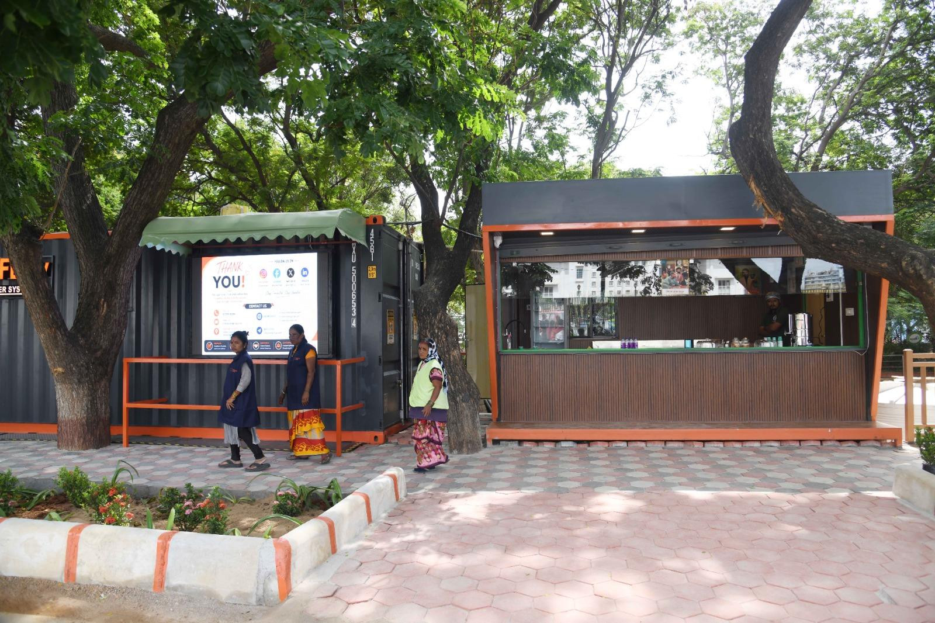


LOOCAFE × REFLOW
How do we make the perfect public toilet?
From a public toilet to a better city.
Vedanth Nath
Karnataka Urban Infrastructure
& Investment Summit 2026
9 September · Conrad Bengaluru
Lumbini Park · Original project photograph, July 2026
Notes:
Hey everybody. I've spent years of my young life thinking about public toilets. A fairly unreasonable amount of time, honestly. Let me take you to a street beside Hussain Sagar.
Source/context: Lumbini Park · Original project photograph, July 2026
Web review slide: 1
Live allocation for this topic: 15 seconds.

Slide 2
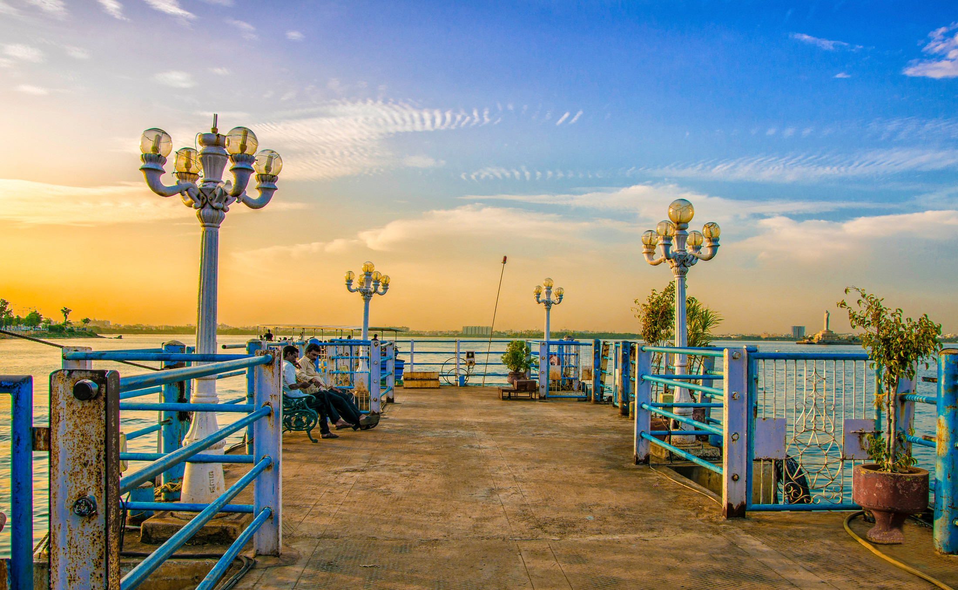
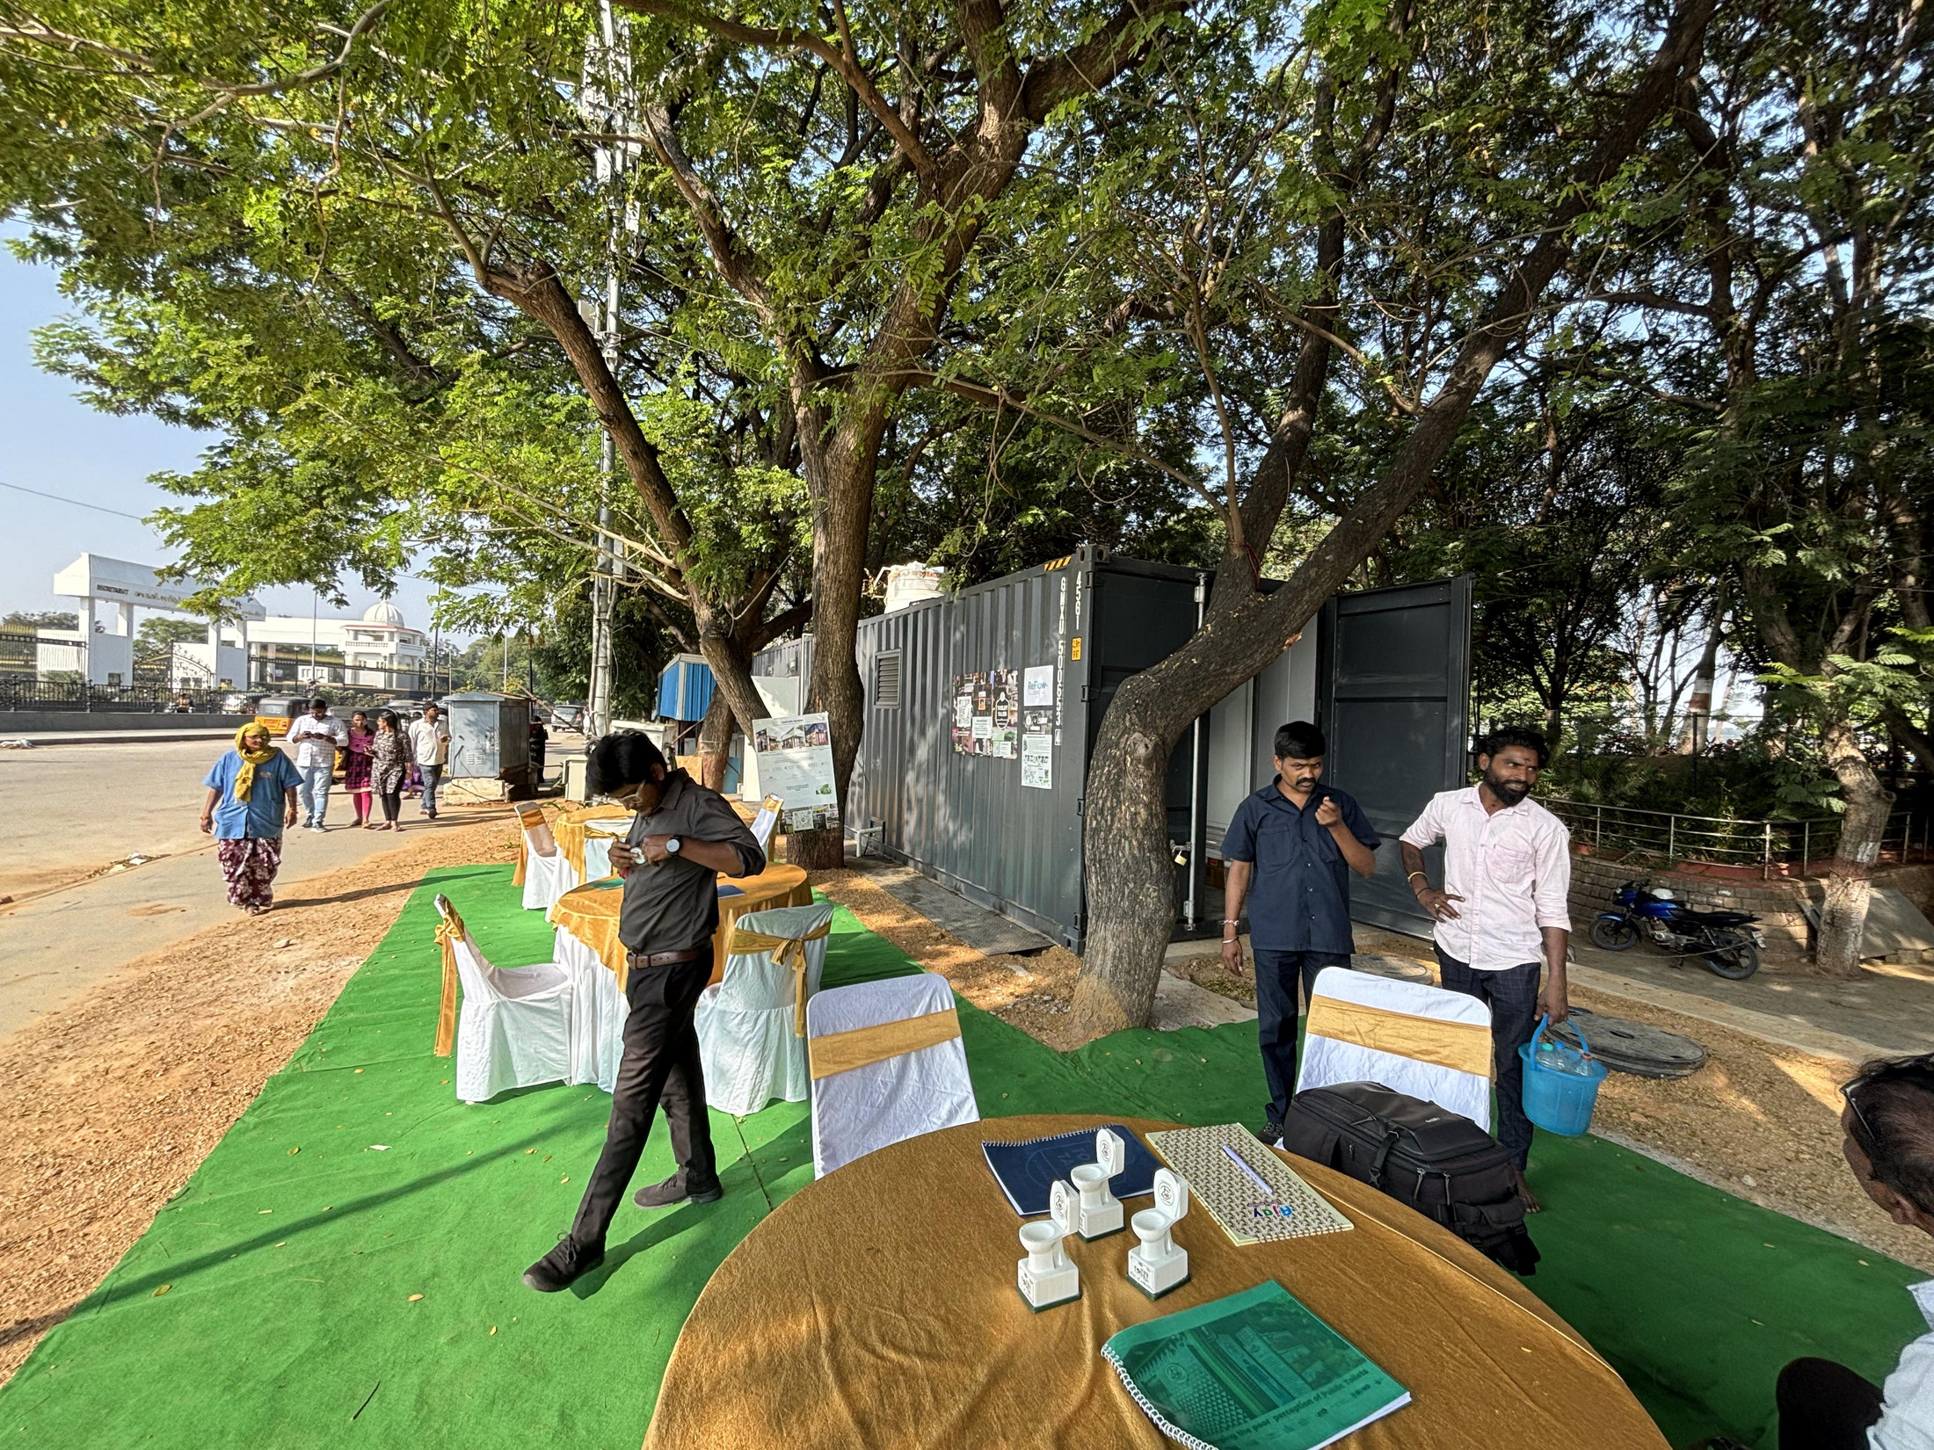
LOOCAFE × REFLOW · THE STREET
The street I grew up with.
A public space has to let people stay.
Hyderabad archive · Photos provide location context, not a documented before/after
02
Notes:
Growing up, I'd come here almost every weekend. Loads of people, something to eat, somewhere to walk. But the toilet was the part you wanted to avoid. Think about women, families and older people. A good public space has to let people stay.
Source/context: Hyderabad archive · Photos provide location context, not a documented before/after
Web review slide: 2
Live allocation for this topic: 20 seconds.

Slide 3
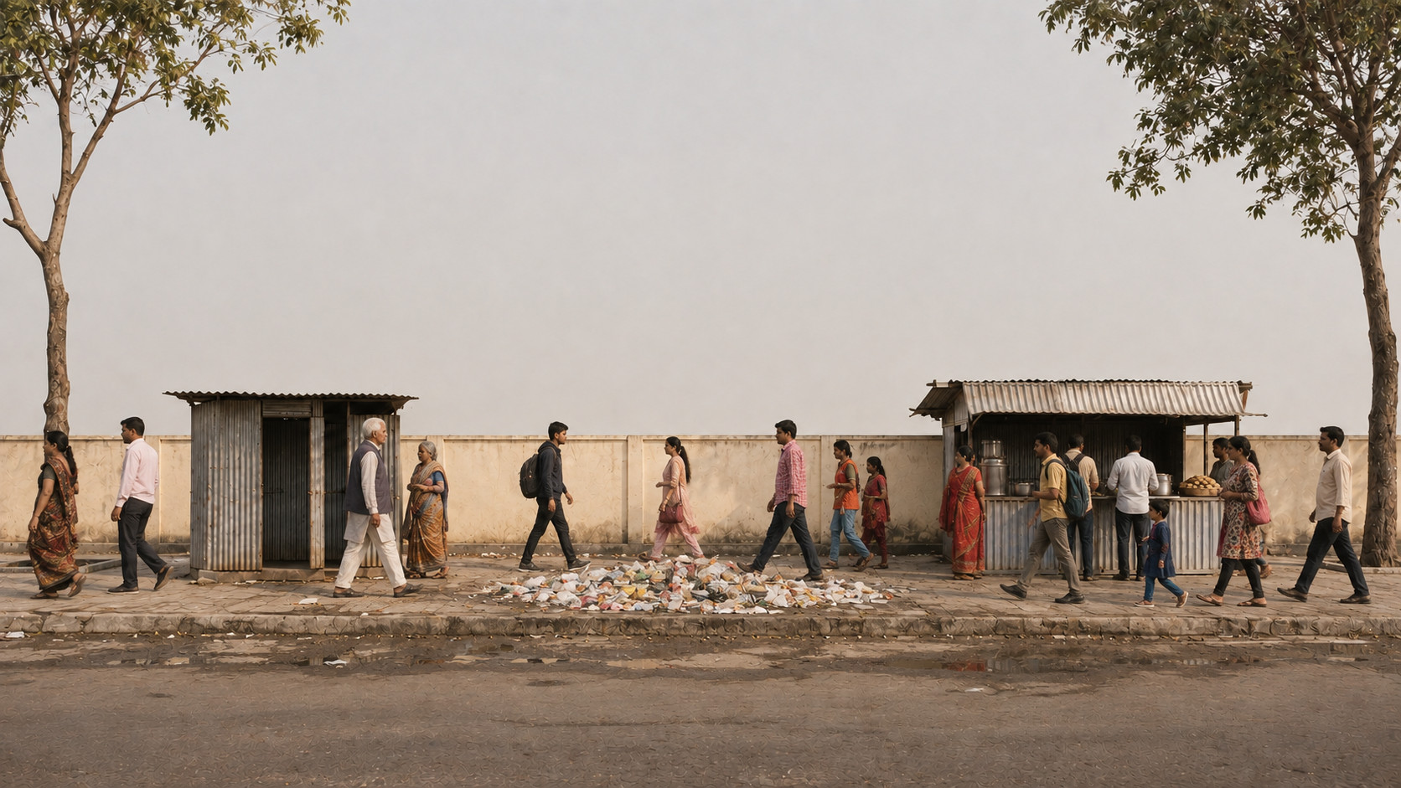
BUILD 1 / 5
This is where we start.
A food stall. Rubbish. A toilet too many people cannot use.
Illustration of the narrated street · Not an as-built reconstruction
Notes:
So, how do we make the perfect public toilet? Let me build the idea with you. Here's our street: a food stall, rubbish and inadequate toilet provision.
Source/context: Illustration of the narrated street · Not an as-built reconstruction
Web review slide: 3 · Street build 1
Live allocation for this topic: 55 seconds.

Slide 4
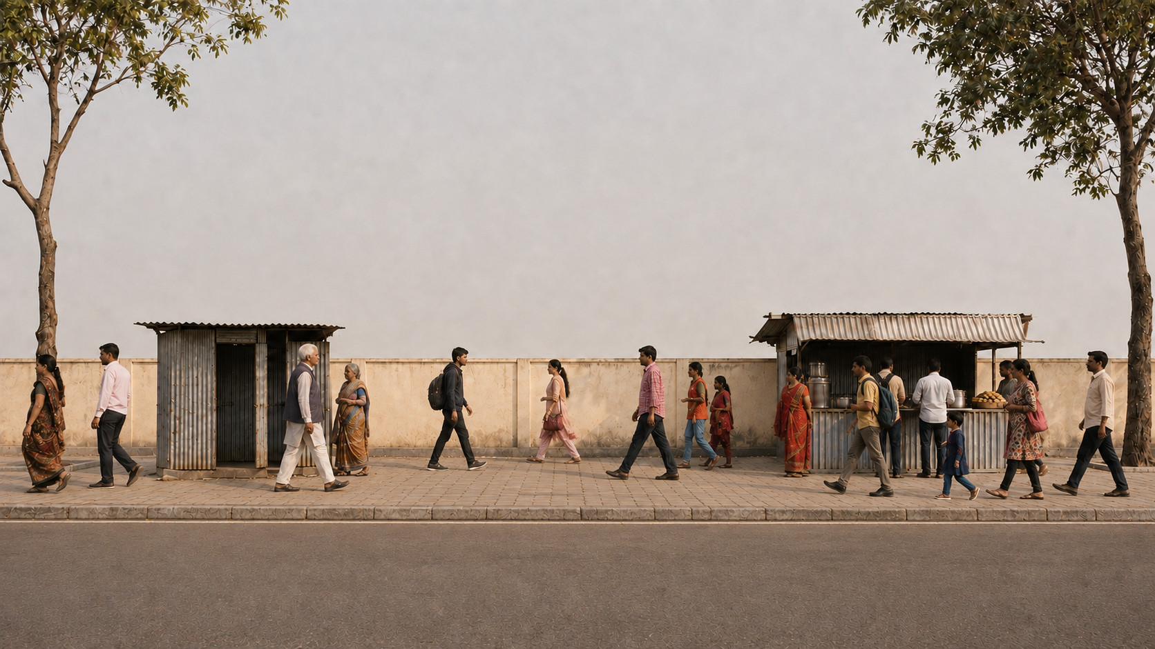
BUILD 2 / 5
First, make room for people.
Clear the rubbish and repair the walking surface.
Illustration of the narrated street · Not an as-built reconstruction
Notes:
First, clear the rubbish and repair the walking surface.
Source/context: Illustration of the narrated street · Not an as-built reconstruction
Web review slide: 3 · Street build 2
Live allocation for this topic: 55 seconds.

Slide 5
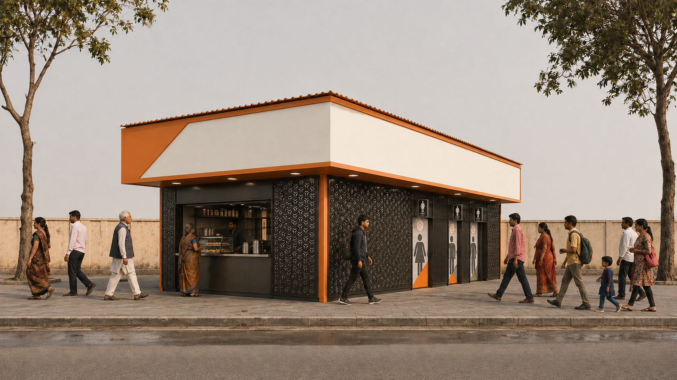
BUILD 3 / 5
One integrated LooCafe.
Shop at the front; toilet entrances on the side and toward the back.
Illustration of the narrated street · Not an as-built reconstruction
Notes:
Then put in one integrated LooCafe. The shop is at the front; the toilets are along the side and toward the back.
Source/context: Illustration of the narrated street · Not an as-built reconstruction
Web review slide: 3 · Street build 3
Live allocation for this topic: 55 seconds.

Slide 6
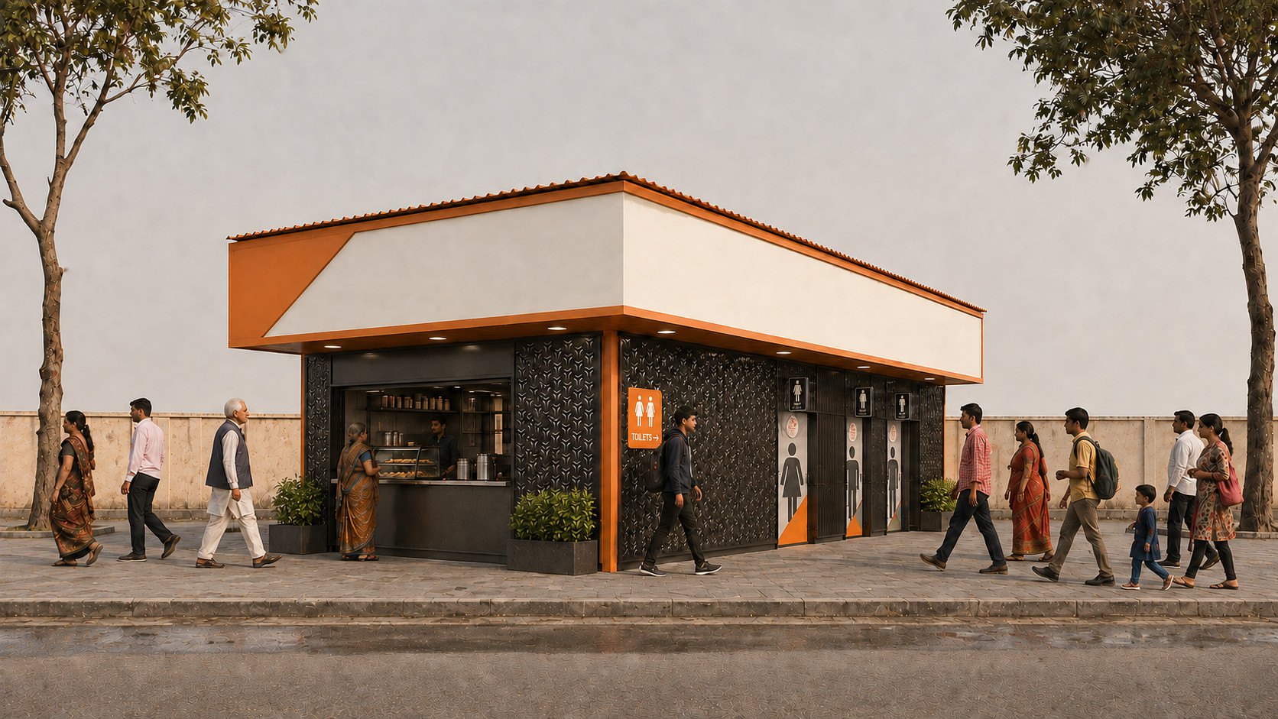
BUILD 4 / 5
The shop supports the service.
SHOP → UPKEEP
The front shop generates revenue to help pay for cleaning and maintenance.
Illustration of the narrated street · Not an as-built reconstruction
Notes:
Now give it a clear entrance, signs and some planting. The shop brings an everyday business into the facility.
Source/context: Illustration of the narrated street · Not an as-built reconstruction
Web review slide: 3 · Street build 4
Live allocation for this topic: 55 seconds.

Slide 7
BUILD 5 / 5
Advertising helps fund upkeep.
ADVERTISING → UPKEEP
Upper advertising panels provide another source of income for upkeep.
Illustration of the narrated street · Not an as-built reconstruction
Notes:
And the panels above it can bring advertising income. The point is to connect the design with a way of keeping it working. Now let's look at the real thing.
Source/context: Illustration of the narrated street · Not an as-built reconstruction
Web review slide: 3 · Street build 5
Live allocation for this topic: 55 seconds.

Slide 8
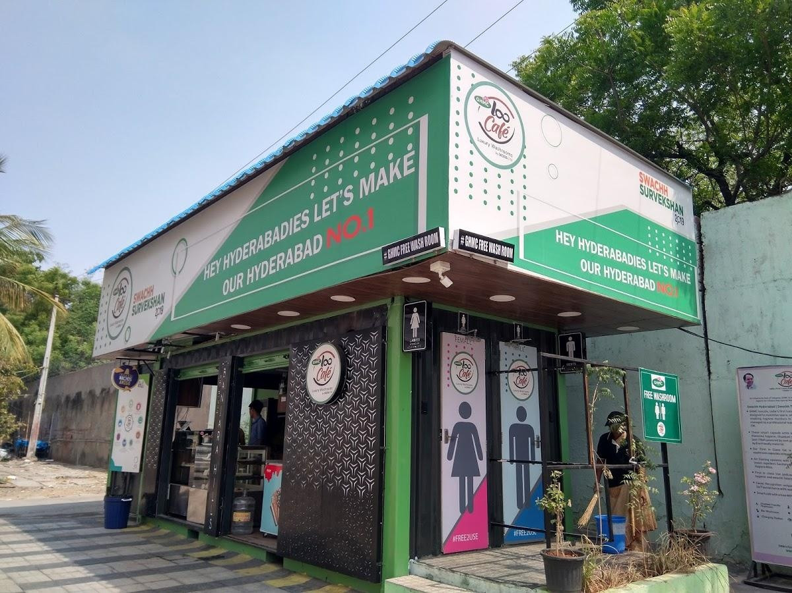
LOOCAFE × REFLOW · THE STREET
This is the standard LooCafe.
1
Toilets along the side
Dedicated entrances keep the toilet access distinct from the shop.
3
2
Shop at the front
The operator’s business helps support daily toilet care.
3
Advertising above
1
Upper panels provide space for advertising income.
2
BANJARA HILLS · ONE INTEGRATED STRUCTURE
Retail at the front. Toilet access along the side. Advertising above.
Sources: loocafe.com/gallery · Company photographs; locations as documented
08
Notes:
This is Banjara Hills. One structure, with different jobs. The shop faces the street. The toilet entrances are along the side. Advertising sits above. But the toilet is the reason the whole thing exists.
Source/context: Sources: loocafe.com/gallery · Company photographs; locations as documented
Web review slide: 4
Live allocation for this topic: 15 seconds.

Slide 9
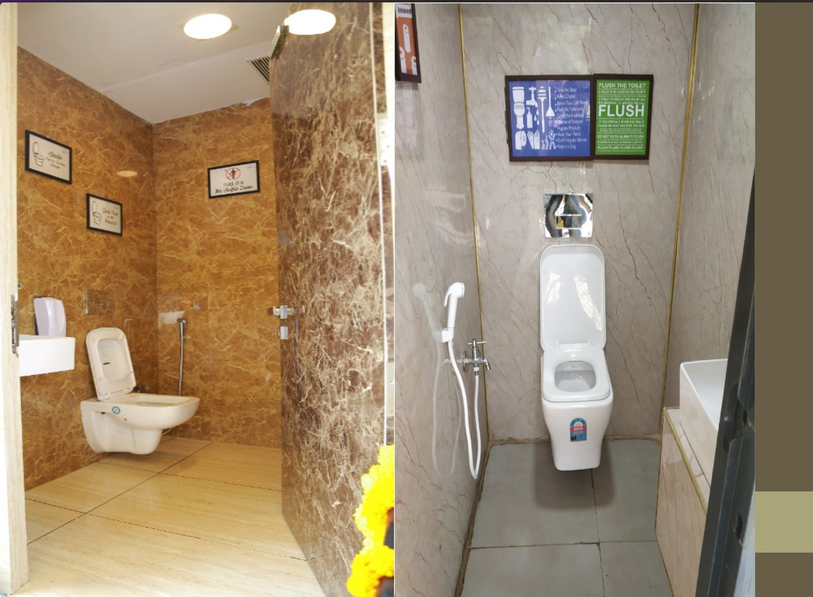
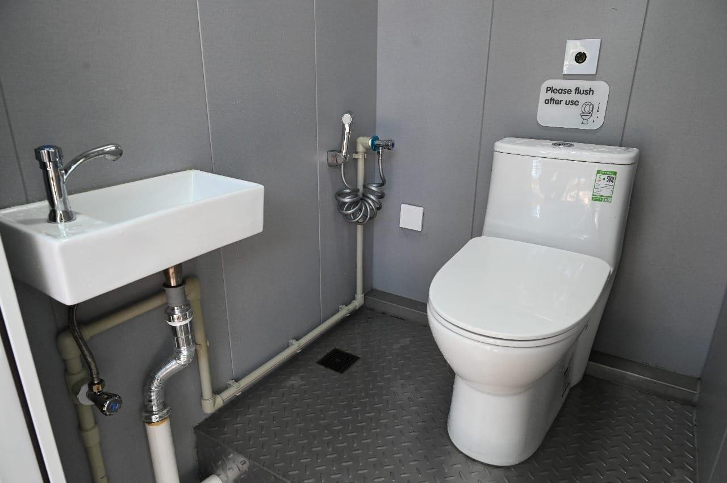
LOOCAFE × REFLOW · THE STREET
Inside the toilet: privacy, fixtures and finish.
Toilet Tales · Enclosed cubicles and finishes
Lumbini Park · WC, washbasin and hand spray
Enclosed cubicles and maintained washing facilities shape the user experience.
Original project / Toilet Tales archive · Interior and entrance details across sites
09
Notes:
Look inside: privacy, a washbasin, fixtures and finishes. The public toilet has to feel like somewhere you can comfortably use—not somewhere you need to escape.
Source/context: Original project / Toilet Tales archive · Interior and entrance details across sites
Web review slide: 5
Live allocation for this topic: 12 seconds.

Slide 10
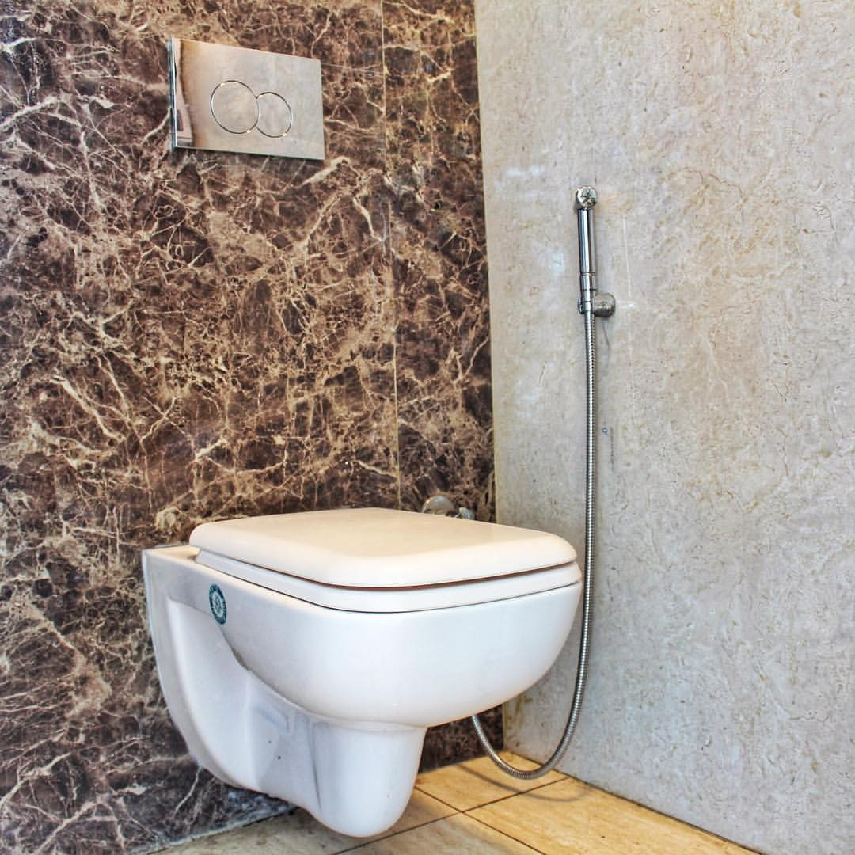
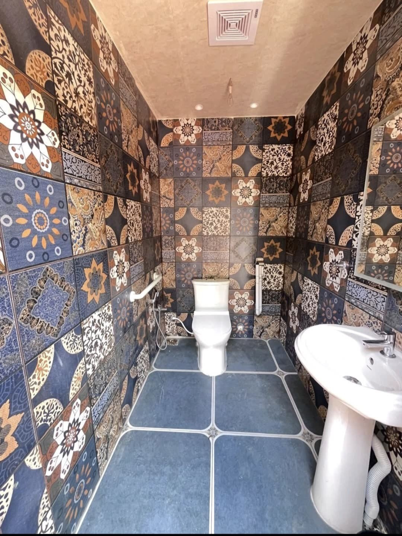
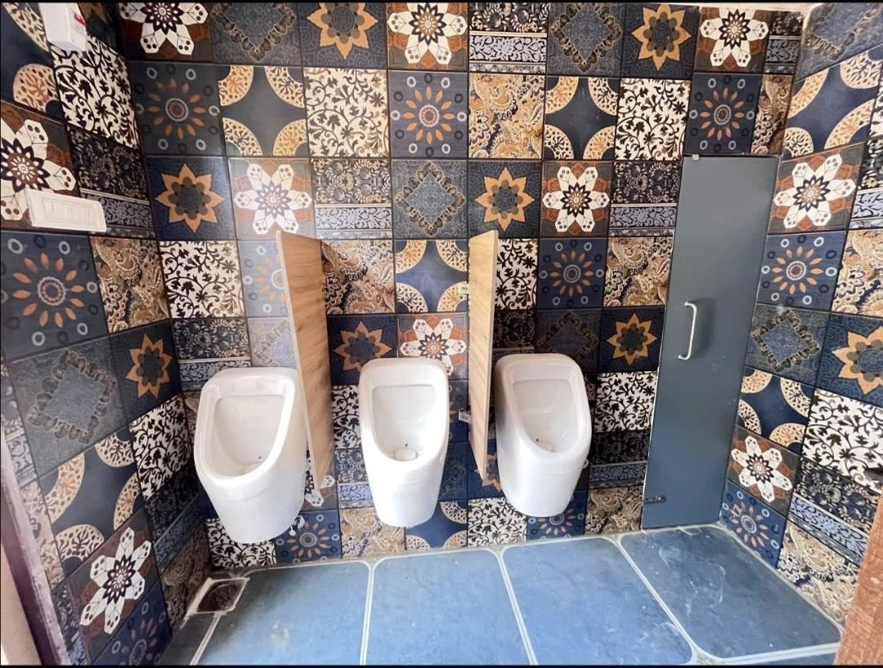
LOOCAFE × REFLOW · THE STREET
“Make sure that it looks really awesome.”
Enclosed WC · Wall finish and handheld wash fixture
Tiled cubicle · WC and washbasin
Urinal bay · Fixture arrangement
Private cubicles, deliberate finishes and clearly arranged fixtures.
Sources: loocafe.com/gallery · Company photographs; locations as documented
10
Notes:
Make sure that it looks really awesome. That's the standard we want to set. Aspiration belongs in public infrastructure too.
Source/context: Sources: loocafe.com/gallery · Company photographs; locations as documented
Web review slide: 6
Live allocation for this topic: 10 seconds.

Slide 11
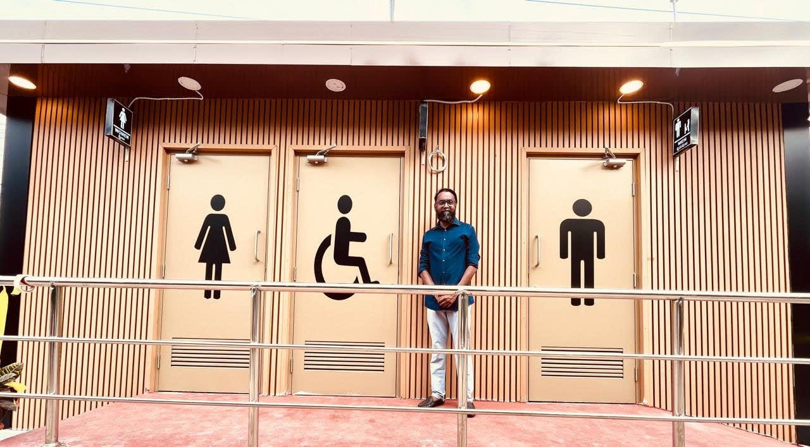
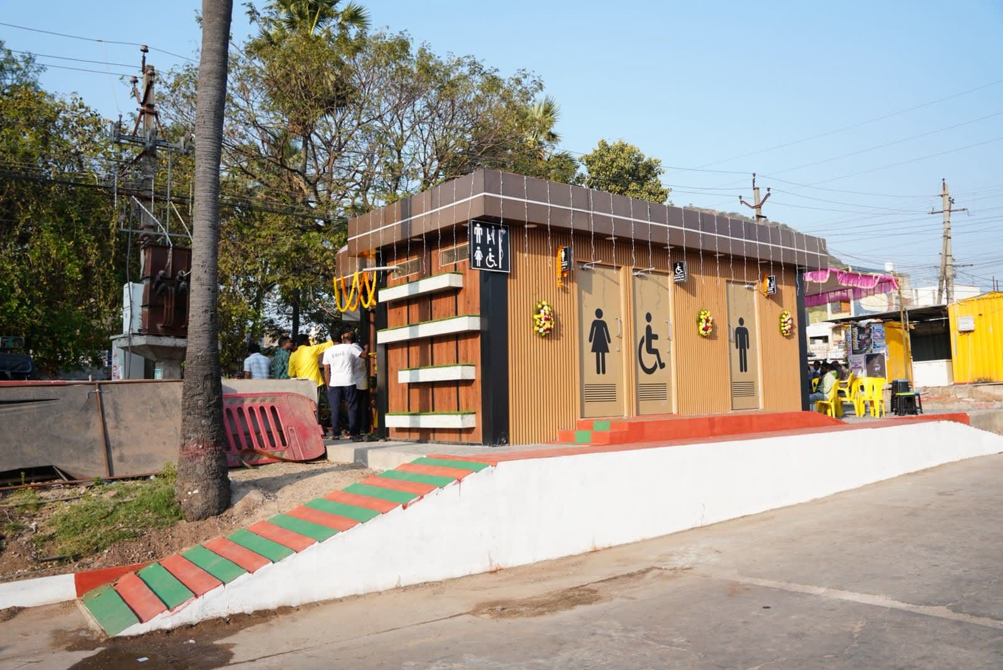
LOOCAFE × REFLOW · THE STREET
The entrance is part of the toilet.
Mangalagiri · Entrance signs and handrails
Mangalagiri · Facility and landscaped approach
Make the facility visible, identify the entrances and keep the approach clear.
Sources: loocafe.com/gallery · Company photographs; locations as documented
11
Notes:
The experience starts at the entrance. Can you find it? Is the approach clear? Safety and access begin on the street.
Source/context: Sources: loocafe.com/gallery · Company photographs; locations as documented
Web review slide: 7
Live allocation for this topic: 10 seconds.

Slide 12
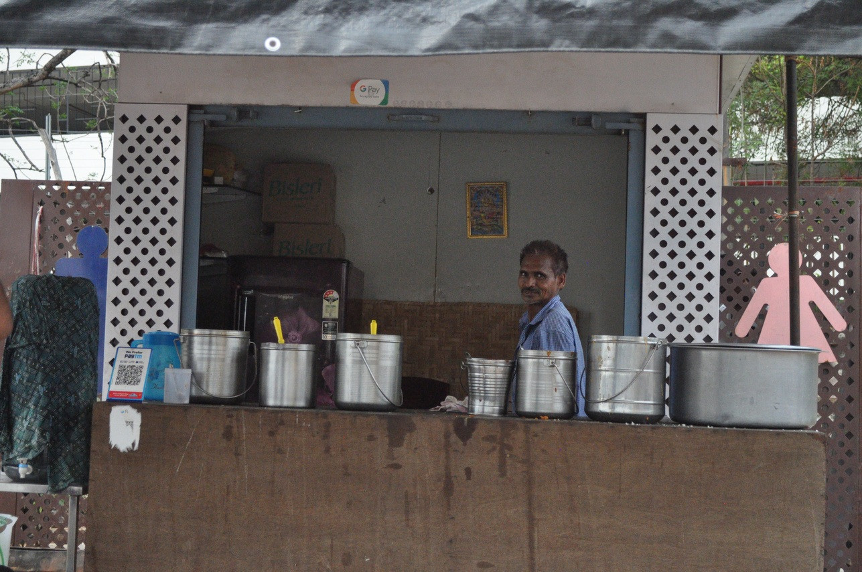
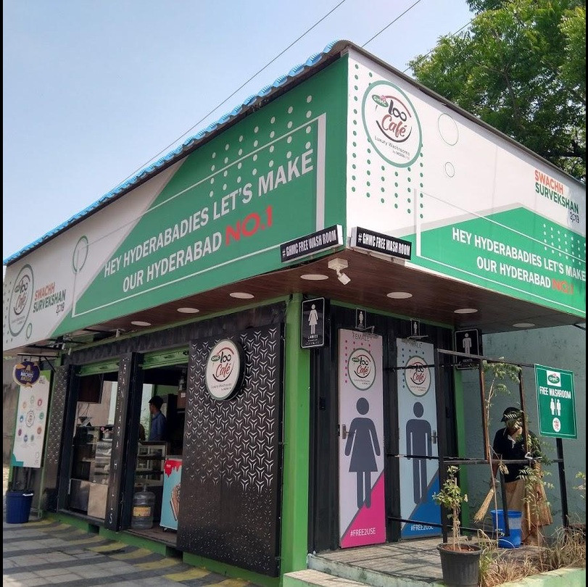
LOOCAFE × REFLOW · THE STREET
The front shop helps fund the toilets behind it.
Retail and advertising revenue help pay for cleaning and maintenance.
Toilet Tales archive · Retail and advertising surfaces; operating-model explanation
12
Notes:
Why the shop? Because cleaning costs money every day. The business and advertising income help support the toilets. There's also someone present whom you can ask for help. But the toilet is at the forefront. The operating agreement has to connect the business with that responsibility.
Source/context: Toilet Tales archive · Retail and advertising surfaces; operating-model explanation
Web review slide: 8
Live allocation for this topic: 25 seconds.

Slide 13
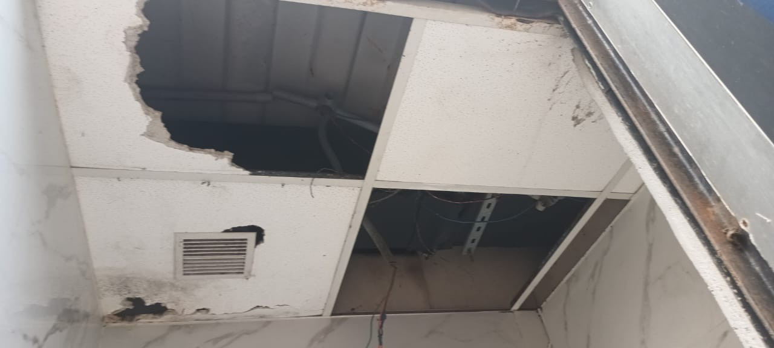
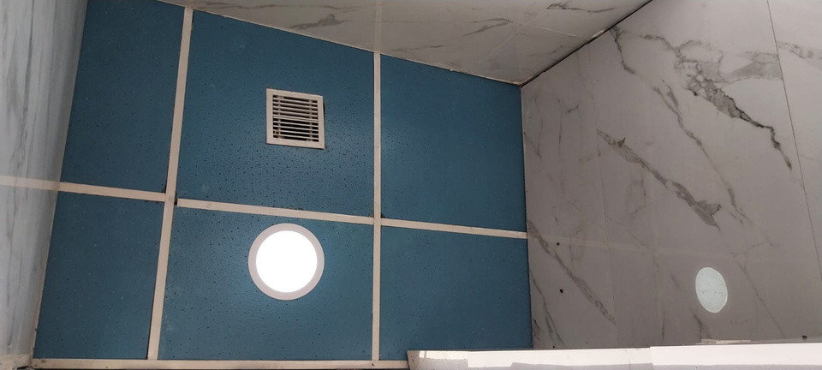
LOOCAFE × REFLOW · THE STREET
ACCOUNTABILITY
Damaged ceiling · Before section, 9 September 2024
Ceiling photograph · Status report, 13 September 2024
Notice the fault. Assign the repair. Check the work.
Dog Park, Gachibowli · Site status report, 13 Sep 2024, pp. 7 & 10 · Different camera views
13
Notes:
Look at the ceiling. This is why accountability matters after opening day. These photographs come from the Dog Park maintenance report. Who notices the fault? Who arranges the repair? Who checks the work? That's the system we need around the building.
Source/context: Dog Park, Gachibowli · Site status report, 13 Sep 2024, pp. 7 & 10 · Different camera views
Web review slide: 10
Live allocation for this topic: 20 seconds.

Slide 14
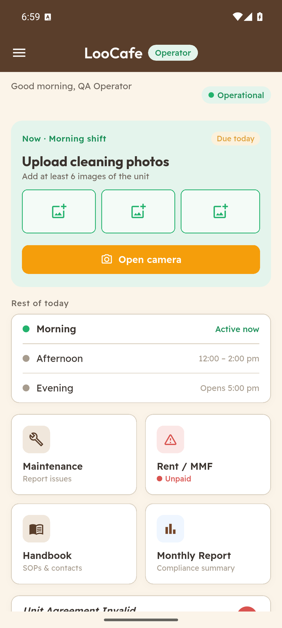
LOOCAFE × REFLOW · THE STREET
The operator knows what is due today.
A clear task
The active shift asks for at least six unit photographs.
A daily schedule
Morning, afternoon and evening are shown together.
One place to act
Maintenance, handbook and monthly reporting are available from home.
Daily cleaning records belong in the operating routine.
Actual Android emulator capture · Local QA operator and unit; demonstration data
14
Notes:
This is our actual operator app, using a test account. Cleaning photographs, shifts, maintenance and the handbook are right there. A clear daily routine on the operator's phone.
Source/context: Actual Android emulator capture · Local QA operator and unit; demonstration data
Web review slide: 12
Live allocation for this topic: 15 seconds.

Slide 15
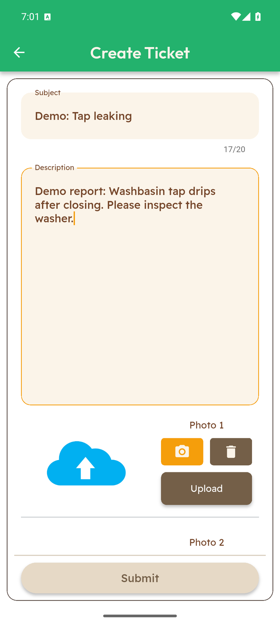
LOOCAFE × REFLOW · THE STREET
Turn a problem into a maintenance ticket.
Describe the problem
A short title and a detailed description record what needs attention.
Show the evidence
The form provides photo uploads alongside the report.
Keep the record
Submitted issues can be reviewed in ticket history.
Describe the issue and attach photographs for review.
Actual Android emulator capture · Illustrative draft entered in the app; not submitted
15
Notes:
Here's an example entered into the actual app: a leaking tap. Describe it, add photographs, and give the next person something concrete to act on. Reporting starts the process. Following it through is the responsibility.
Source/context: Actual Android emulator capture · Illustrative draft entered in the app; not submitted
Web review slide: 13
Live allocation for this topic: 15 seconds.

Slide 16
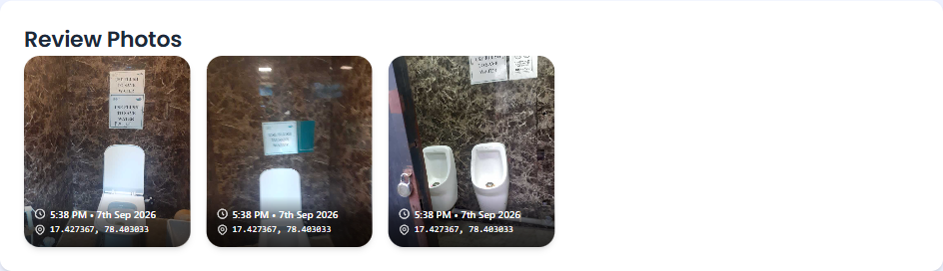
LOOCAFE × REFLOW · THE STREET
Open the record. Inspect the photographs.
Actual submitted review · Toilet and urinal photographs with recorded time and location
The dashboard brings the submitted photographs, time and location together.
Actual dashboard.loocafe.com capture · LC_ID_023 evening review, 7 Sep 2026 · Submitted record, not independent verification
16
Notes:
And here's the real dashboard photo review. Open the unit's record and inspect the photographs. The record makes the condition visible; follow-up makes accountability work.
Source/context: Actual dashboard.loocafe.com capture · LC_ID_023 evening review, 7 Sep 2026 · Submitted record, not independent verification
Web review slide: 14
Live allocation for this topic: 12 seconds.

Slide 17
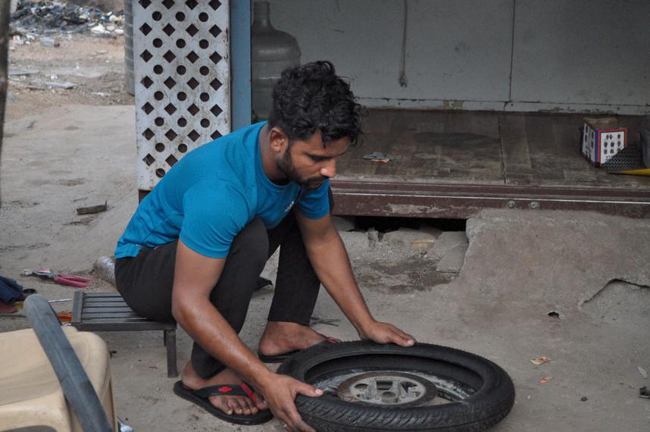
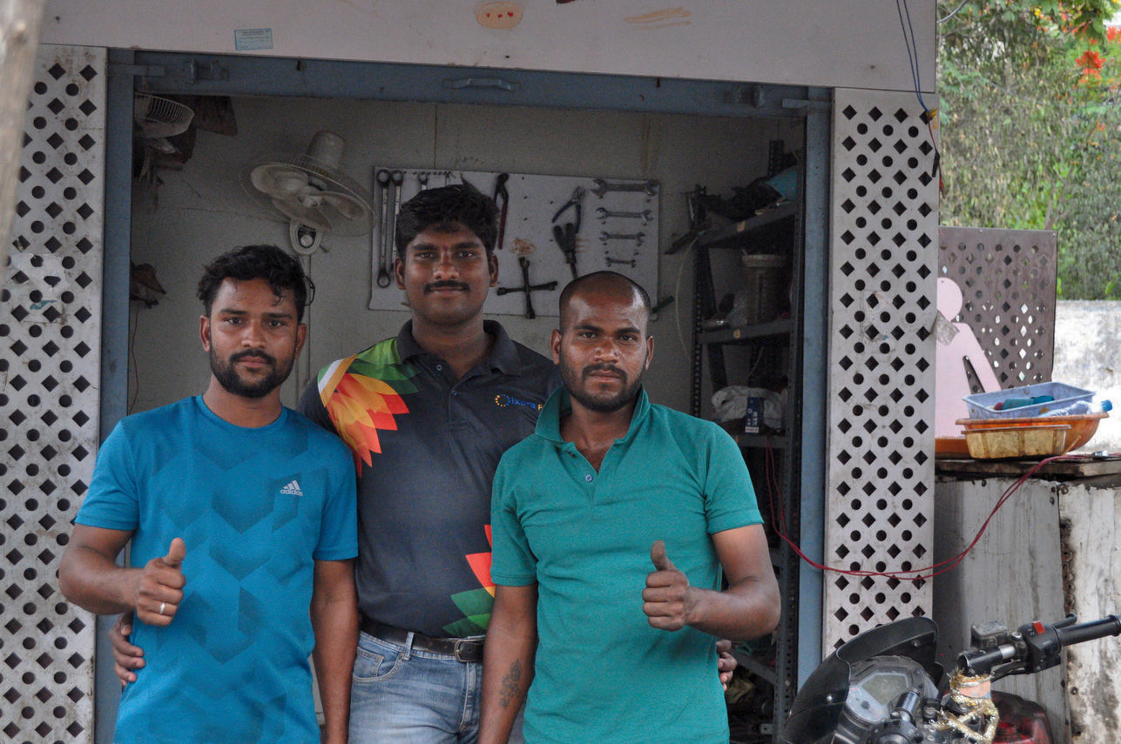
LOOCAFE × REFLOW · THE STREET
A livelihood, with responsibility.
Asif repairing a wheel
Group photograph at the repair workspace
A skill
A business
A daily responsibility
Bike repair, learned from his father.
A repair shop beside LooCafe Mini.
Toilet care before repair work.
Asif paired a LooCafe Mini with bike repair, and made toilet care part of his day.
Toilet Tales 2.1, p. 27 · Asif profile and original photographs
17
Notes:
This is Asif, from Toilet Tales. He paired a Mini with bike repair, using skills his father taught him. His day began with toilet care, then repair work. That's agency: a business and responsibility for a public service.
Source/context: Toilet Tales 2.1, p. 27 · Asif profile and original photographs
Web review slide: 15
Live allocation for this topic: 20 seconds.

Slide 18
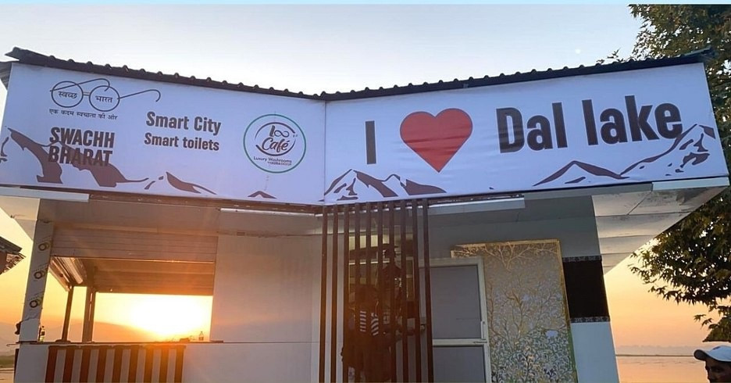
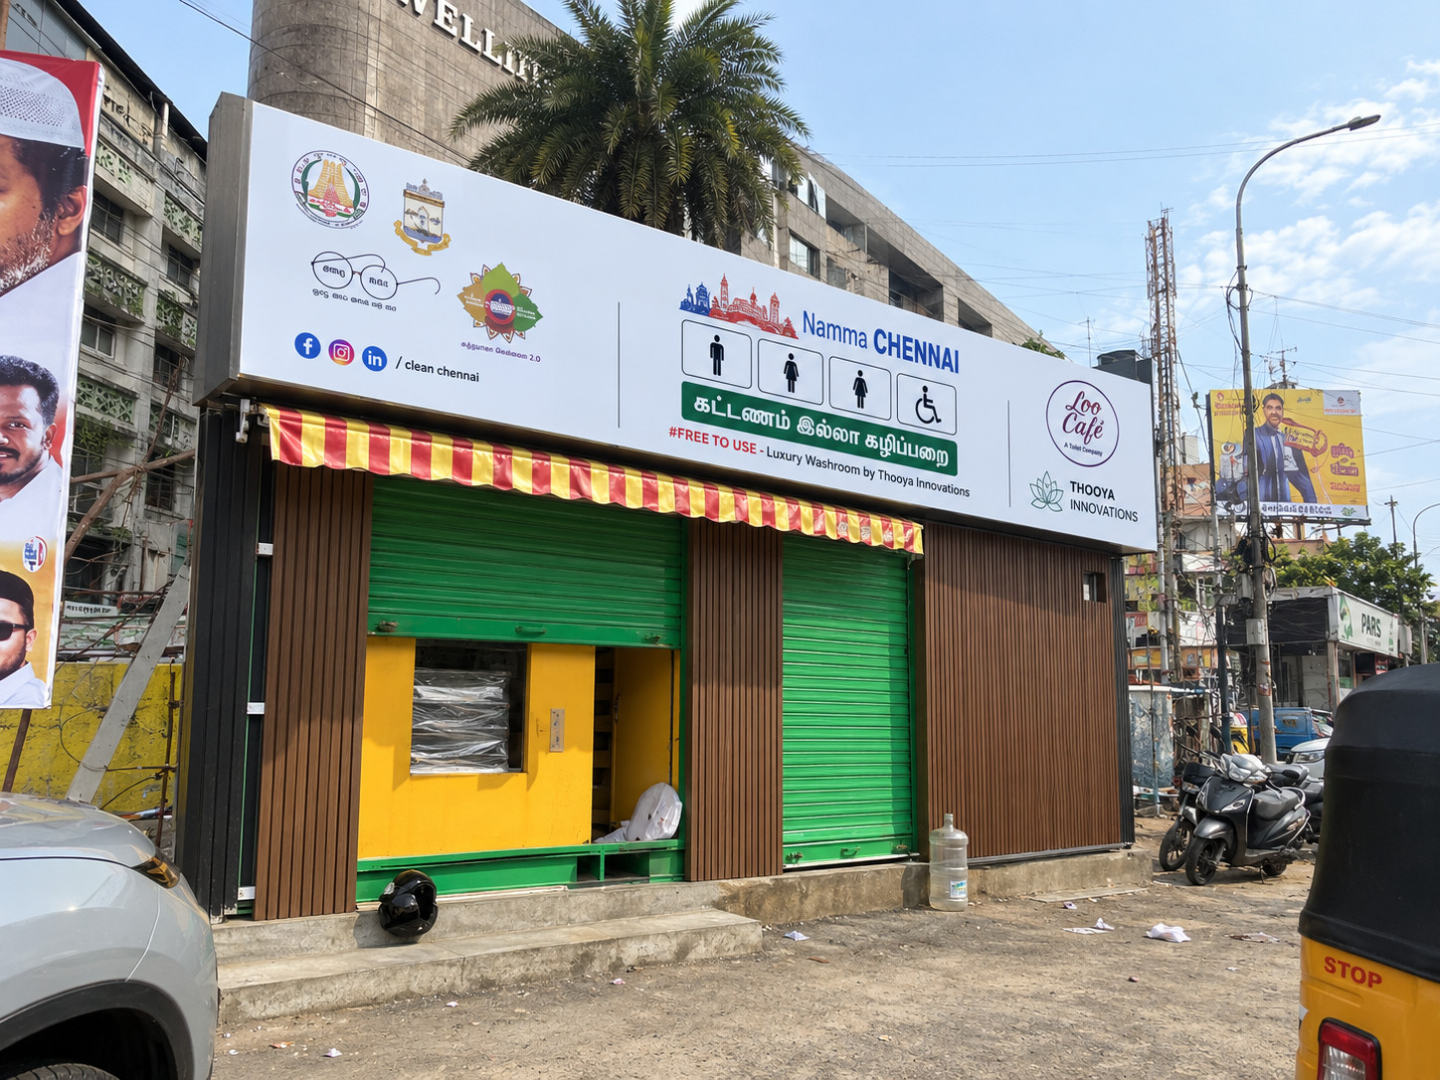
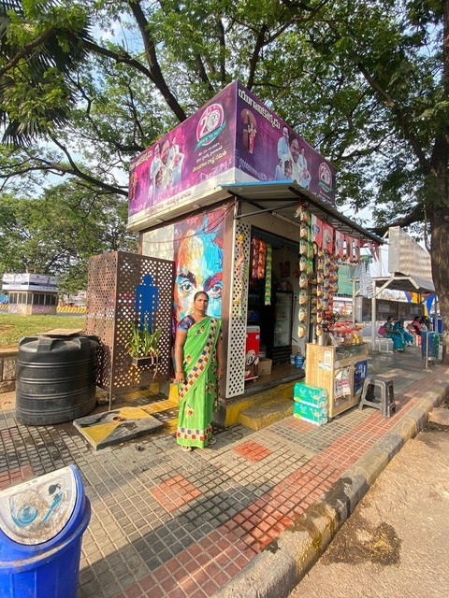
LOOCAFE × REFLOW · THE STREET
Different streets. A repeatable service.
Different site formats use the same link between business income and toilet care.
Original archive · Dal Lake, Chennai and Mini examples; not all are ReFlow installations
18
Notes:
The format changes with the site: a Mini, a larger unit, a different business alongside it. Repeat the service principle, then adapt the physical design.
Source/context: Original archive · Dal Lake, Chennai and Mini examples; not all are ReFlow installations
Web review slide: 16
Live allocation for this topic: 12 seconds.

Slide 19
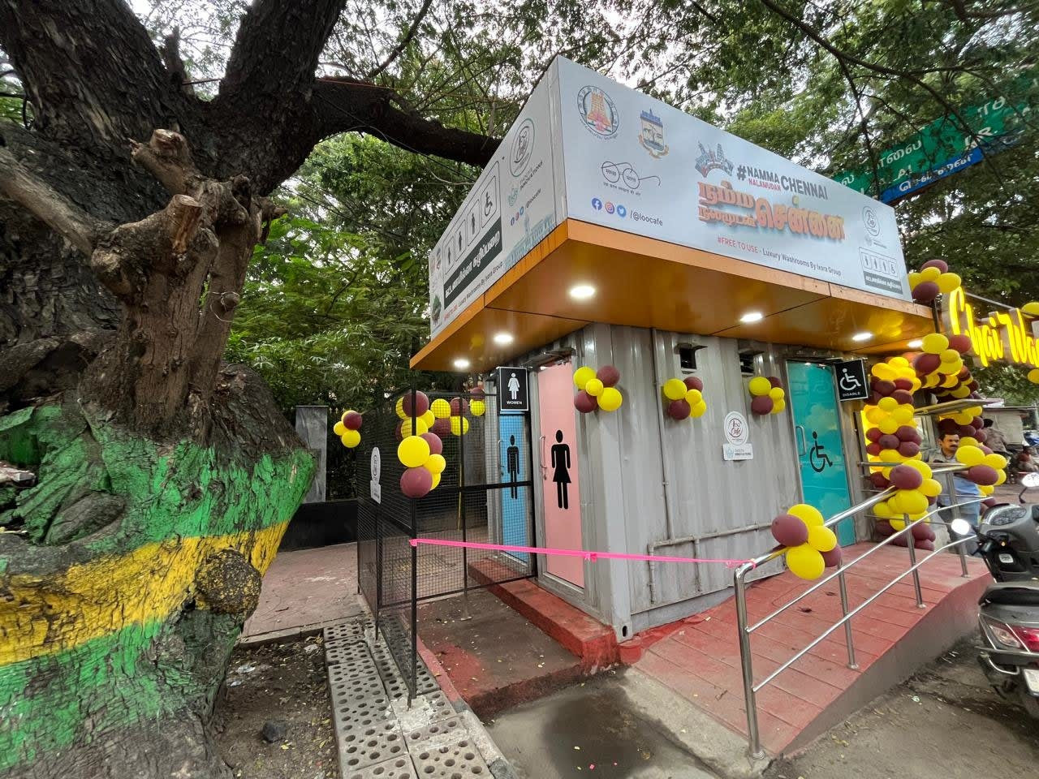
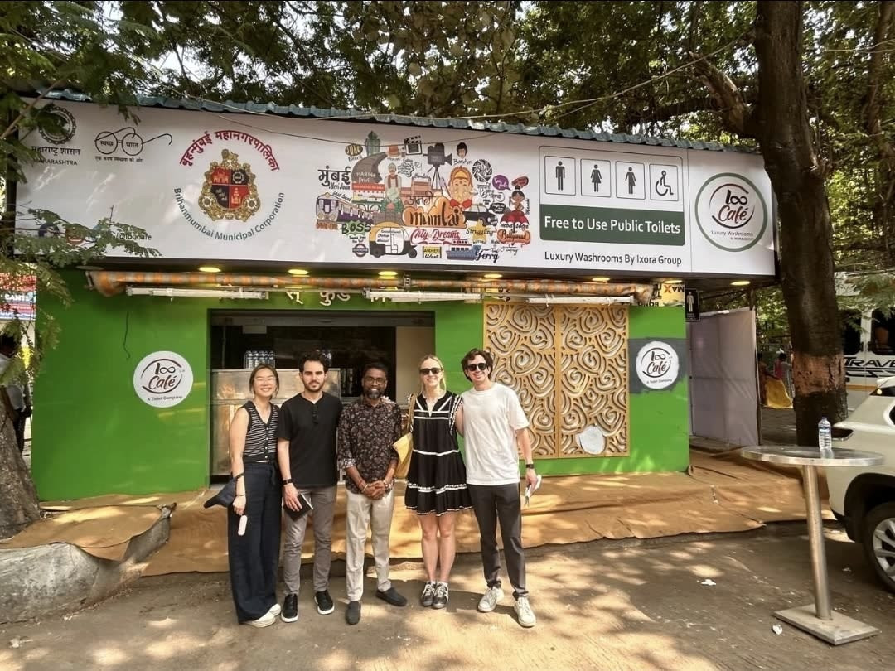
LOOCAFE × REFLOW · THE STREET
Our footprint: different cities and settings.
Mangalagiri
Chennai
Mumbai
Andhra Pradesh
Tamil Nadu
Maharashtra
Landscaped unit
Street-side unit
BMC-linked facility
Each location needs a suitable site, a working toilet and a maintenance plan.
Sources: loocafe.com/gallery · Company photographs; locations as documented
19
Notes:
Here are different LooCafe settings: Mangalagiri, Chennai and Mumbai. The footprint is more than a number. Space, users and operating conditions change. The model has to travel with a maintenance plan, not just a container.
Source/context: Sources: loocafe.com/gallery · Company photographs; locations as documented
Web review slide: 17
Live allocation for this topic: 15 seconds.

Slide 20
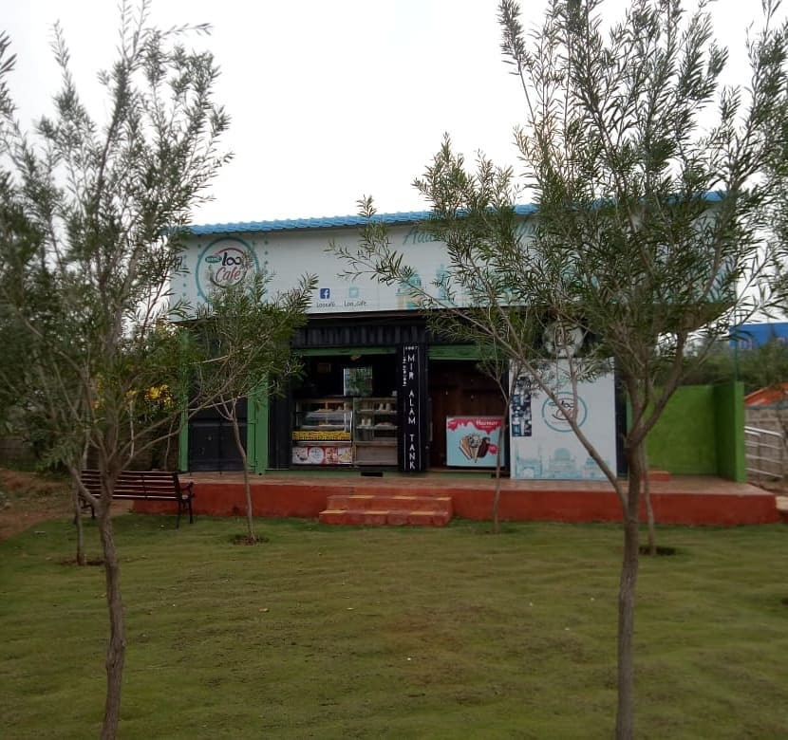
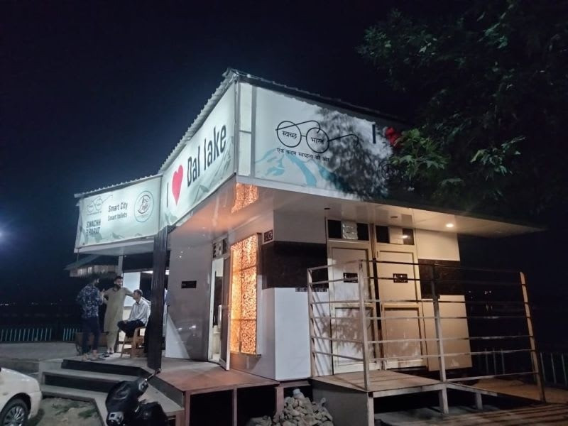
LOOCAFE × REFLOW · THE STREET
From Hyderabad parks to Dal Lake.
Mir Alam Park · Public park setting
Dal Lake, Srinagar · Night-time frontage
Mir Alam Park, Hyderabad · Dal Lake, Srinagar
Sources: loocafe.com/gallery · Company photographs; locations as documented
20
Notes:
Here it is beside Dal Lake. Different surroundings bring different access and utility constraints. The site plan has to work as carefully as the toilet design.
Source/context: Sources: loocafe.com/gallery · Company photographs; locations as documented
Web review slide: 18
Live allocation for this topic: 12 seconds.

Slide 21
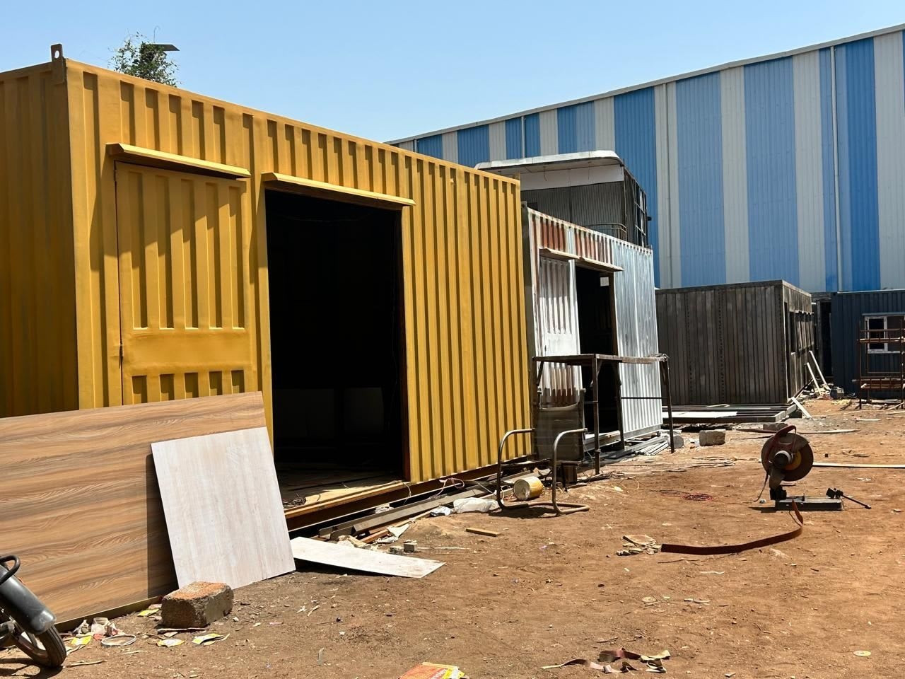
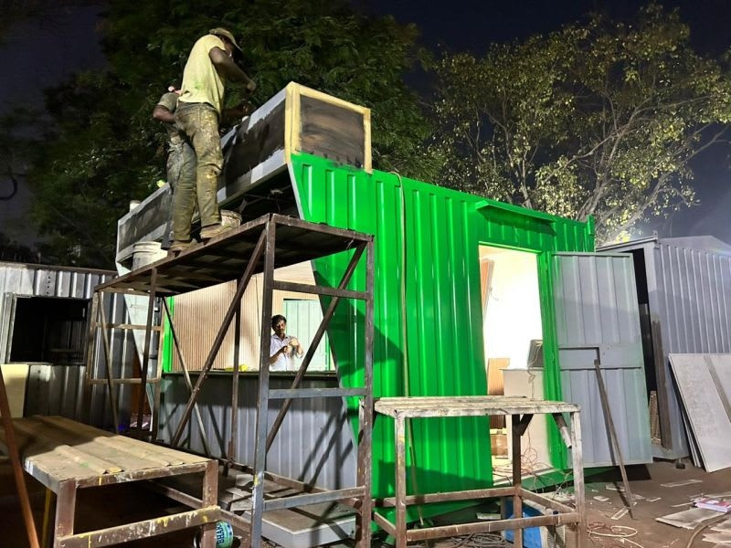
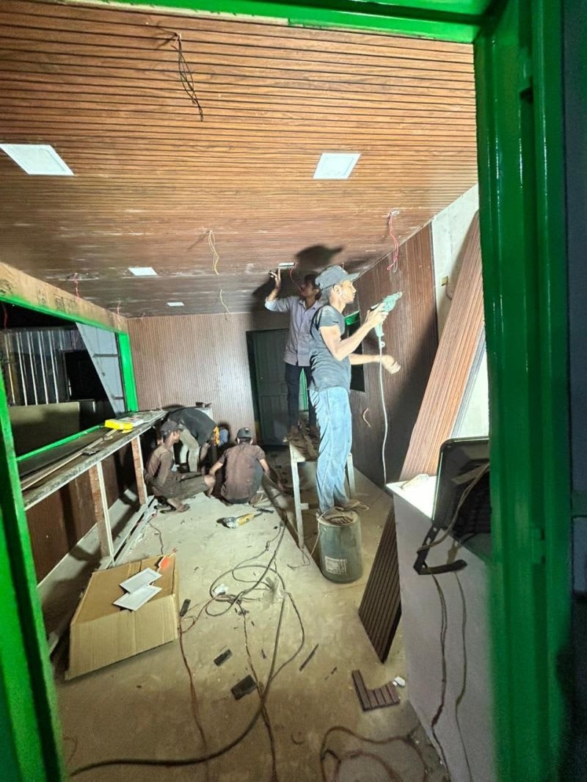
LOOCAFE × REFLOW · THE STREET
Scalability starts in the workshop.
1 · Enclosure
2 · Exterior
3 · Interior
Build the structure
Fabricate and finish
Fit the usable space
Container conversion
Exterior workshop view
Interior fit-out
At every site: prepare, install, commission and maintain.
Sources: loocafe.com/gallery · Company photographs; locations as documented
21
Notes:
Scalability starts in the workshop: repeat the fabrication, fit the interior, prepare the components. Then match the product to the site. Commissioning and operations make it a working service.
Source/context: Sources: loocafe.com/gallery · Company photographs; locations as documented
Web review slide: 20
Live allocation for this topic: 15 seconds.

Slide 22
LOOCAFE × REFLOW · BELOW THE STREET
But where does the flush go?
URBAN INDIA · 2020 INVENTORY
NTR SAMADHI MINI · COMPANY RECORD
Estimated sewage generation
10 metres
72.4
billion L/day
The unit moved.
The drain connection did not follow.
Actual STP utilisation
20.2
billion L/day
Mini
→
New site
Our 11 April 2023 letter reports no drain connection at the new location.
Historical national baseline, not current coverage or ReFlow performance.
Choose the treatment route. Fund the operation. Verify the result.
CPCB, March 2021, Fig. 3.1: 2020 inventory · Ixora relocation letter, 11 Apr 2023: company-reported case
22
Notes:
Now come back to the street. At NTR Marg, our April 2023 letter reported a Mini moved just ten metres, with no drain connection at the new spot. The container moved. The sanitation problem came with it. These CPCB figures show the wider treatment challenge: a historical national baseline, not our results. So where does the flush go, and who keeps that route working?
Source/context: CPCB, March 2021, Fig. 3.1: 2020 inventory · Ixora relocation letter, 11 Apr 2023: company-reported case
https://cpcb.gov.in/openpdffile.php?id=UmVwb3J0RmlsZXMvMTIyOF8xNjE1MTk2MzIyX21lZGlhcGhvdG85NTY0LnBkZg%3D%3D
Web review slide: 22
Live allocation for this topic: 30 seconds.

Slide 23
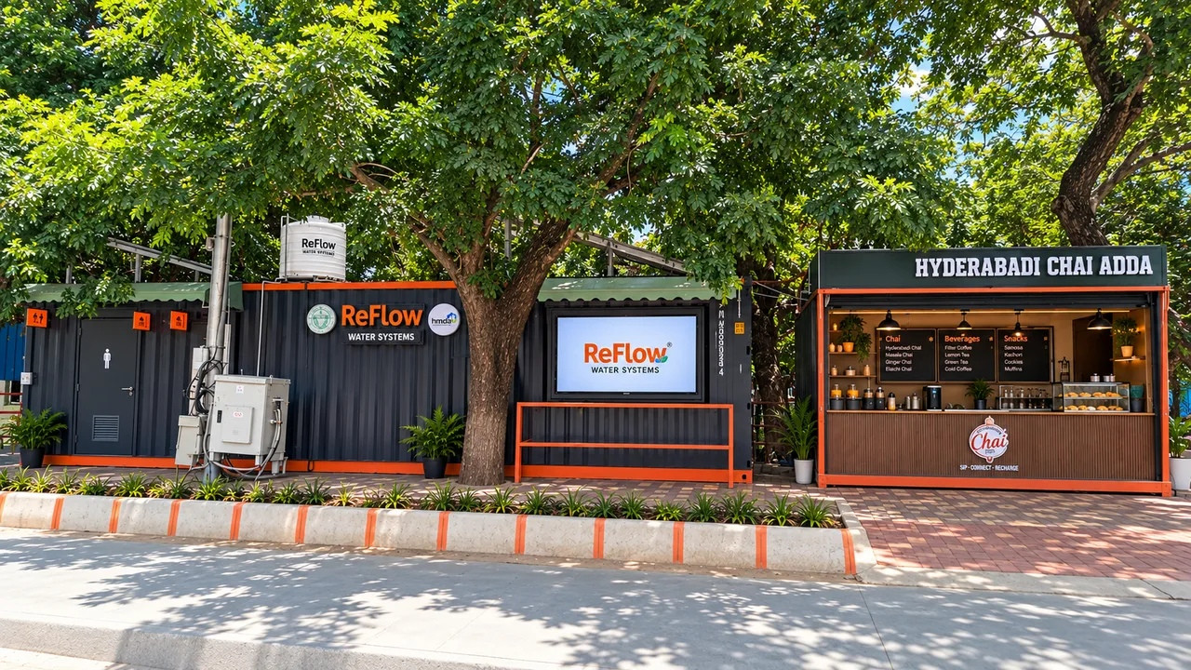
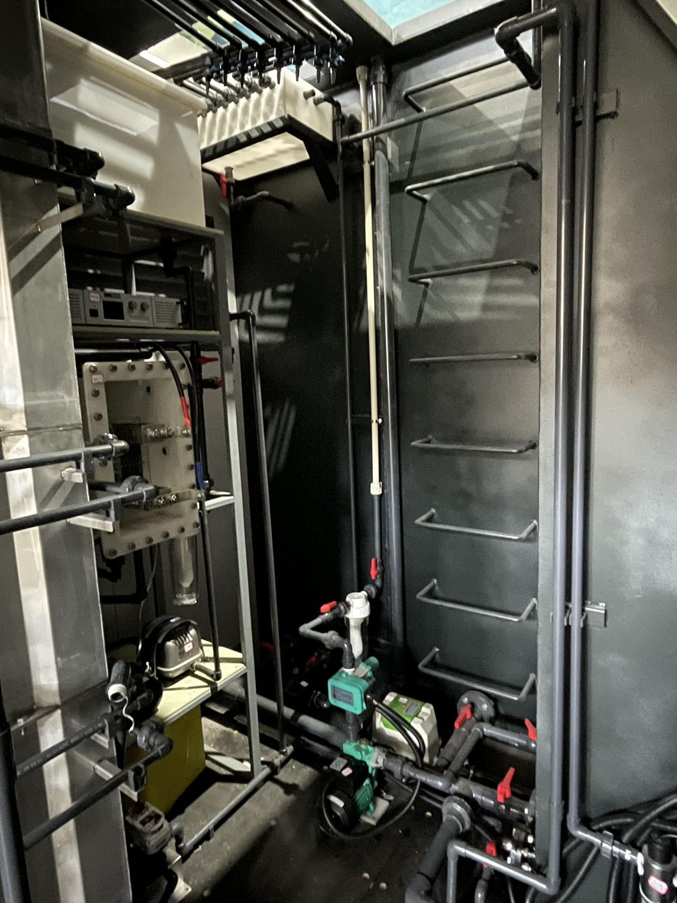
LOOCAFE × REFLOW · BELOW THE STREET
Bring treatment to the site.
Lumbini Park · ReFlow installation and adjoining kiosk
Factory view · Treatment equipment and pipework
The service bay contains the treatment equipment behind the public toilets.
Original Lumbini and factory photographs · Factory equipment is labelled separately
23
Notes:
That's where ReFlow comes in. Here is Lumbini Park and a factory equipment view. Treatment becomes part of the toilet infrastructure, returning water for a defined use: flushing.
Source/context: Original Lumbini and factory photographs · Factory equipment is labelled separately
Web review slide: 23
Live allocation for this topic: 15 seconds.

Slide 24
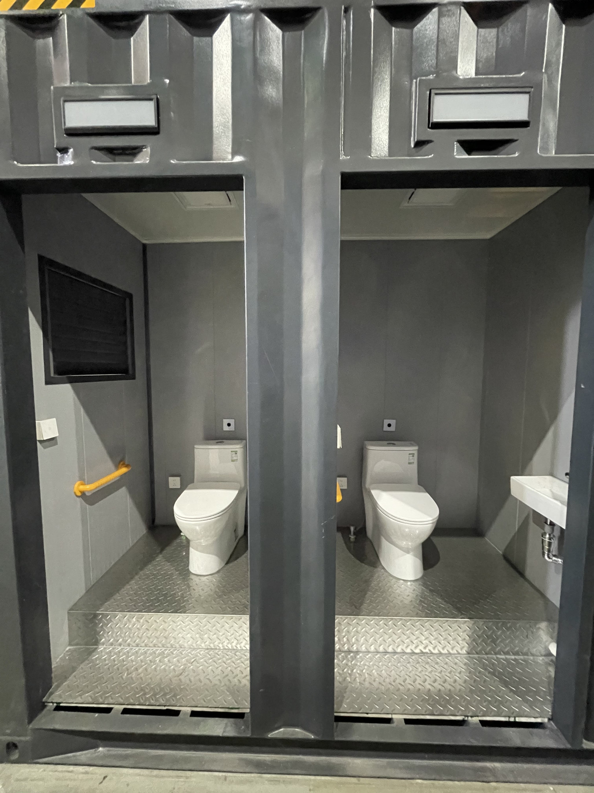
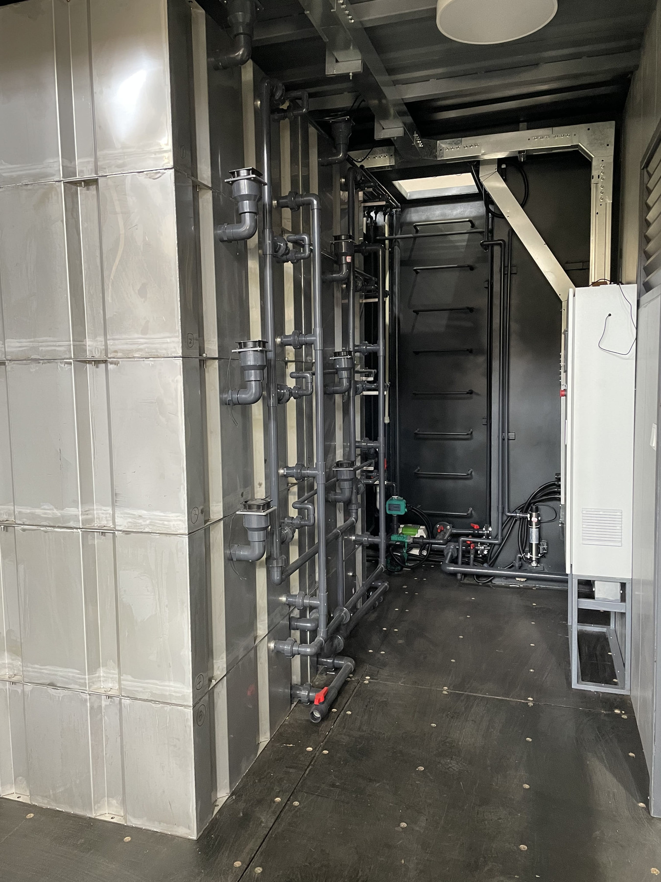
LOOCAFE × REFLOW · BELOW THE STREET
The public side and the service side.
Factory cubicles · User-facing space
Factory treatment passage · Service access
Separate the user experience from access to the treatment equipment.
Sources: loocafe.com/gallery · Company photographs; locations as documented
24
Notes:
There are two sides to this design. The user needs a good cubicle. The maintenance team needs to reach the tanks, pumps and pipework. Both have to work. An attractive enclosure with equipment you can't service is an unfinished design.
Source/context: Sources: loocafe.com/gallery · Company photographs; locations as documented
Web review slide: 25
Live allocation for this topic: 15 seconds.

Slide 25
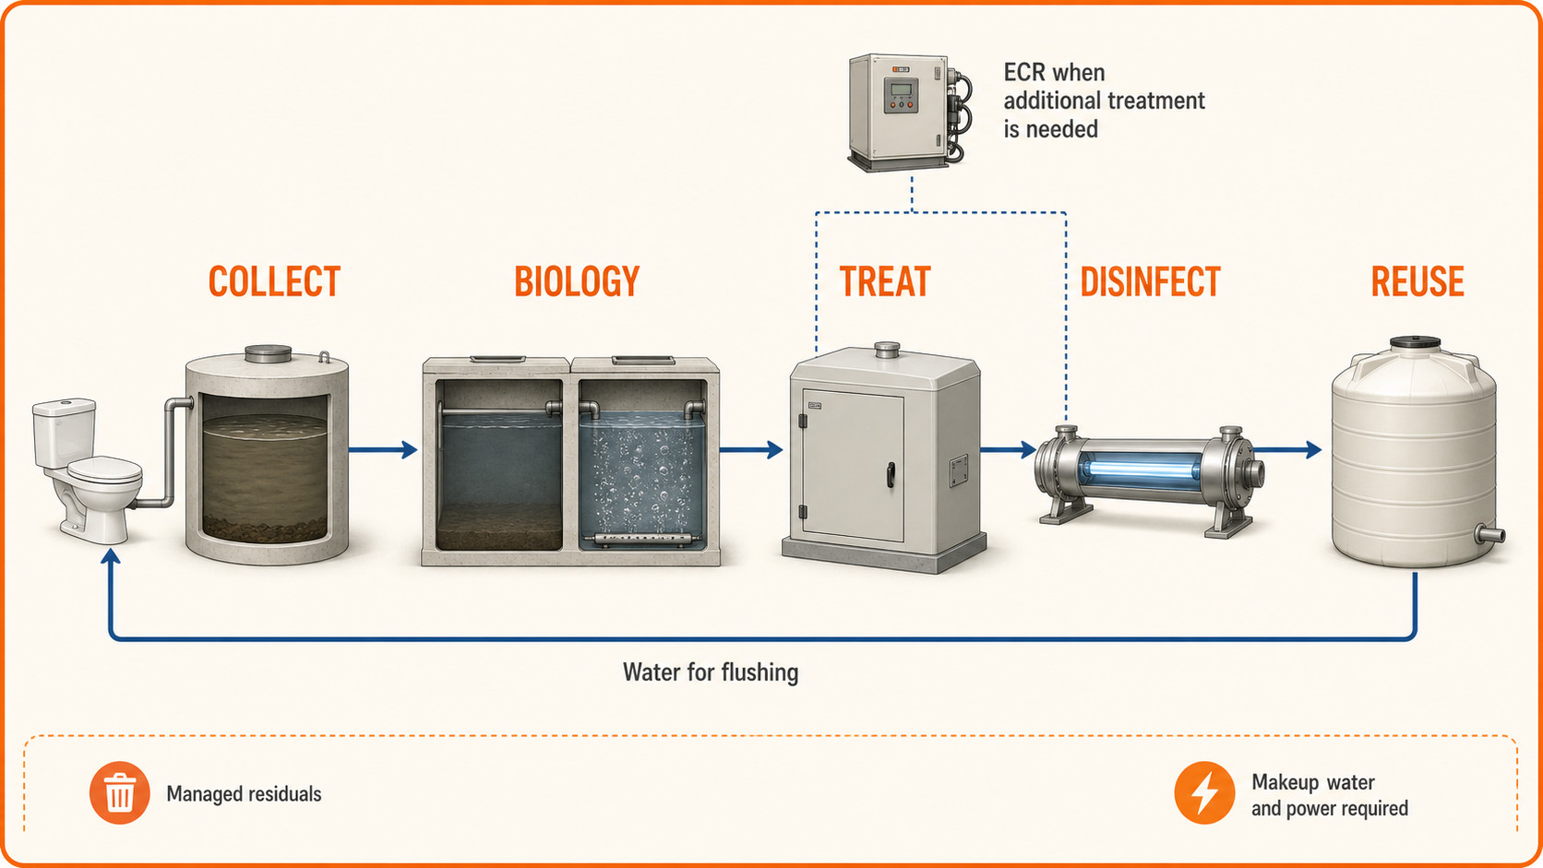
LOOCAFE × REFLOW · BELOW THE STREET
The treatment stages—and the return to flushing.
ECR provides additional treatment when required; the reuse route returns water for flushing.
Based on BCRT O&M manual, Aug 2024 · Conceptual equipment shapes; not to scale
25
Notes:
Let me take you through the water. First, collection and regulation: manage the incoming flow. Then biological treatment. Anaerobic and aerobic stages use microorganisms to reduce the pollutant load; aeration supports the oxygen-dependent stage. Further treatment and disinfection prepare the water for flushing reuse. In the selected BCRT manual, the electrochemical reactor provides additional treatment when the load is high or the effluent is unstable. That's why it's shown as a conditional branch. Finally, the reuse tank and pump return water to flushing. This is a functional explanation of the documented configuration. The important thing is that each stage has a job, and the operating conditions have to support that job.
Source/context: Based on BCRT O&M manual, Aug 2024 · Conceptual equipment shapes; not to scale
Web review slide: 27
Live allocation for this topic: 55 seconds.

Slide 26
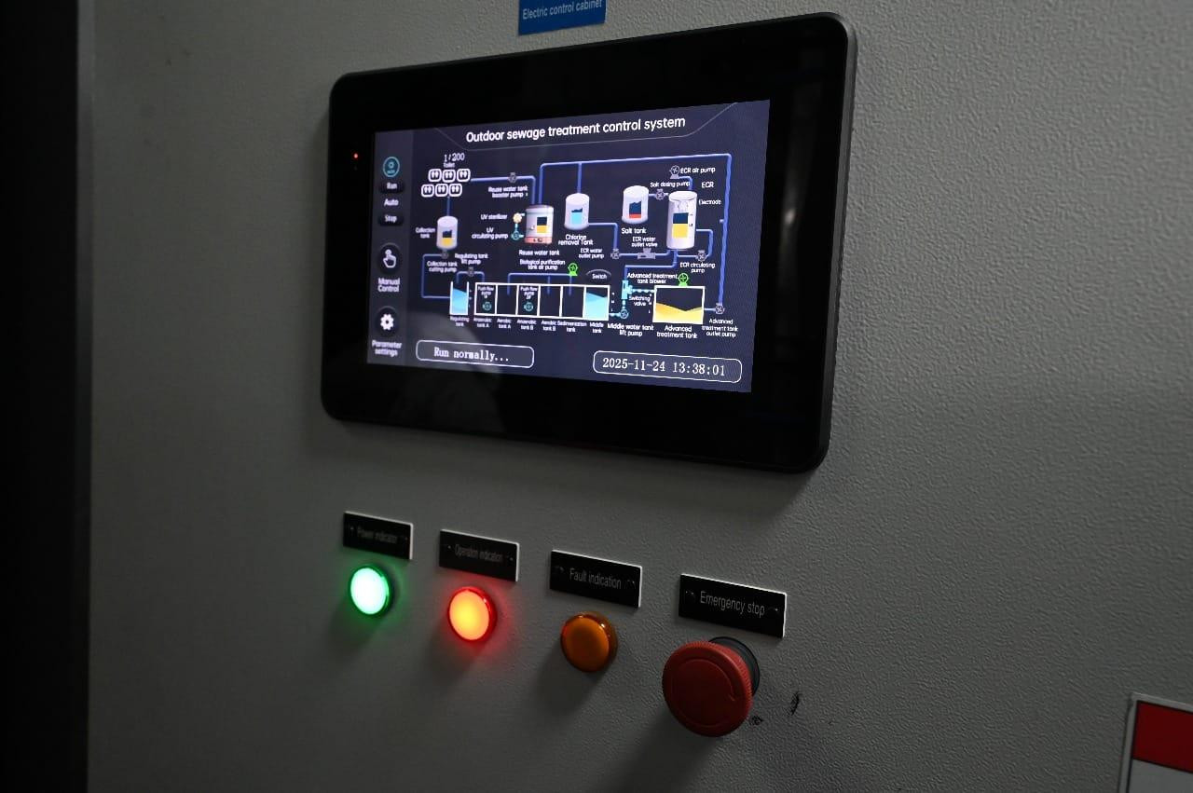
LOOCAFE × REFLOW · BELOW THE STREET
The engineering is in the operating limits.
Commission the biology
Seed the process and increase loading in stages.
Connect controls to use
Reuse-water levels gate pump and UV operation.
Coordinate cleaning
Use a treatment-compatible cleaning protocol.
Hardware, operating conditions and daily care have to work together.
BCRT O&M Manual, Aug 2024, printed pp. 12, 14–15, 23 · Documented configuration; actual control-panel photo
26
Notes:
This is why the technology is more than a box in a container. We have to commission the biology, then increase the load in stages. Tank-level controls connect to pump and UV operation; the manual describes suspending use when required. Even cleaning has to work with the treatment process, so the operator needs a compatible cleaning protocol. The hardware, operating conditions and daily routine all have to work together. Then we sample the water and check the result.
Source/context: BCRT O&M Manual, Aug 2024, printed pp. 12, 14–15, 23 · Documented configuration; actual control-panel photo
Web review slide: 28
Live allocation for this topic: 35 seconds.

Slide 27
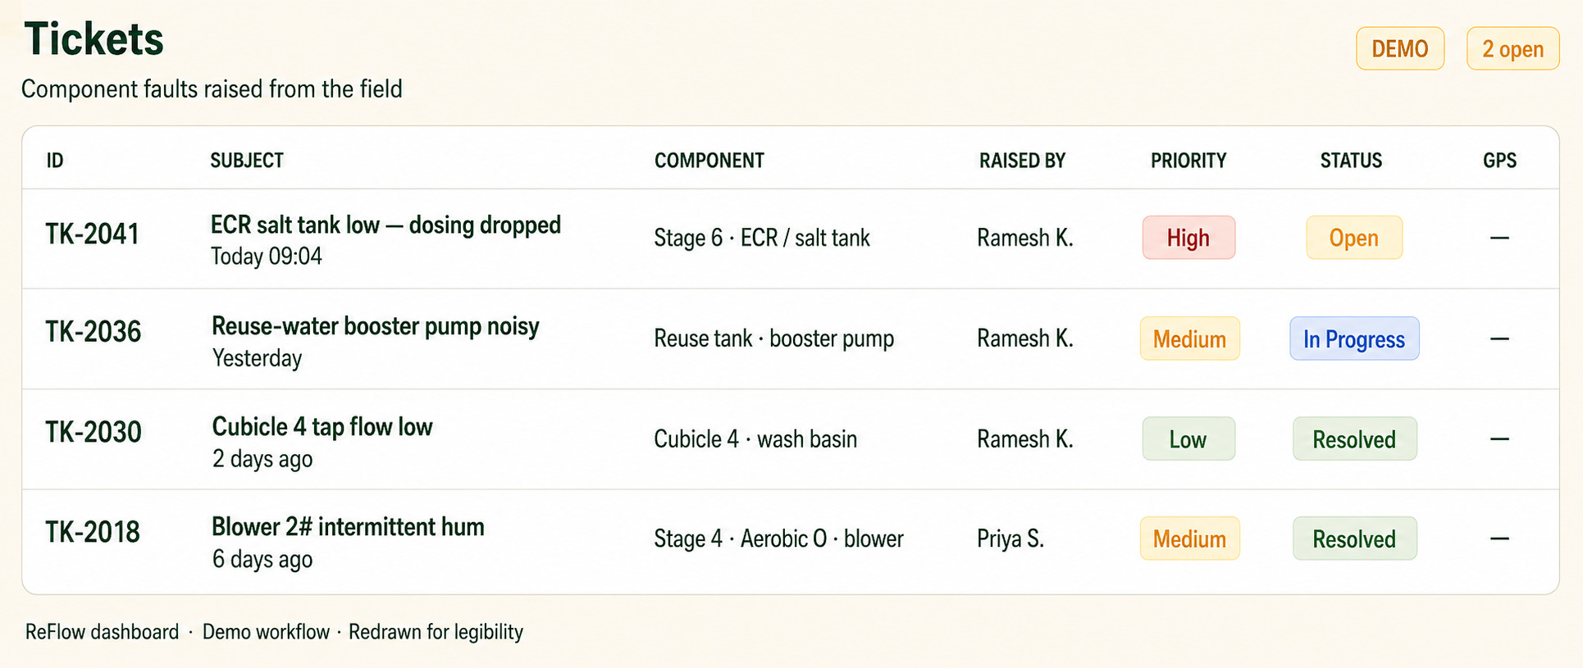
LOOCAFE × REFLOW · BELOW THE STREET
ReFlow issues can be tracked by component.
Name the component. Set the priority. Track the response.
ReFlow dashboard DEMO workflow · AI-cleaned reproduction; original capture retained
27
Notes:
This ReFlow dashboard example shows the maintenance workflow with demo records. Name the affected component, set the priority and track the status. That's how a plant issue becomes a task someone can take responsibility for.
Source/context: ReFlow dashboard DEMO workflow · AI-cleaned reproduction; original capture retained
Web review slide: 29
Live allocation for this topic: 15 seconds.

Slide 28
LOOCAFE × REFLOW · BELOW THE STREET
A loop has responsibilities.
KEEP THE SYSTEM RUNNING
PLAN THE OUTLET
On-site treatment
Inputs
Outputs to manage
↑
↓
Makeup water
Residuals
Wastewater
Treated water
Electricity
Site-specific excess water
Consumables + maintenance
Flushing
Collection, handling and a suitable destination remain part of the service.
NON-POTABLE REUSE
Flushing reuse still needs makeup water, power, maintenance and residuals handling.
BCRT O&M manual · Conceptual system boundary; not an as-built piping drawing
28
Notes:
The water returns to flushing. The loop still needs makeup water, power, consumables and a residuals route. Measure the whole system: how much returns, how reliably, and what it costs to keep working.
Source/context: BCRT O&M manual · Conceptual system boundary; not an as-built piping drawing
Web review slide: 30
Live allocation for this topic: 20 seconds.

Slide 29
LOOCAFE × REFLOW · BELOW THE STREET
Measure the difference.
400
Water reused
Freshwater makeup
litres/day
litres/day
Energy intensity
Verified service
people/day pre-launch
Speaker-reported activity; not measured treatment performance.
kWh/m³ treated
Availability + sample results
Measure water, reliability and treatment quality together.
400 people/day: speaker-reported pre-launch activity; period and count method unverified
29
Notes:
Our team reports around 400 people a day before launch. Now I want to turn that activity into measured impact: reused water, freshwater makeup, energy, treatment quality and availability. Then add the operator's income and the whole-life cost per use. Those are the numbers a city needs to decide where this service should go next.
Source/context: 400 people/day: speaker-reported pre-launch activity; period and count method unverified
Web review slide: 31
Live allocation for this topic: 25 seconds.

Slide 30
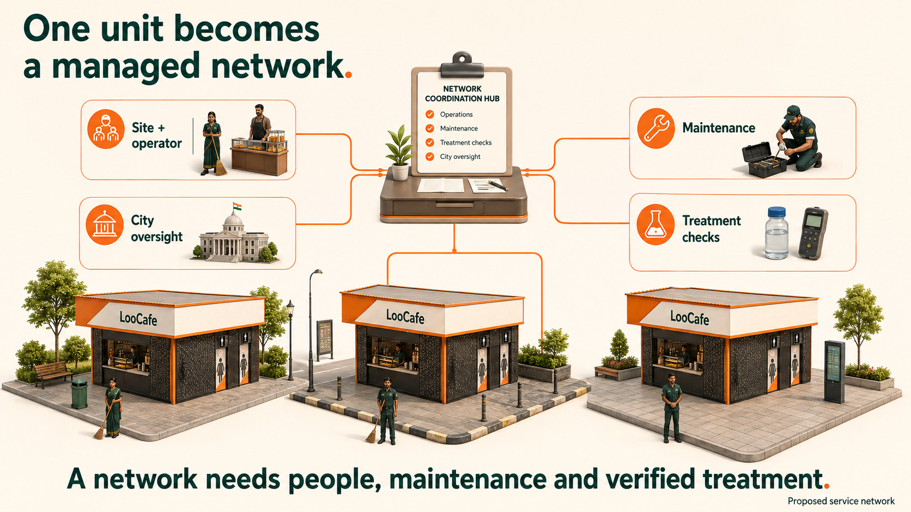
Concept illustration · Proposed service-network illustration · Not a deployment map
30
Notes:
Pull back to a network: an operator at each site, maintenance coverage, treatment checks and city oversight. The product repeats. The responsibility has to repeat with it.
Source/context: Concept illustration · Proposed service-network illustration · Not a deployment map
Web review slide: 32
Live allocation for this topic: 15 seconds.

Slide 31
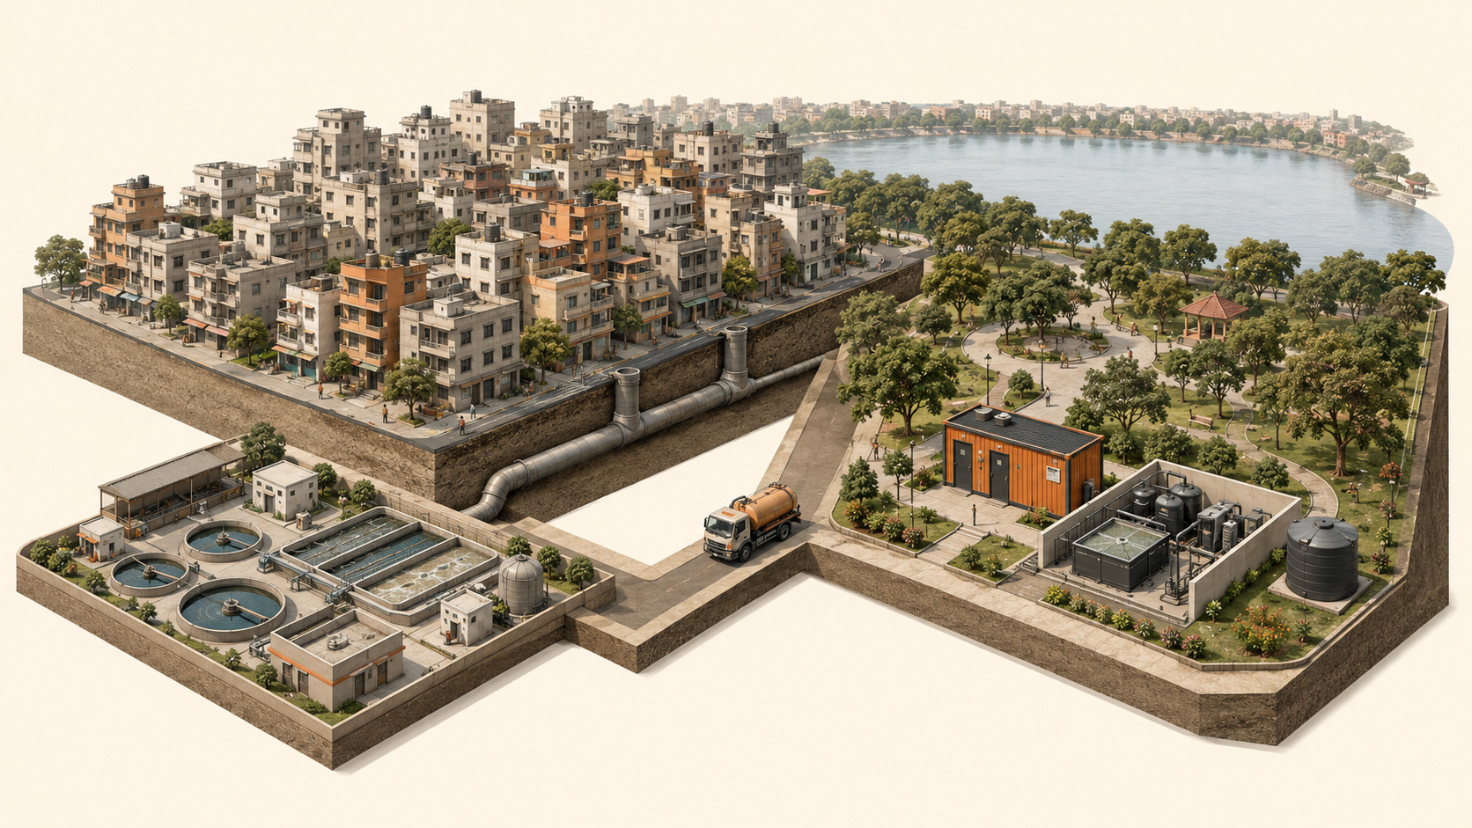
LOOCAFE × REFLOW · THE CITY
Citywide sanitation uses more than one treatment route.
1
Sewers + treatment
Convey wastewater to a suitable treatment plant.
2
Local treatment
Treat at or near the site; match the reuse or disposal route.
3
3
Managed residuals
1
2
Arrange collection, transport and suitable treatment or disposal.
MATCH THE ROUTE TO THE SITE
Connect suitable sites to sewers; use appropriate local treatment where it fits the service need.
Concept illustration · NIUA handbook, 2019, pp. 19, 23–27, 40–43 · Not a city map or piping plan
31
Notes:
A city needs several routes: suitable sewers, appropriate local treatment, and managed residuals transport. ReFlow belongs within that wider network. Choose the route for the site.
Source/context: Concept illustration · NIUA handbook, 2019, pp. 19, 23–27, 40–43 · Not a city map or piping plan
Web review slide: 33
Live allocation for this topic: 12 seconds.

Slide 32
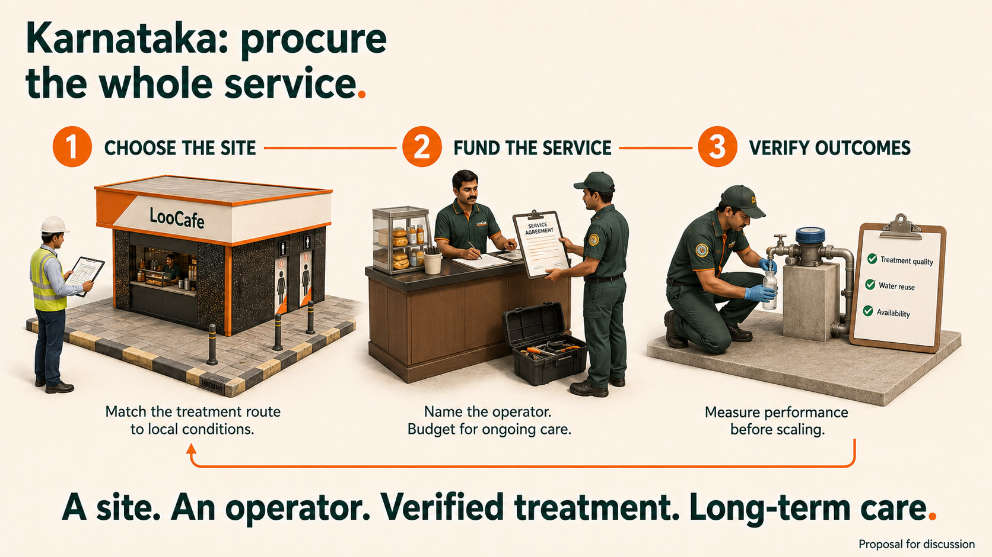
Concept illustration · Proposal for discussion · Karnataka wastewater-reuse workshop: PIB, 8 Nov 2025
32
Notes:
For Karnataka, this is the conversation I'd like us to have. Choose the site and the right treatment route. Name the operator and budget for ongoing care. Verify treatment quality, reuse and availability before scaling. Circular sanitation belongs in policy as a service we fund and measure, alongside the city's wider sewered and non-sewered network.
Source/context: Concept illustration · Proposal for discussion · Karnataka wastewater-reuse workshop: PIB, 8 Nov 2025
Web review slide: 35
Live allocation for this topic: 30 seconds.

Slide 33

LOOCAFE × REFLOW
A better city starts here.
A public toilet people can use—and a system that keeps working.
Lumbini Park · Scan for the presentation notes
Notes:
For me, this still comes back to that street: a place where people can stay, a toilet they want to use and a system that keeps working. Come and visit us. Let's look at what it takes to make this work for Karnataka.
Source/context: Lumbini Park · Scan for the presentation notes
Web review slide: 36
Live allocation for this topic: 15 seconds.

