Slide 1


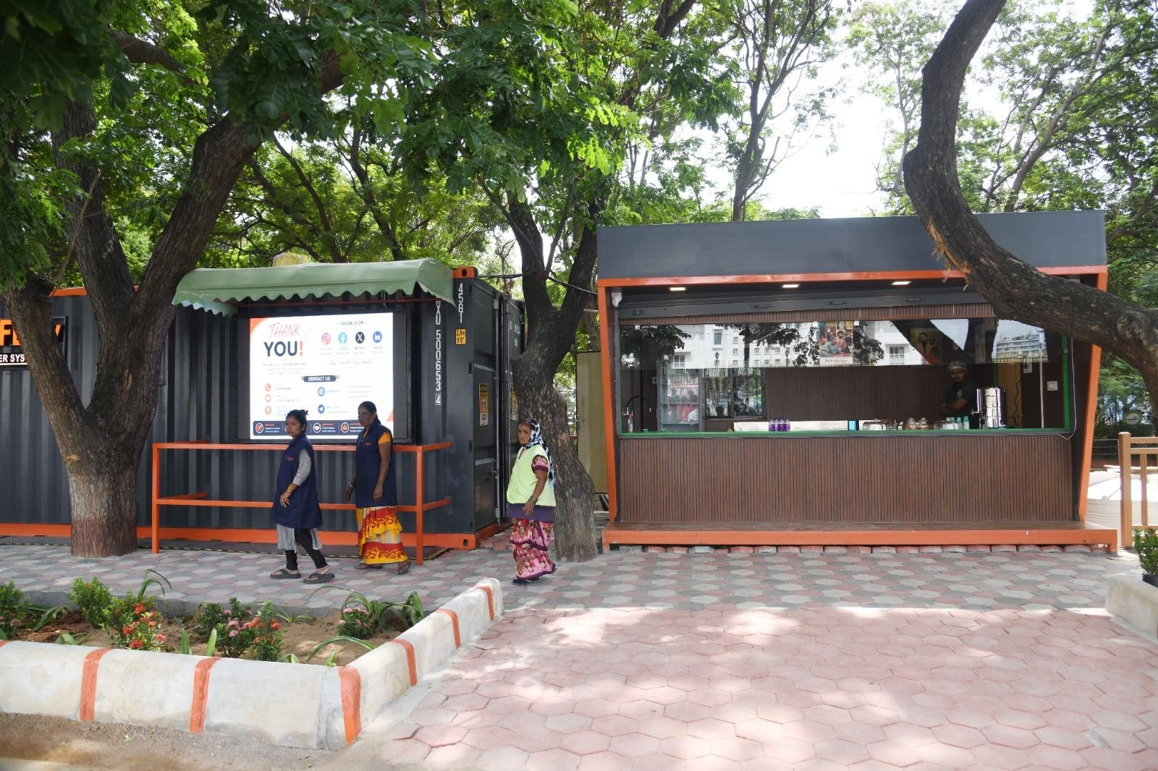
LOOCAFE × REFLOW
How do we make the perfect public toilet?
Lumbini Park, Hyderabad · Original project photograph, July 2026
01
Notes:
Hey everybody. I want to take you to a street in Hyderabad, beside Hussain Sagar. I grew up coming here. I have spent years of my young life thinking about something you might not expect: the public toilet. Let me show you why.
Source: Lumbini Park, Hyderabad · Original project photograph, July 2026
Main presentation

Slide 2
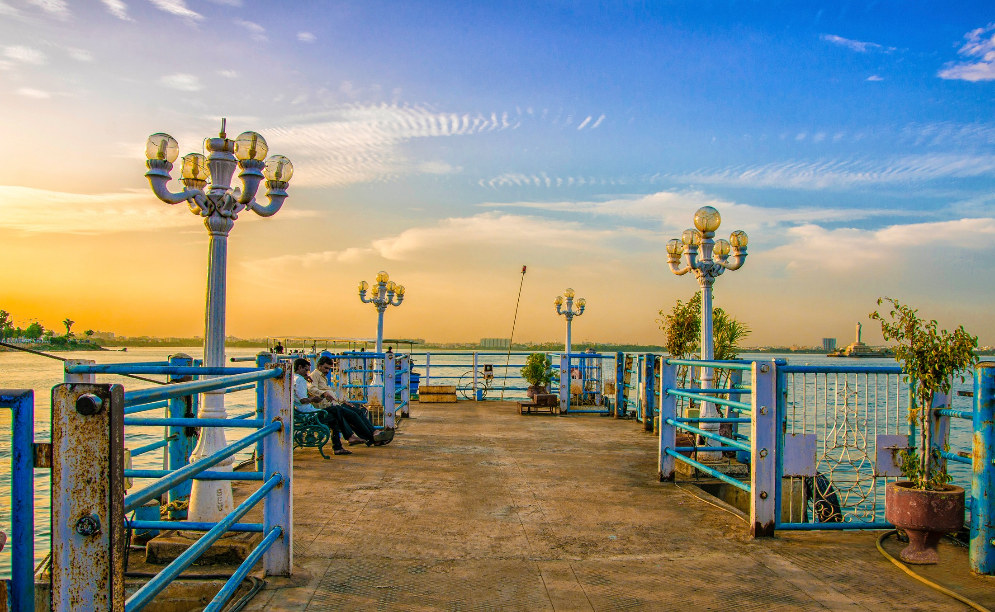
THE STREET
The street I grew up with.
LooCafe / ReFlow original project archive
Present-day Lumbini Park photograph · Earlier conditions described from personal recollection
LooCafe / ReFlow original project archive
02
Notes:
If you know Hyderabad, you know this part of the city. Hussain Sagar, the roads around the lake, Lumbini Park. Growing up, I'd come here almost every weekend. Loads of people, something to eat, somewhere to walk. This was a good evening in the city. When I think about this area growing up, I remember the hawker, rubbish and an inadequate public toilet. We have not located a photograph of that exact earlier scene. This is the site today; I want to explain what a public toilet can change. If you cannot find a toilet you can use, how long can you stay here? Think about women, older people, families. A good public space has to let people stay.
Source: LooCafe / ReFlow original project archive. Full original path in stage-assets/provenance.json.
Main presentation

Slide 3
THE STREET
Here is the LooCafe + ReFlow site.
Lumbini Park · Original July 2026 photograph; highlights are explanatory
03
Notes:
Here is the real site today. The toilet, the cared-for space around it and the business beside it. Let us build up the explanation, one part at a time.
Source: Lumbini Park · Original July 2026 photograph; highlights are explanatory
Main presentation

Slide 4
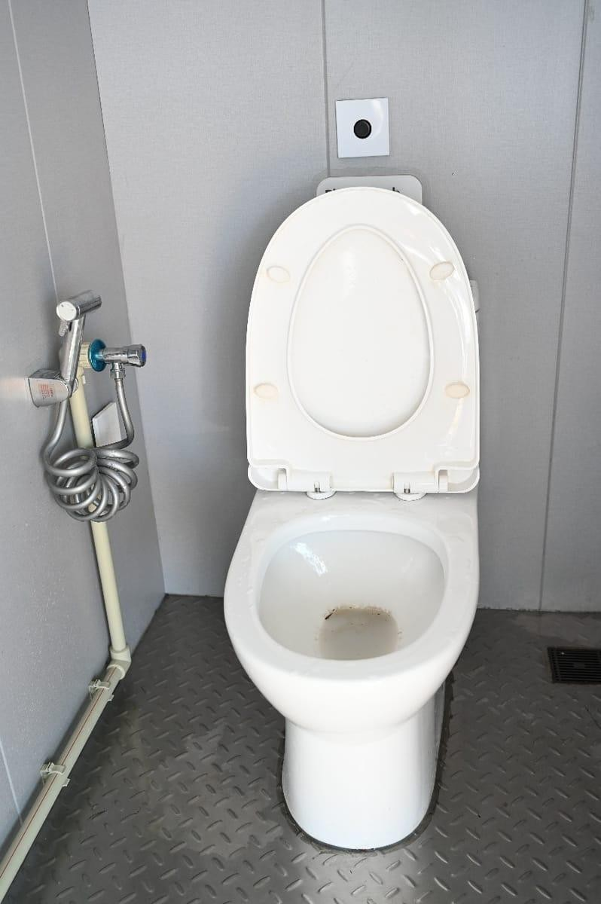
THE STREET
The toilet comes first.
Lumbini Park · Original July 2026 photograph; highlights are explanatory
Generated Karnataka concept based on the Banjara Hills archive. Illustrative adaptation, not an installed unit or access
Lumbini Park · Original July 2026 photograph; highlights are explanatory
04
Notes:
Stay with the same street. Before I explain the shop, let us go inside the toilet. That is why all of this is here. A container gives us a repeatable structure. The toilet is the purpose of the unit. The shop and the advertising help support its operation. Now let's take it apart, one piece at a time.
Source: Lumbini Park · Original July 2026 photograph; highlights are explanatory
Main presentation

Slide 5
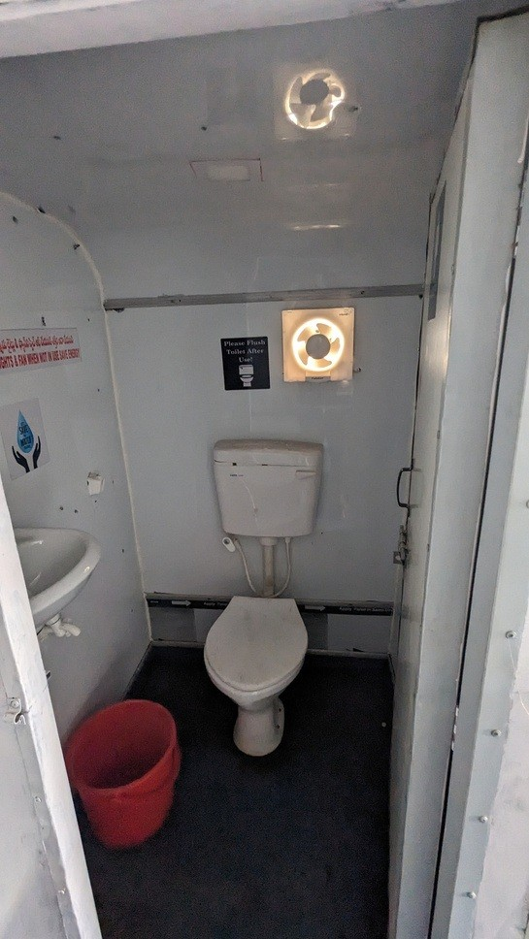
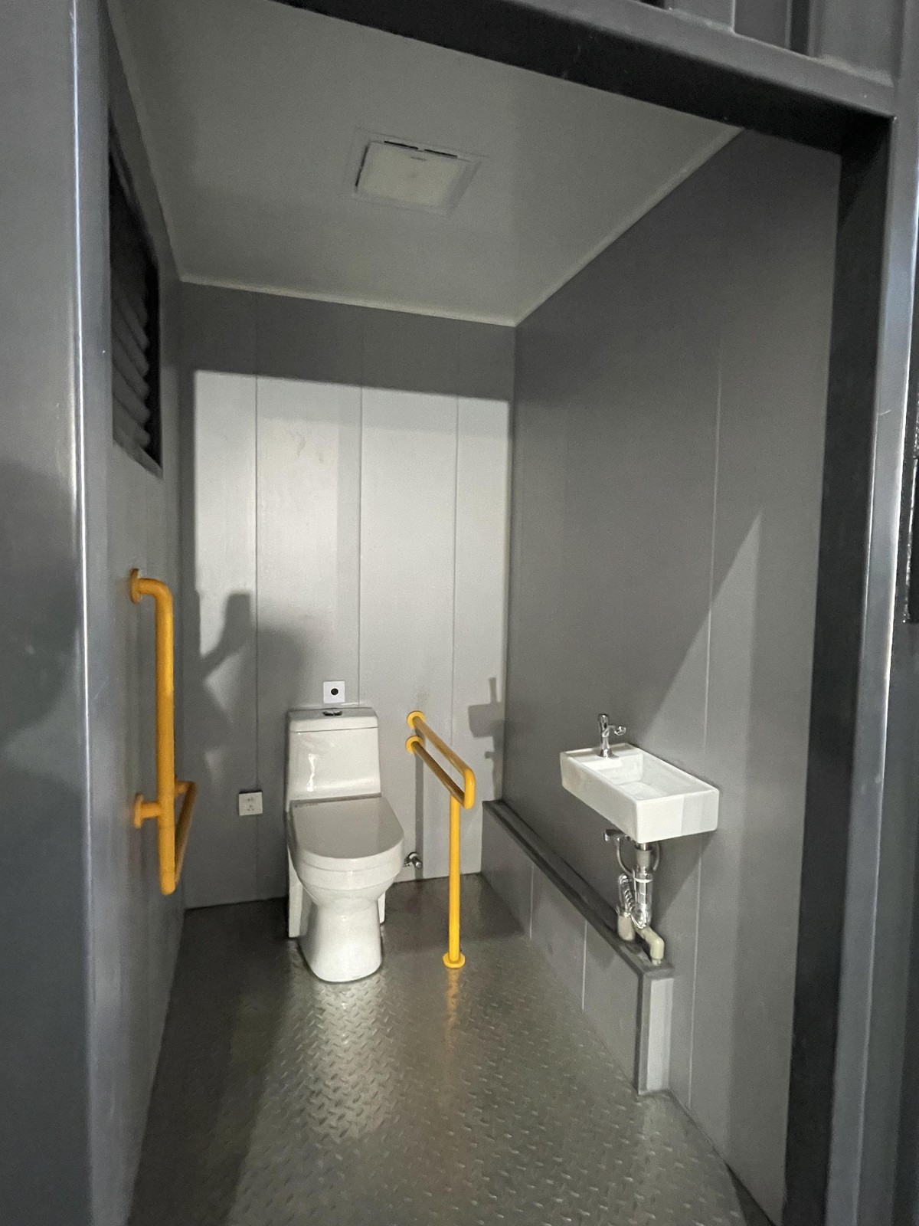
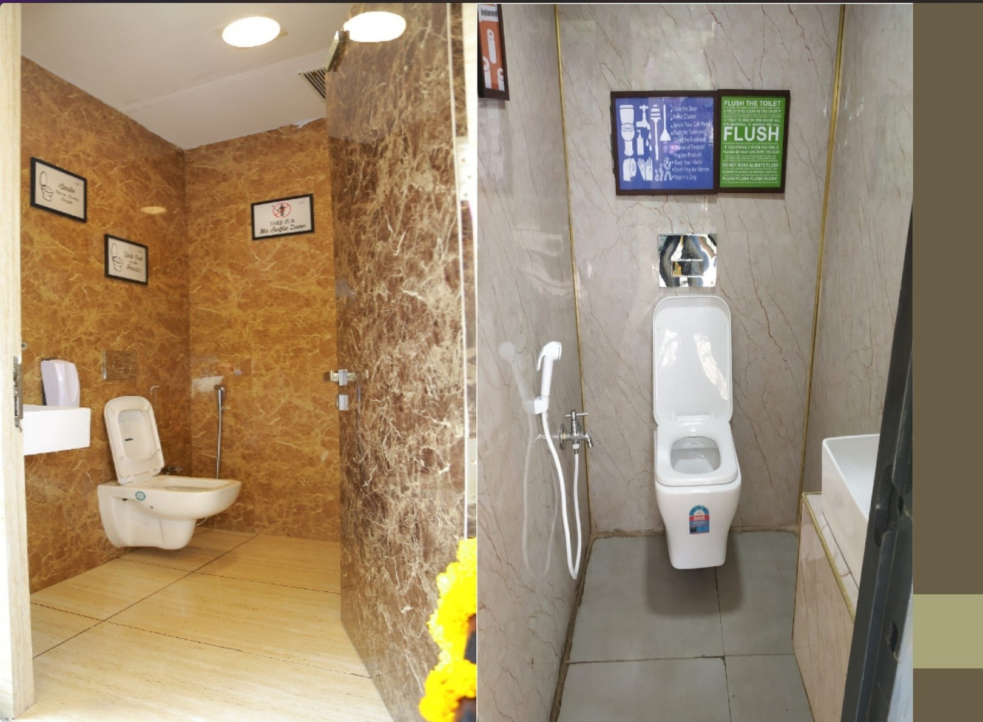
THE UNIT
Dignity is in the details.
Toilet Tales, p.13 · Original interior photograph; separate archive site
Toilet Tales · Original interior photograph; separate archive site
Factory archive · Accessible-fixture configuration, not the photographed Lumbini installation
Toilet Tales, p.13 · Original interior photograph; separate archive site
05
Notes:
Inside, we want it to look really good. You should feel comfortable walking in. Clean surfaces, lighting, the details you actually touch. Aspiration matters here. We want to set a standard that people expect, and that the operator takes pride in maintaining. A clear entrance. A private cubicle. A space that looks as though someone cares about it. These are basic design decisions with very real consequences. Think about the approach, the signs, the door and privacy. A wheelchair symbol by itself doesn't solve access. The whole route and the space inside have to work. That's part of making the perfect toilet.
Source: Toilet Tales, p.13 · Original interior photograph; separate archive site
Main presentation

Slide 6
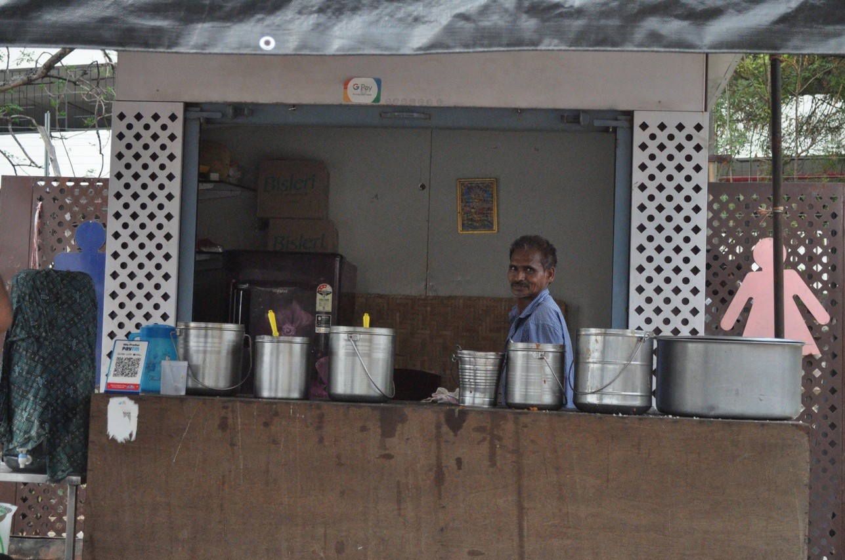
THE LIVELIHOOD
A business that helps fund the care.
Lumbini Park · Original July 2026 photograph; highlights are explanatory
Toilet Tales · Original shop-counter photograph
Lumbini Park · Original July 2026 photograph; highlights are explanatory
06
Notes:
Back to our street. Now look at the shop. Its role is to give someone an ongoing business here, linked to keeping the public facility working. The shop is somebody's livelihood. A partner has an establishment, customers, and a place to take responsibility for. Commercial activity can contribute to maintaining the toilets. But that responsibility has to be explicit. A counter by itself doesn't make cleaning happen. This is a person running a business. The model has to make sense for them too. Revenue has to cover the actual work of keeping the toilet usable.
Source: Lumbini Park · Original July 2026 photograph; highlights are explanatory
Main presentation

Slide 7
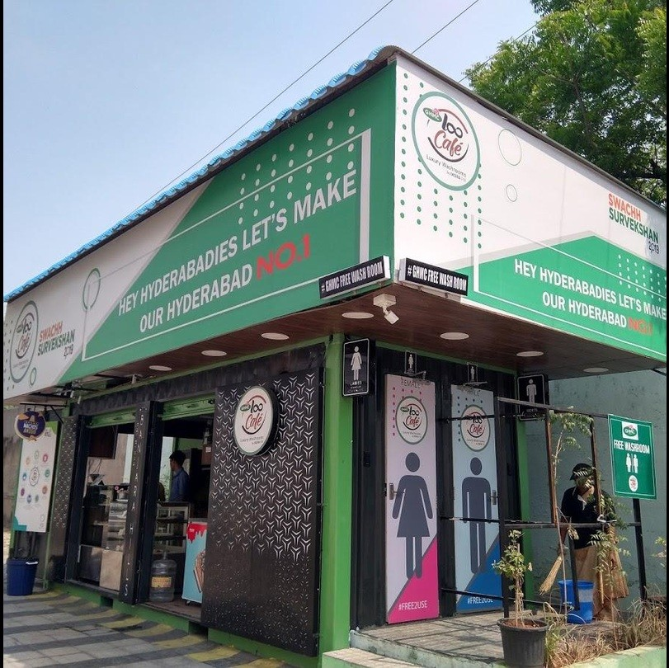
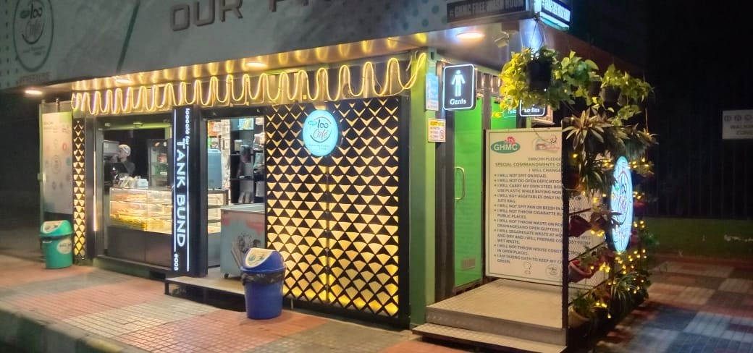
THE LIVELIHOOD
Revenue. Presence. A reason to stay.
LooCafe / ReFlow original project archive
LooCafe / ReFlow original project archive
LooCafe / ReFlow original project archive
07
Notes:
And look up. These panels are another potential source of revenue. They're also a very visible part of the street. In Karnataka, that surface should belong to the place. The important commercial question is how committed income pays for the service over time. There is also someone there. You can ask for help. An active frontage and lighting make the place more approachable. Safety still needs privacy, good design and operating procedures. The shopkeeper is part of that.
Source: LooCafe / ReFlow original project archive. Full original path in stage-assets/provenance.json.
Main presentation

Slide 8
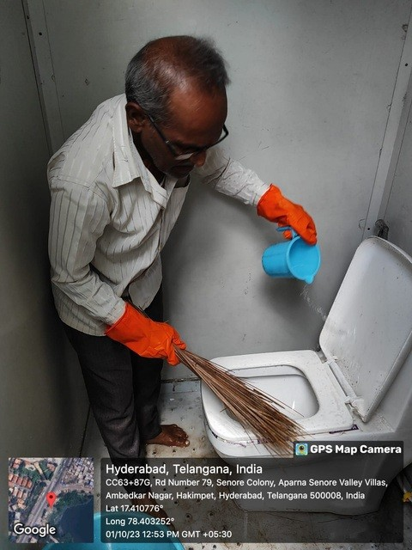
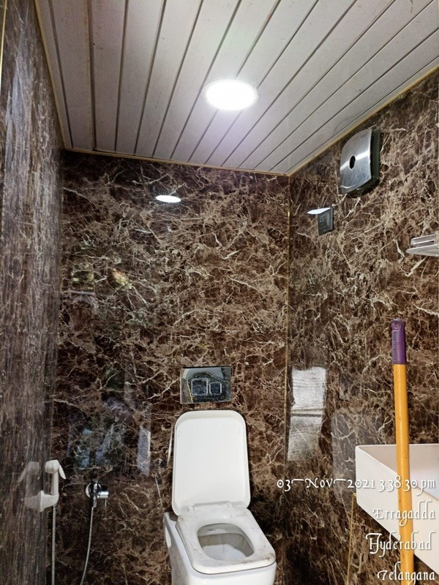
THE CARE
Accountability, every day.
Toilet Tales · Original cleaning photograph; operating routine described by Vedanth
Toilet Tales · Original interior photograph
Toilet Tales · Original cleaning photograph; operating routine described by Vedanth
08
Notes:
Someone has to own the task. Cleaning is recorded. A supervisor checks it. When there is an issue, it needs an owner and a resolution. That is the routine our software needs to support. It is visible to the next person who opens the door. That is the standard we are trying to repeat.
Source: Toilet Tales · Original cleaning photograph; operating routine described by Vedanth
Main presentation

Slide 9
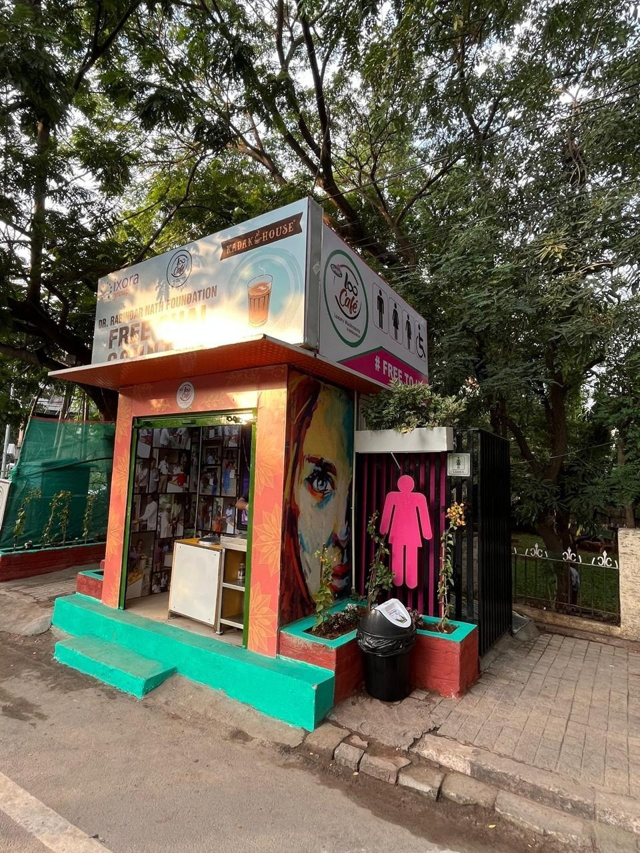
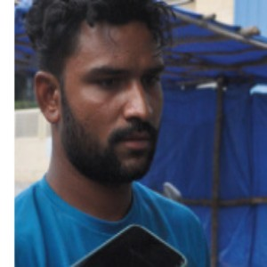
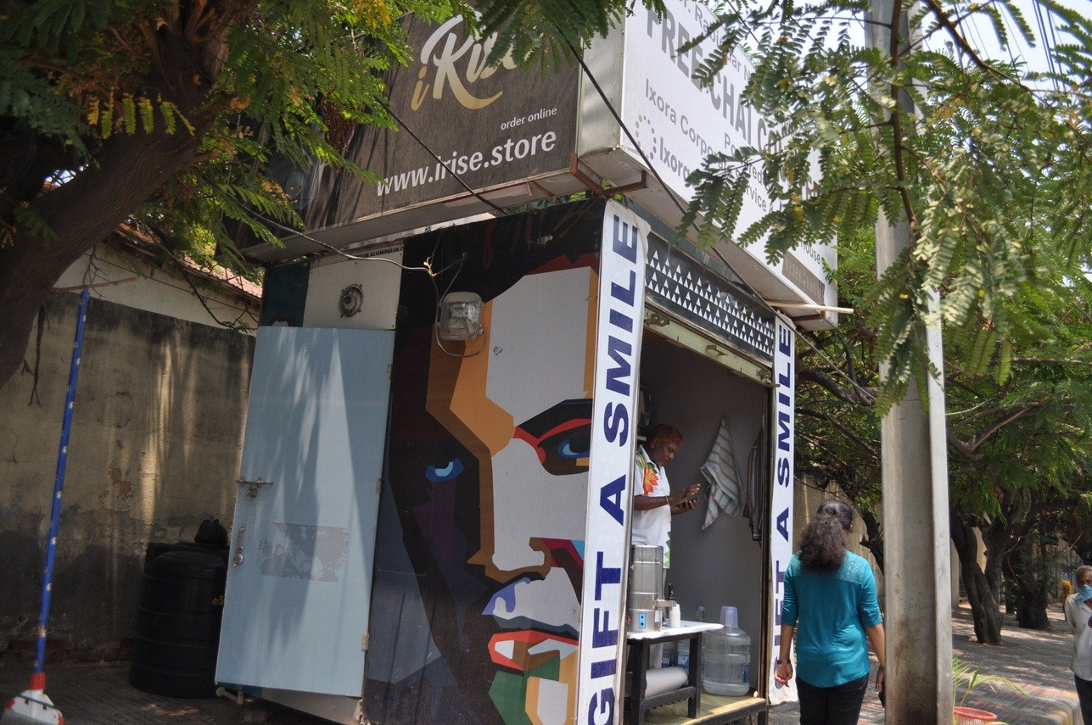
THE PEOPLE
A Mini. A livelihood.
Toilet Tales, Ixora Edition, PDF p. 22. Reported account; no current income or employment guarantee.
Toilet Tales, PDF p.22 · Asif story and original site photograph
LooCafe Mini · Original project photograph
Toilet Tales, Ixora Edition, PDF p. 22. Reported account; no current income or employment guarantee.
09
Notes:
Here's Asif, from Toilet Tales. He paired a LooCafe Mini with a bike-repair business. His day included cleaning the toilet, then repairing bikes. That's what I mean by agency. The business can fit the person's skills and the needs of that street. A small footprint can still support a real livelihood. Asif paired his Mini with bike repair. The format can fit the person and the street. The Mini takes the same relationship into a smaller site: public toilets and a local business. We adapt the format to the space.
Source: Toilet Tales, Ixora Edition, PDF p. 22. Reported account; no current income or employment guarantee.
Main presentation

Slide 10
THE WATER
Now look below the street.
Lumbini Park · Original July 2026 photograph; highlights are explanatory
10
Notes:
But come back to the street. We have made the place look better. Where does the waste go? That is the next part of the problem.
Source: Lumbini Park · Original July 2026 photograph; highlights are explanatory
Main presentation

Slide 11
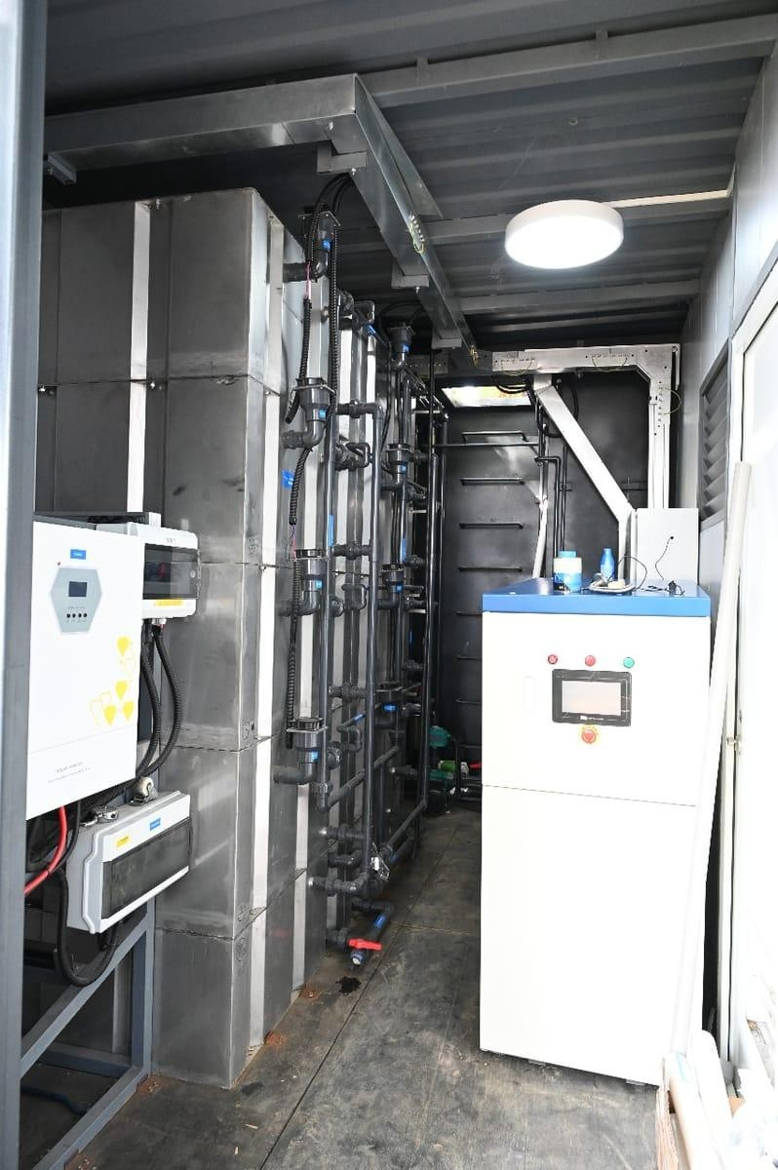
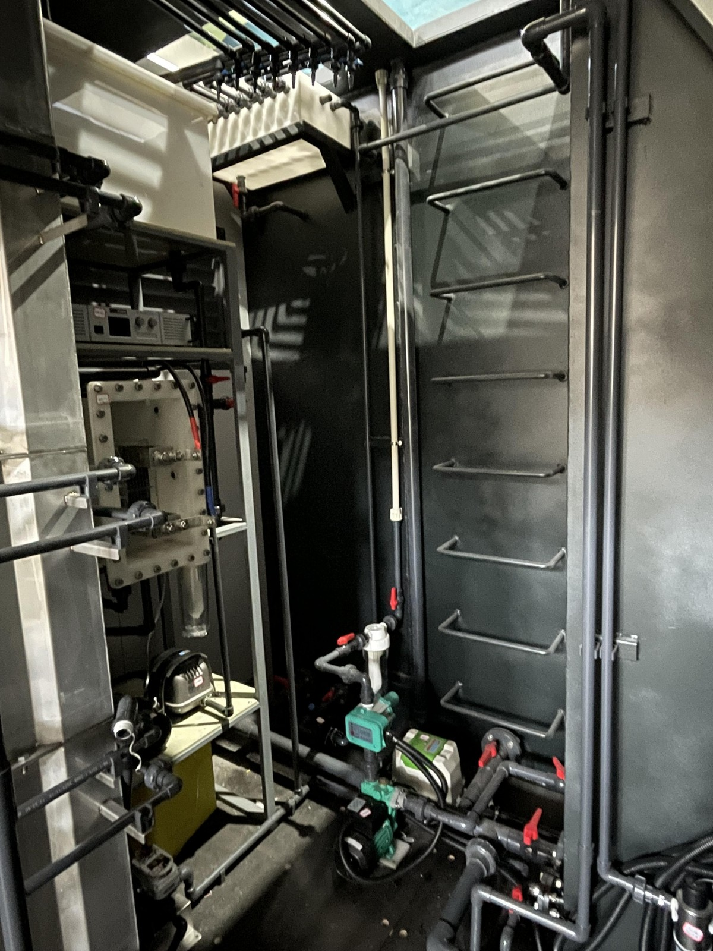
THE WATER
Inside the treatment system.
LooCafe / ReFlow original project archive
Factory archive · Treatment pipework; biology explained from the OEM manual
LooCafe / ReFlow original project archive
11
Notes:
Here is the actual treatment bay. Wastewater comes into a managed treatment process. The flow is collected and regulated. Biological treatment reduces the pollution load. Further treatment and disinfection prepare the water for its intended reuse. It goes into storage and returns to flushing. Each of those steps has a specific job. There are anaerobic and aerobic stages. Microorganisms do much of the work of reducing the pollutant load. The blowers support the aerobic process. And biology needs time to establish itself. We can place a prefabricated structure quickly, but we still have to commission the treatment and verify what comes out.
Source: LooCafe / ReFlow original project archive. Full original path in stage-assets/provenance.json. Process explanation: Eco-san b-CRT O&M manual, printed pp6–8.
Main presentation

Slide 12
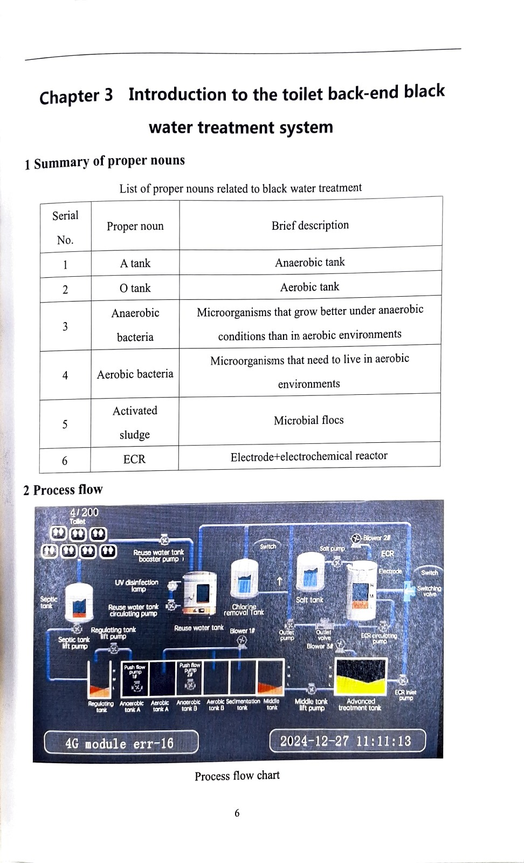
THE WATER
Treatment responds to the load.
Eco-san b-CRT O&M manual, PDF pp9–11 / printed pp6–8. Text specifies additional ECR treatment under high-load or unstable-effluent conditions.
12
Notes:
Disinfection is a separate step. The manual describes UV on the reuse path, and an electrochemical reactor for additional treatment under high load or unstable effluent conditions. Those controls matter. You need the process to respond to what's happening, with limits and a maintenance routine.
Source: Eco-san b-CRT O&M manual, PDF pp9–11 / printed pp6–8. Text specifies additional ECR treatment under high-load or unstable-effluent conditions.
Main presentation

Slide 13
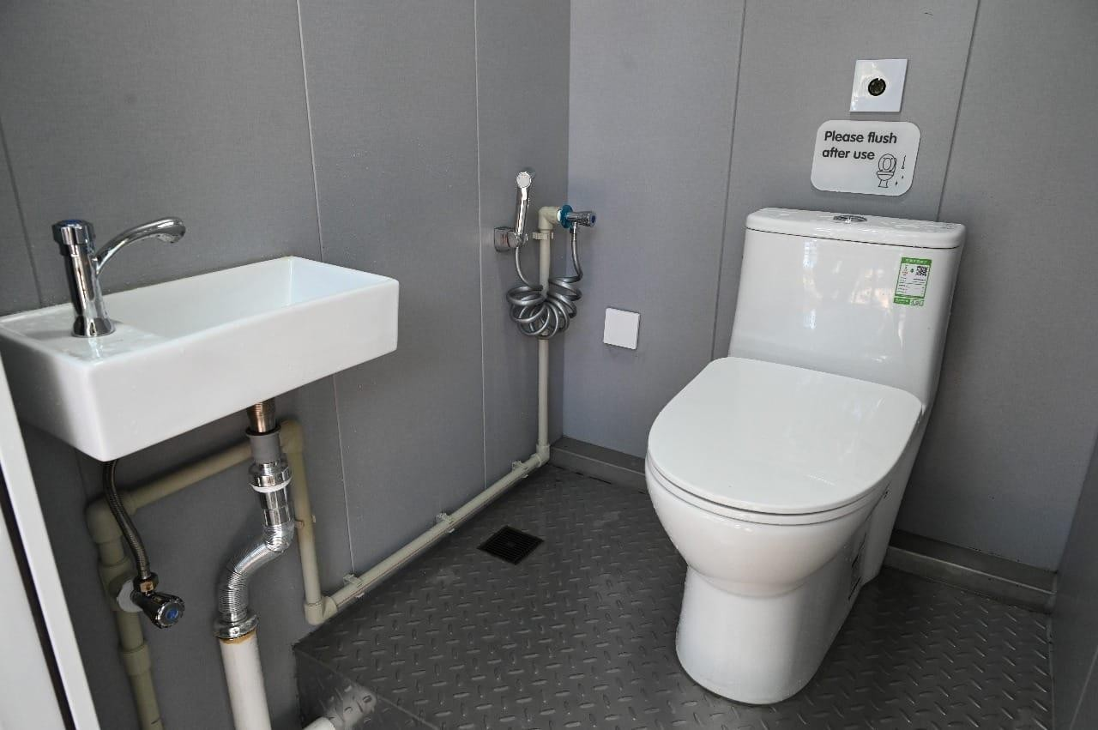
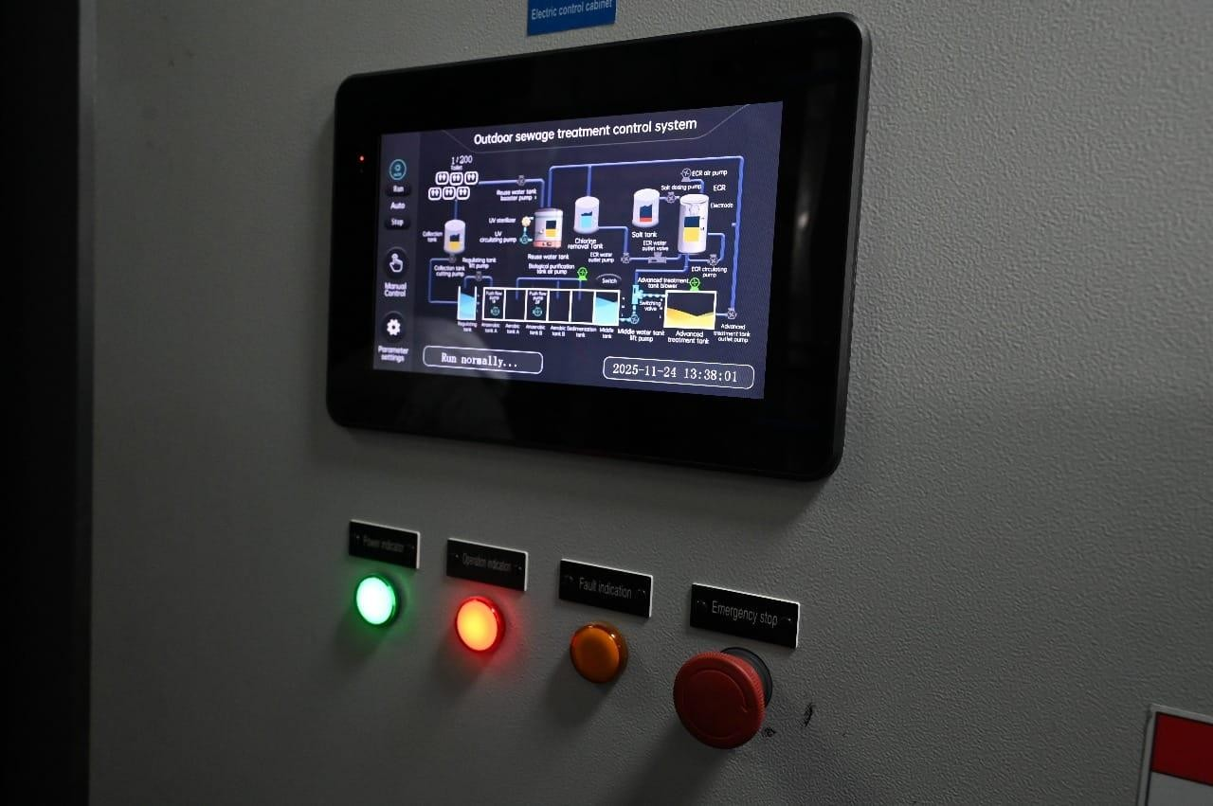
THE WATER
Reuse, with controls.
LooCafe / ReFlow original project archive
LooCafe / ReFlow original project archive
LooCafe / ReFlow original project archive
13
Notes:
The treated water comes back for flushing. That's the loop we want people to understand. The useful number is the fresh water we avoid using, measured against a clear baseline. We should be able to show the reused volume and the makeup water, rather than just say that everything is circular. The controls also do physical work. Tank levels affect whether pumps and UV can operate. Overload protection and maintenance modes are part of the system. The operator app and the plant controller have different jobs. Together, the operating team needs to know when something requires attention.
Source: LooCafe / ReFlow original project archive. Full original path in stage-assets/provenance.json. Flushing reuse explanation: OEM manual.
Main presentation

Slide 14
THE WATER
The whole loop needs care.
Original OEM backend treatment drawing. 20-foot treatment module; not automatically the selected installed configuration.
14
Notes:
There is still makeup water, energy, maintenance and residual material to manage. Those all belong inside the discussion. A city needs to know the whole route, right through treatment and safe reuse or disposal. That's how this becomes a credible part of a sanitation network.
Source: Original OEM backend treatment drawing. 20-foot treatment module; not automatically the selected installed configuration.
Main presentation

Slide 15
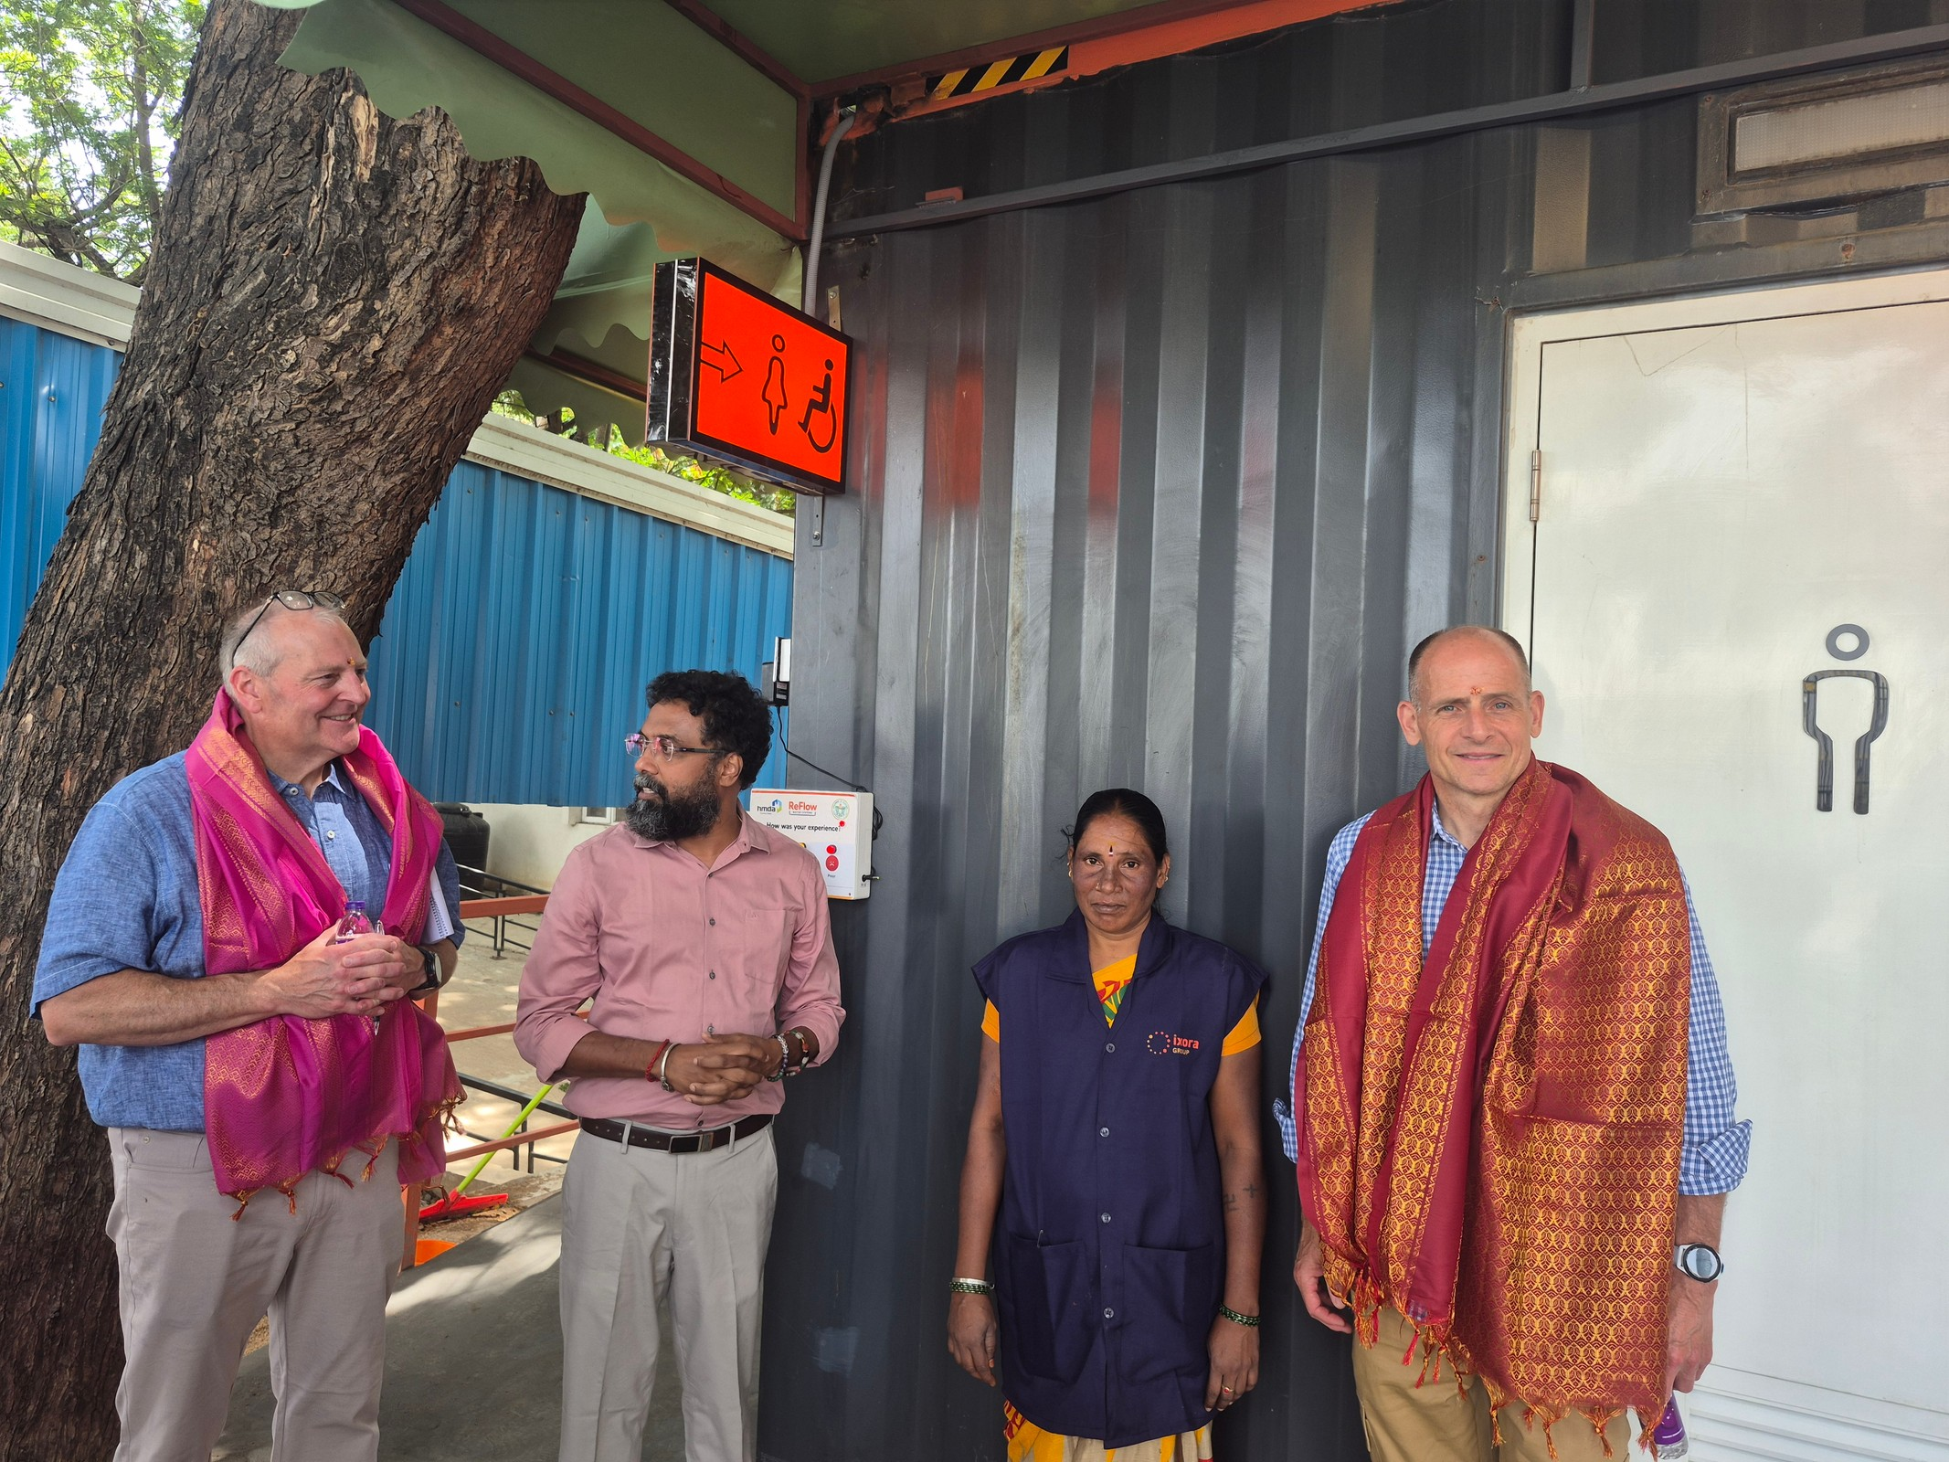
THE EVIDENCE
400 people a day, before launch.
Vedanth Nath, 6 Sep 2026: reported pre-launch use. Not an audited counter result or a treatment-capacity rating. Period and counting method not supplied.
15
Notes:
Even before launch, our operating account is around four hundred people a day. That's the demand we're seeing on the ground. Demand and the plant's rated treatment capacity are different things. The engineering has to account for actual flush volumes, peaks and the configuration installed.
Source: Vedanth Nath, 6 Sep 2026: reported pre-launch use. Not an audited counter result or a treatment-capacity rating. Period and counting method not supplied.
Main presentation

Slide 16
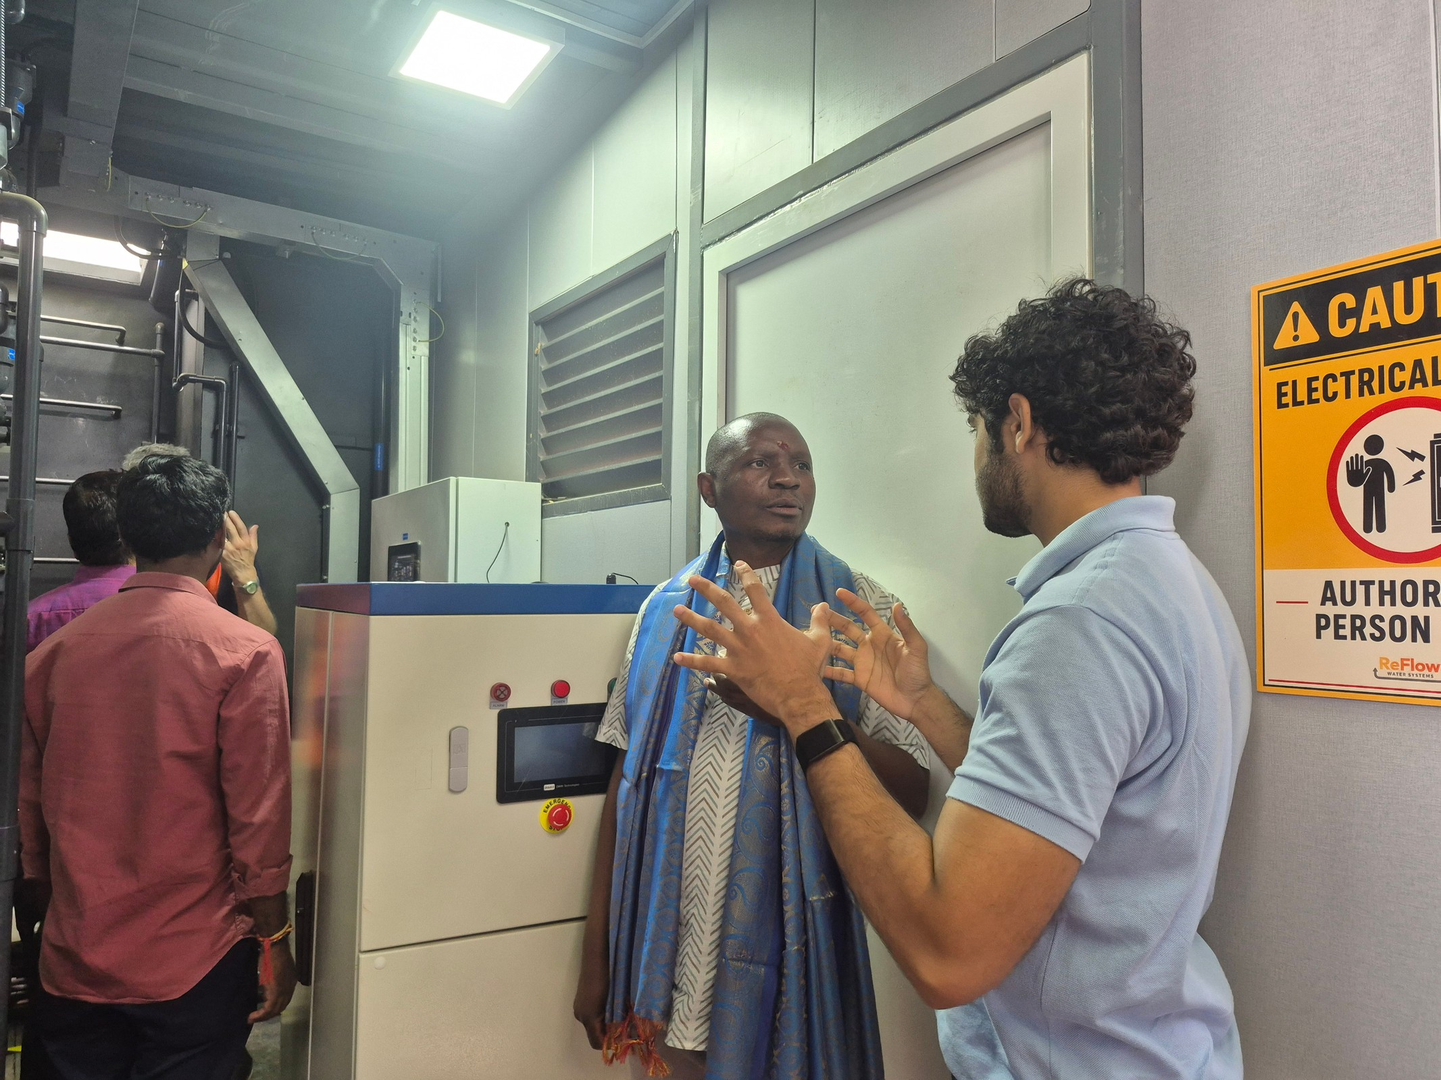
THE EVIDENCE
Come and see it.
LooCafe July 2026 visit archive, 20260714_110319.jpg. No unnamed visitor is presented as an endorser.
16
Notes:
People come to the site, walk through it and discuss the engineering with us. I'd like to extend that invitation to you. See the actual place, the team and the treatment process. Ask us the difficult questions.
Source: LooCafe July 2026 visit archive, 20260714_110319.jpg. No unnamed visitor is presented as an endorser.
Main presentation

Slide 17
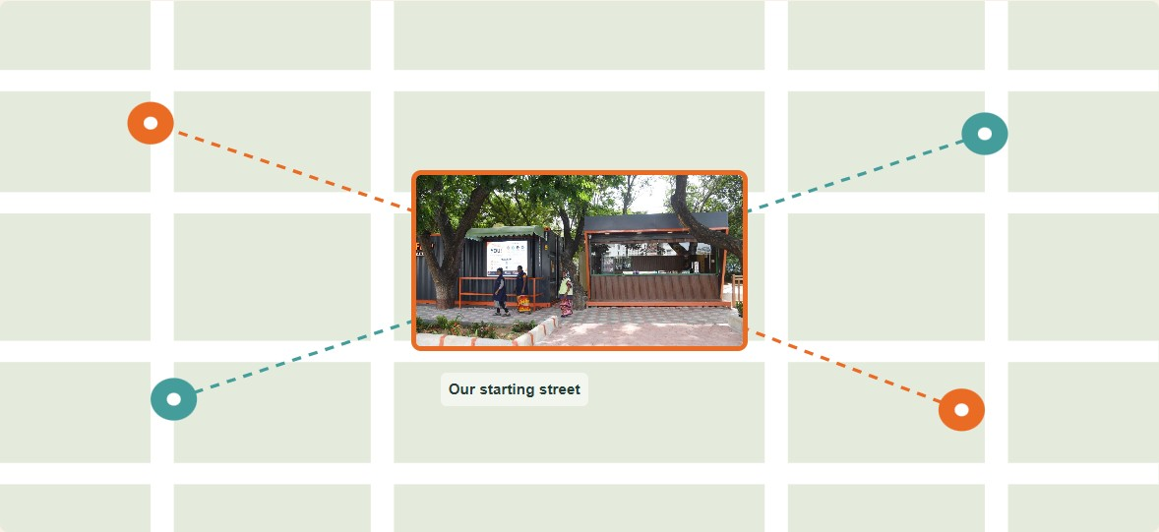
THE NETWORK
One street becomes a network.
Proposed service network · Real Lumbini photo anchors a schematic, not a geographic deployment map
17
Notes:
Now zoom out. We are repeating a service, with people responsible for each site. Some sites connect to sewers and functioning treatment. Suitable constrained sites can use onsite treatment.
Source: Proposed service network · Real Lumbini photo anchors a schematic, not a geographic deployment map
Main presentation

Slide 18
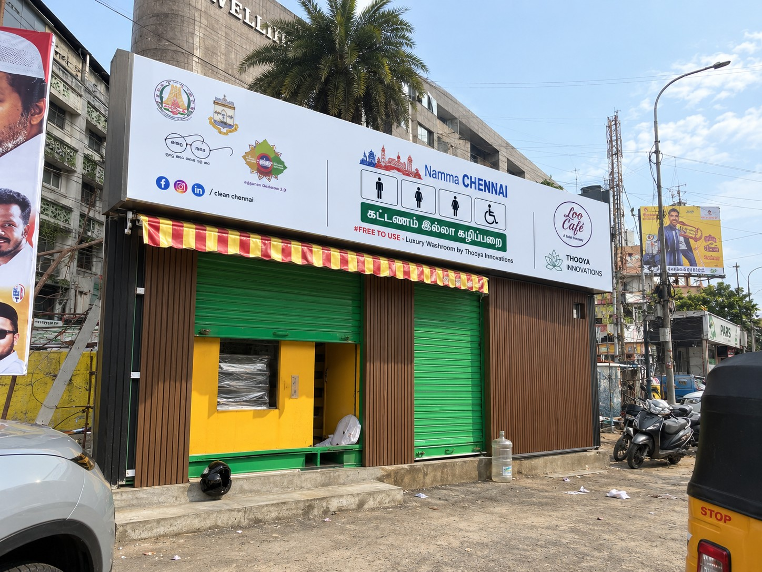
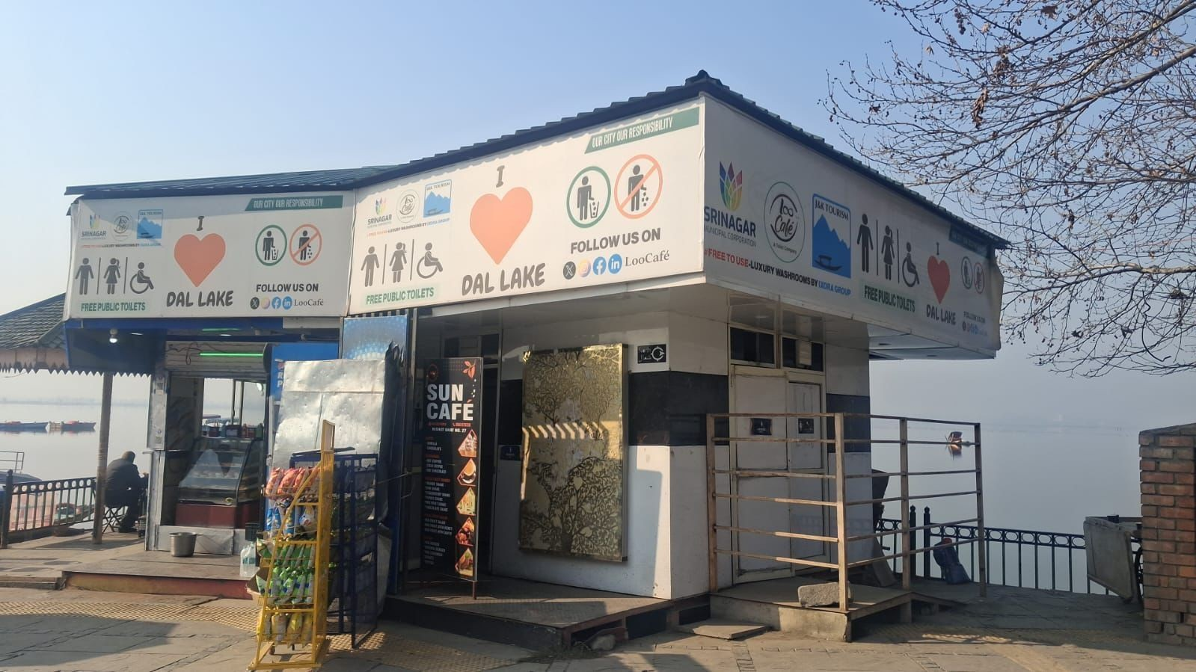
THE NETWORK
Different cities. The same responsibility.
Project site images and LooCafe gallery: https://www.loocafe.com/gallery/ . Selected documented locations, not a current
LooCafe project archive, 1768030099257.jpg. This image does not establish that ReFlow treatment is installed at this Dal
Project site images and LooCafe gallery: https://www.loocafe.com/gallery/ . Selected documented locations, not a current national operating census.
18
Notes:
Our work across India shows that range. Srinagar, Hyderabad, Chennai, Mangalagiri. Different surroundings and formats. Scaling means repeating the service as well as the structure. Here it is beside Dal Lake. Difficult connections or constrained access make the infrastructure question very real. Now look at what happens after someone flushes.
Source: Project site images and LooCafe gallery: https://www.loocafe.com/gallery/ . Selected documented locations, not a current national operating census.
Main presentation

Slide 19
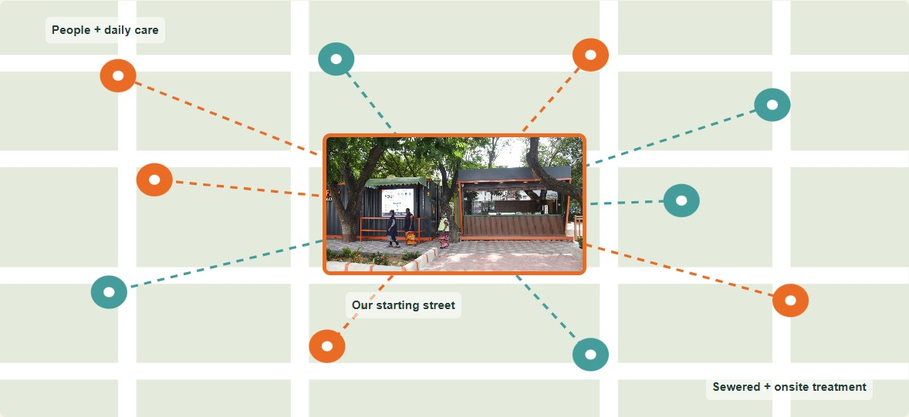
THE CITY
Imagine this across the city.
Proposed city service network · Illustrative routes, not an existing city map
19
Notes:
Every dot is a public place that needs care. The links are the teams, the checks and the treatment arrangements that keep it working. That is how a good public toilet contributes to a smarter city.
Source: Proposed city service network · Illustrative routes, not an existing city map
Main presentation

Slide 20
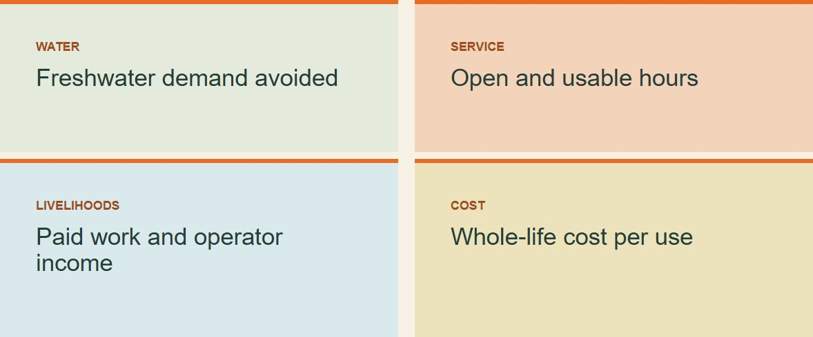
THE CITY
Measure what changes.
Impact framework · Site results and projections must remain separate
20
Notes:
How much freshwater do we avoid using? How reliably is the toilet open? What does the service cost? How many livelihoods does it support? Those are the numbers we should use to decide what to expand.
Source: Impact framework · Site results and projections must remain separate
Main presentation

Slide 21
KARNATAKA
Build a working service for Karnataka.
Lumbini Park · Original July 2026 photograph; highlights are explanatory
Presenter policy proposal informed by Citywide Inclusive Sanitation; generated Karnataka concept. | MoHUA, AMRUT 2.0 Ope
Lumbini Park · Original July 2026 photograph; highlights are explanatory
21
Notes:
For Karnataka, let's start with the service gaps. Where is a public toilet missing? Where does a sewer connection make sense? Where does onsite treatment fit? Then agree the responsibilities and measure the results together, including treatment quality and the cost of keeping it working. And let's make circular sanitation part of how we commission public infrastructure. AMRUT 2.0 already connects sewerage, septage and treated-water reuse in city planning. For Karnataka, let's turn that direction into well-chosen sites, funded operation and measured performance. The toilet, the treatment and the person running it have to work together.
Source: Lumbini Park · Original July 2026 photograph; highlights are explanatory
Main presentation

Slide 22

BACK TO THE STREET
A better place to spend an evening.
Lumbini Park · Original project photograph
22
Notes:
We started with a street. A public toilet made us think about design, livelihoods, accountability and what happens to the water. Now let us build those things together. Thank you.
Source: Lumbini Park · Original project photograph
Main presentation

Slide 23
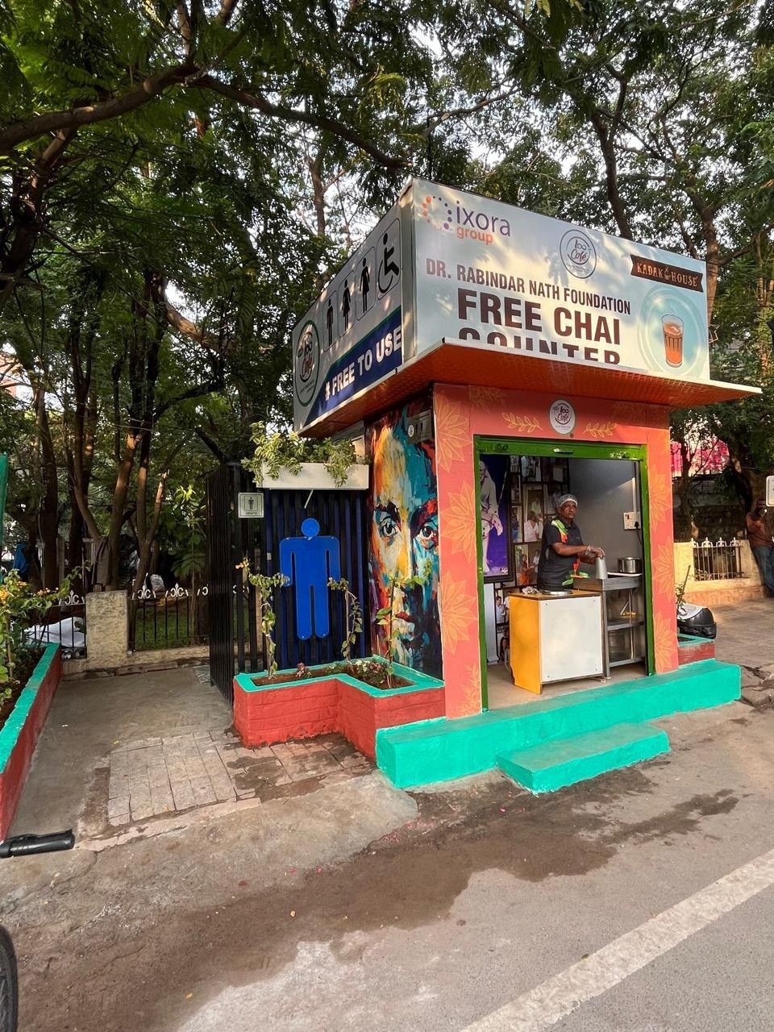
PHOTO APPENDIX
Mini: the front
Original LooCafe Mini photo
23
Notes:
Optional photograph for discussion. Original LooCafe Mini photo. Use its original site context; this is not evidence that every LooCafe shares these fixtures.
Source: Original LooCafe Mini photo
Optional appendix

Slide 24
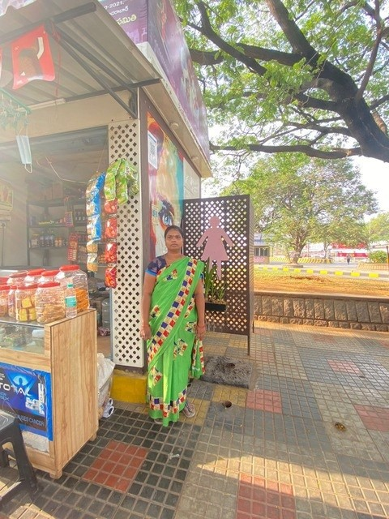
PHOTO APPENDIX
Mini: the street edge
Toilet Tales p.39
24
Notes:
Optional photograph for discussion. Toilet Tales p.39. Use its original site context; this is not evidence that every LooCafe shares these fixtures.
Source: Toilet Tales p.39
Optional appendix

Slide 25
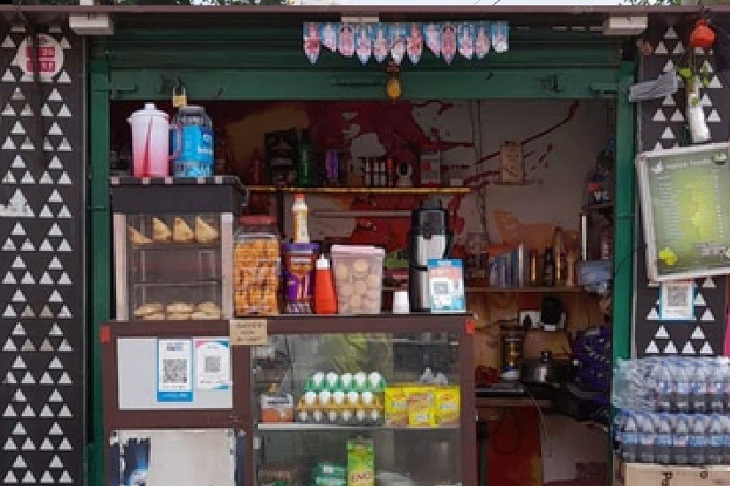
PHOTO APPENDIX
The shop at work
Toilet Tales p.42
25
Notes:
Optional photograph for discussion. Toilet Tales p.42. Use its original site context; this is not evidence that every LooCafe shares these fixtures.
Source: Toilet Tales p.42
Optional appendix

Slide 26
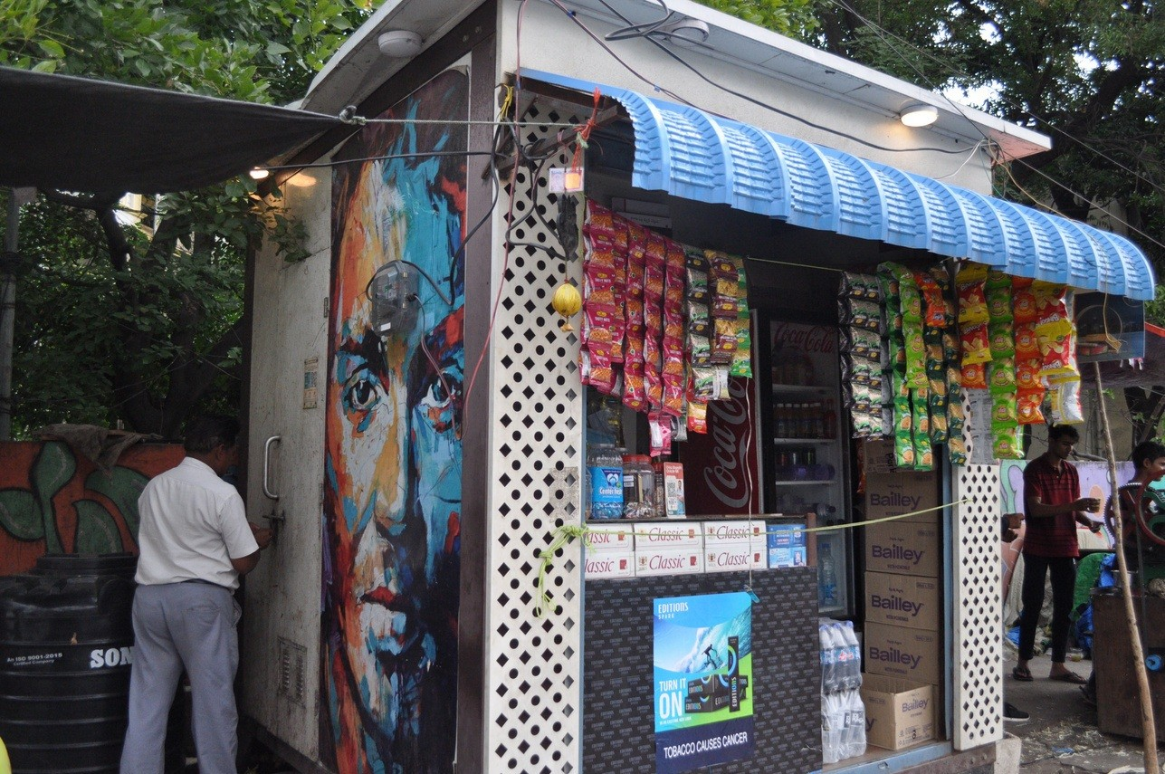
PHOTO APPENDIX
The side entrance
Toilet Tales p.43
26
Notes:
Optional photograph for discussion. Toilet Tales p.43. Use its original site context; this is not evidence that every LooCafe shares these fixtures.
Source: Toilet Tales p.43
Optional appendix

Slide 27
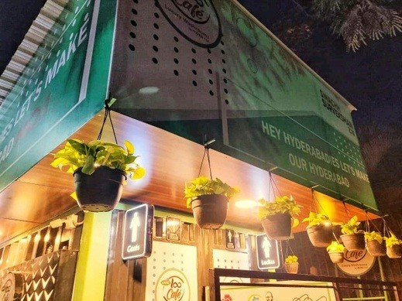
PHOTO APPENDIX
Lighting and planting
Toilet Tales p.3
27
Notes:
Optional photograph for discussion. Toilet Tales p.3. Use its original site context; this is not evidence that every LooCafe shares these fixtures.
Source: Toilet Tales p.3
Optional appendix

Slide 28
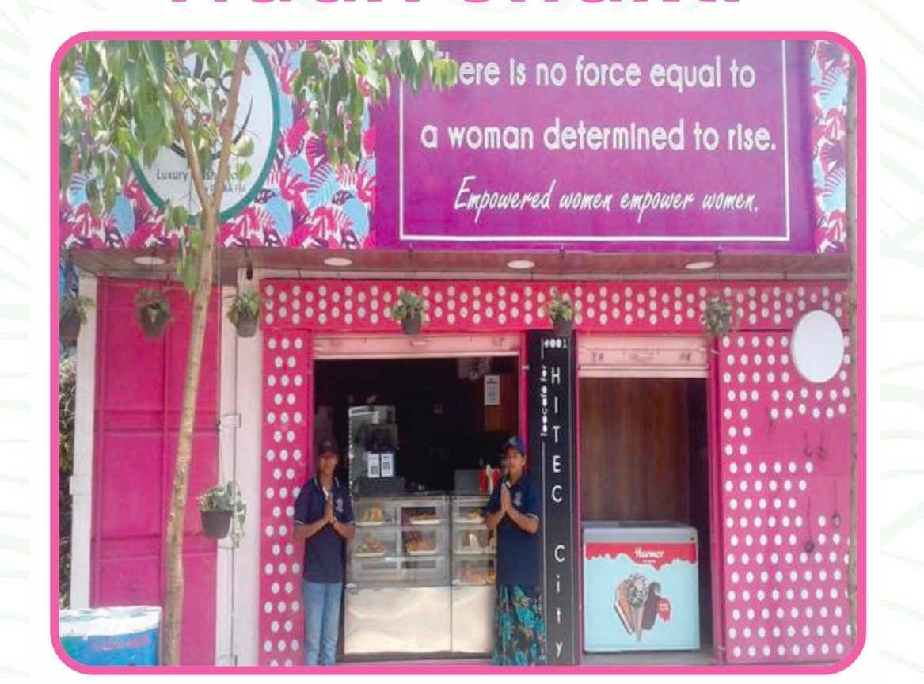
PHOTO APPENDIX
Women’s facility
Toilet Tales p.45
28
Notes:
Optional photograph for discussion. Toilet Tales p.45. Use its original site context; this is not evidence that every LooCafe shares these fixtures.
Source: Toilet Tales p.45
Optional appendix

Slide 29
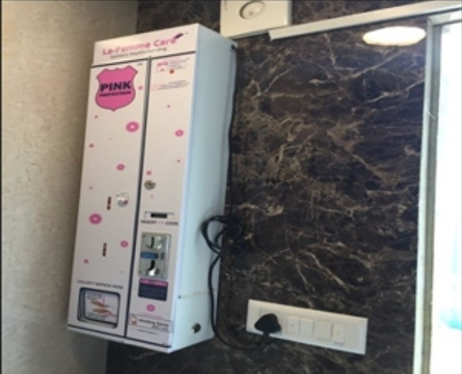
PHOTO APPENDIX
The hygiene details
Toilet Tales p.13
29
Notes:
Optional photograph for discussion. Toilet Tales p.13. Use its original site context; this is not evidence that every LooCafe shares these fixtures.
Source: Toilet Tales p.13
Optional appendix

Slide 30
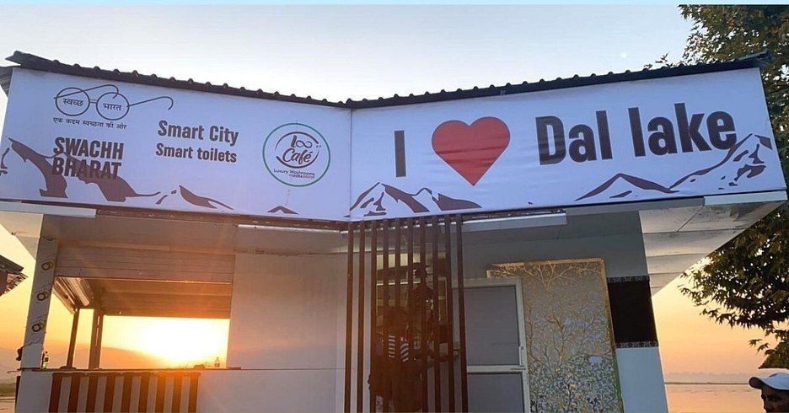
PHOTO APPENDIX
Dal Lake at sunset
Toilet Tales p.47
30
Notes:
Optional photograph for discussion. Toilet Tales p.47. Use its original site context; this is not evidence that every LooCafe shares these fixtures.
Source: Toilet Tales p.47
Optional appendix

Slide 31
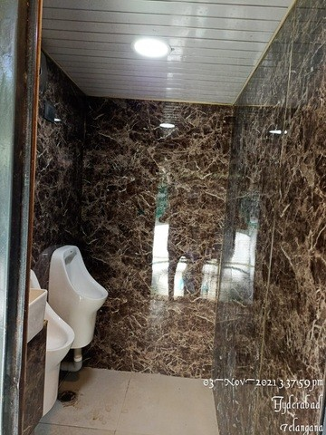
PHOTO APPENDIX
Another interior angle
Toilet Tales p.47
31
Notes:
Optional photograph for discussion. Toilet Tales p.47. Use its original site context; this is not evidence that every LooCafe shares these fixtures.
Source: Toilet Tales p.47
Optional appendix

Slide 32
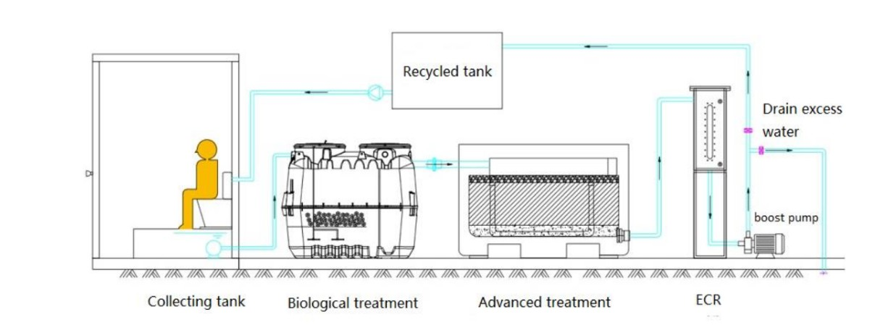
TECHNICAL APPENDIX
The documented treatment sequence
Eco-san b-CRT O&M manual, Aug 2024, 40-foot configuration; PDF pp. 5, 9–12. See technical-brief.md for source path.
32
Notes:
The sequence shown comes from the supplied technical documents. Exact equipment and capacities depend on the installed configuration. The 20-foot training bill of materials and the 40-foot O&M manual should not be combined into a single unverified design.
Source: Eco-san b-CRT O&M manual, Aug 2024, 40-foot configuration; PDF pp. 5, 9–12. See technical-brief.md for source path.
Optional appendix

Slide 33
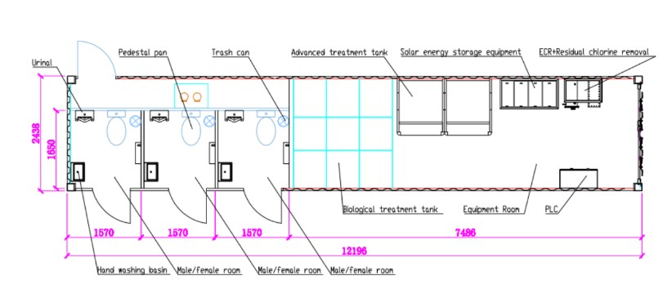
TECHNICAL APPENDIX
Design rating and observed use
Eco-san O&M manual, PDF p. 6; user operating account dated 6 Sep 2026. Ratings are not verified performance of the July photographed installation.
33
Notes:
These are the ratings in the August 2024 40-foot manual. Our reported site use is a different measure. To reconcile them, we need the installed model, actual flush counts and metered volumes. We should not turn users into flushes or quote one model's rating for another.
Source: Eco-san O&M manual, PDF p. 6; user operating account dated 6 Sep 2026. Ratings are not verified performance of the July photographed installation.
Optional appendix

Slide 34
TECHNICAL APPENDIX
What proves performance?
ISO 30500:2025, https://www.iso.org/standard/87343.html . Supplied historical documentation refers to earlier versions. No ReFlow certificate verified.
34
Notes:
For any site, the evidence should identify the unit, sampling dates, intended reuse and operating conditions. ISO 30500 concerns the design and performance testing of non-sewered sanitation systems. A reference to that standard is different from evidence that this particular product has certification.
Source: ISO 30500:2025, https://www.iso.org/standard/87343.html . Supplied historical documentation refers to earlier versions. No ReFlow certificate verified.
Optional appendix

Slide 35
TECHNICAL APPENDIX
Who pays for the service?
Toilet Tales, p. 48; people-and-scale.md. No confidential workshop cost assumptions used.
35
Notes:
The commercial model has to cover cleaning, staffing, utilities, treatment consumables, repairs, supervision and residuals handling. Gross shop sales are not sanitation funding. The contribution and obligations need to be set out in the site agreement, including whatever public support is required.
Source: Toilet Tales, p. 48; people-and-scale.md. No confidential workshop cost assumptions used.
Optional appendix

Slide 36
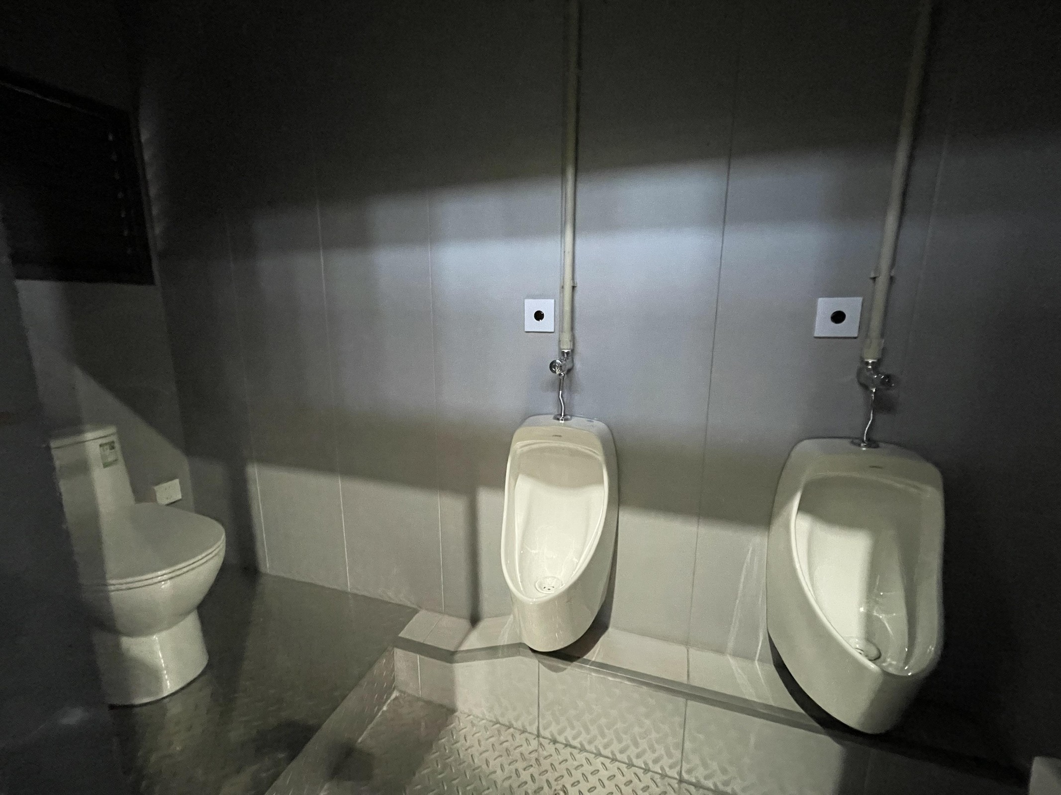
TECHNICAL APPENDIX
Engineering for local use
LooCafe / Ixora, Yixing Eco-Sanitary Comprehensive Requirements Document, PDF pp1–3, in Letters G2RT/Reccomendations full - by LooCafe, Ixora Corporate Ser
36
Notes:
The engineering is also in the everyday use. Our requirements document asks for waterless urinals, a separate fresh-water supply for health faucets, separate counts for WC and urinal use, and better access around the equipment. Those choices affect loading, water demand and maintainability. They are documented requirements; we need the installed drawings to identify which revisions are in this unit.
Source: LooCafe / Ixora, Yixing Eco-Sanitary Comprehensive Requirements Document, PDF pp1–3, in Letters G2RT/Reccomendations full - by LooCafe, Ixora Corporate Services Pvt. Ltd..pdf. Requirements, not completion evidence. Photo: July 2026 project visit.
Optional appendix

Slide 37
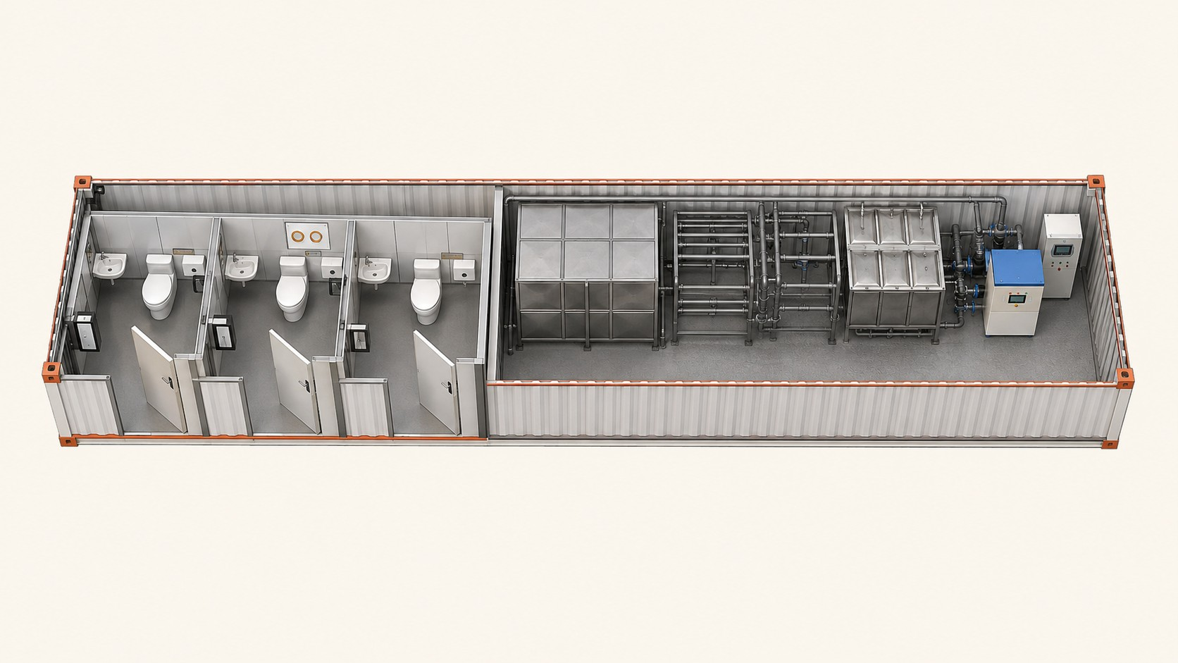
TECHNICAL APPENDIX
Reading the BCRT layout
Original OEM CAD floor plan: L12196 × W2438 mm. Generated interpretation referenced to that drawing and a real equipment-room photo. Detailed piping and ex
37
Notes:
This illustration follows the three-compartment drawing beside it. It helps us discuss the split between the sanitary rooms and the treatment/service bay. It is not an as-built model of Lumbini Park, and it is a different configuration from the seven-cubicle manual. Use the original drawing for dimensions.
Source: Original OEM CAD floor plan: L12196 × W2438 mm. Generated interpretation referenced to that drawing and a real equipment-room photo. Detailed piping and exact as-built geometry are not established.
Optional appendix

